Slide 1
An Extended Flight Level Dataset
Jonathan L. Vigh and Hugh E. Willoughby and Frank D. Marks and Mark DeMaria and Wayne H. Schubert
Colorado State University, Florida International University, AOML Hurricane Research Division, NOAA-RAMMB, CSU
9:00 AM Tuesday August 26, 2008
Joint Informal NCAR-MMM/CSU/CIRA Hurricane Symposium
NASA/TCSP Grant NNG06GA54G and
NSF Grant ATM-0332197

Slide 2
What in the world was I thinking?
Primary Eye formation
  Causes of the central subsidence
  Development of warm core
    Two-cell secondary circulation develops
    Role of inertial stability (Sawyer-Eliassen and geopotential tendency equations)
    Role of baroclinity/eyewall slope
  Convective morphology (microwave/aircraft/radar)
    The curled ball stage
    Strong primary band
    Low-level convective ring (37 GHz) – first hallmark of 2-cell structure
    Deep convection wraps around, mature eye development stage
  Organization of eyewall region
    Boundary layer forcing (Eliassen and Lystad, 1977)
    Frontogenesis and the ”wall of inertial stability” – low level tangential jet
    Hot towers, prototypical eyes, destructive internal dynamics, role of moisture
    Air-sea interaction
  WRF Modeling
    Sensitivity study
    Initialization challenges
    Trajectory budget analyses
    Analytic diagnosis of subsidence in model
    Real-time case studies

Slide 3
Summary of Work with Geopotential Tendency Equation
Inertial stability plays a crucial role in determining the storm’s response to latent heating.
  Heating in the region of high inertial stability strongly localizes the warming response resulting in rapid development of the warm core.
  Heating outside the RMW has almost no effect, no matter how small the Rossby radius becomes in the core.
Development of the warm core acts as a brake on further intensification.
  Diabatic heating is locked out of the region of high inertial stability.
  m-surfaces slope outward and PV and heating become “locked” together, shutting down PV production in the eyewall.

Slide 4
But what about real storms?
Real storms aren’t barotropic
Real storms often have sloping eyewalls
Real storms don’t have a Dirac delta function of heating
Real storms don’t always have sharply-peaked profiles of tangential wind
What IS the distribution of inertial stability in the storm?

Slide 5
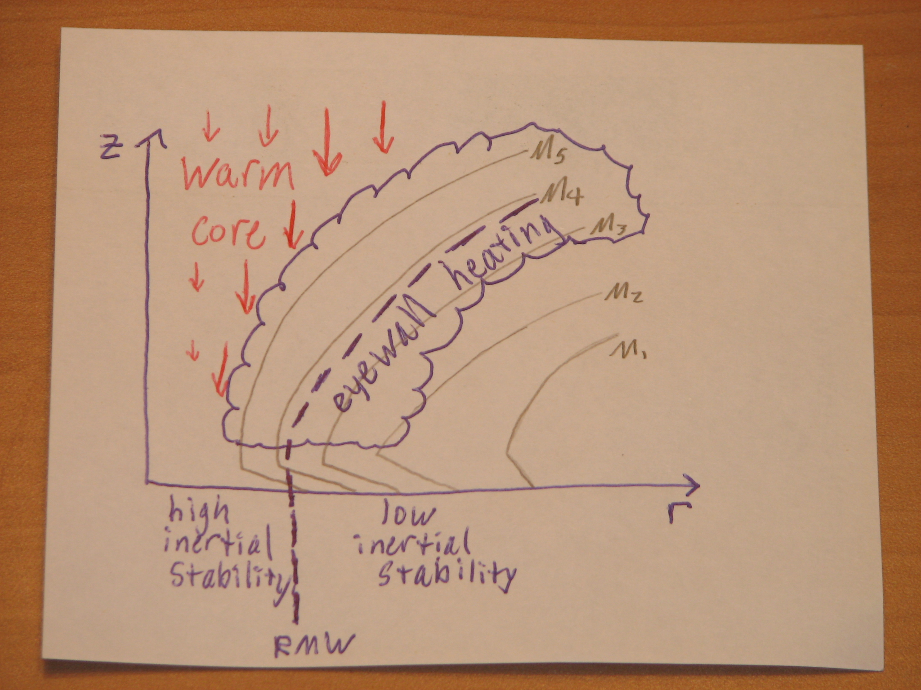

Slide 6
Observational component
Goal: calculate inertial stability and temperature tendencies, relate to warm core development
Willoughby-Rahn flight level dataset (1977-2001)
My research focus is on more recent storms
  Microwave satellite data
  GPS dropwindsondes
  CIRA GOES IR satellite archive
  SFMR
  QuikSCAT

Slide 7
Famous last words: “All I want are some radial profiles of tangential wind and temperature . . .”
Data issues
  HRD raw flight level data come in variety of formats
    Several USAFR ASCII formats (mostly 10-sec, some 1-sec)
    Older data at 1-minute time resolution on HRD web site – have to ask to get higher time resolution
    standard tape format (binary)
    NOAA ASCII listings (1-sec and 10-sec)
    Newer NOAA data in netCDF format with its own share of problems (no vetting of variables, variables change names from year to year and file to file)
  Raw flight level data are in earth-relative coordinates (Lat/Lon)
    NOT translated to moving storm center
    Winds not decomposed into tangential and radial components
  No separation of “useful” flight legs from all the other stuff

Slide 8
Features of the Willoughby-Rahn dataset
Raw flight level data used to calculate dynamic center of storm – a track is produced and fit to these center using Ooyama’s beta splines
  Willoughby, H.E., and M. B. Chelmow, 1982, "Objective determination of hurricane tracks from aircraft observations", Mon. Wea. Rev., 110, p.1298-1305.
Winds are translated to the moving storm center, decomposed into radial and tangential components

Slide 9
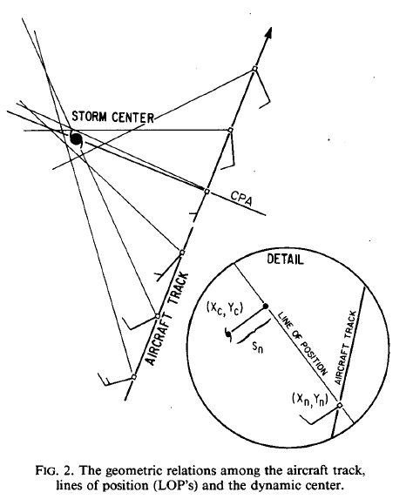
Willoughby and Chelmow
1982

Slide 10
The flight level data were parsed by hand into the “good” radial legs - other portions of flight discarded
Data are put into 300 overlapping radial bins using a linear distance weighting (Bartlett window). Weighting decreases linearly from 1.0 at the nominal bin radius to 0.0 at plus or minus the half bin width (DR).
Typical half bin width of 1.0 km with bins 0.5 km apart, so each data point is represented in 4 bins. Typical profiles go out to 150 km.
Legacy format is “ASCII ProFile” with accompanying metadata listed in a variety of other little ASCII files which serve as indices for navigating the data by flight and leg.

Slide 11
Epiphany
While these issues are not intractable, they present a high barrier to anyone who’d like to use the flight level data
To use a substantial amount of flight level data would require mastering the various not-so-nice raw data formats – not trivial
Getting data for many storms (for compositing, data assimilation studies, or research on wind profiles) requires an overwhelming data request to HRD – something they haven’t had the man-power for in the past
Wind center finding too technical for the casual data user
Future users could be spared this major chore – hopefully spur much more usage of the flight level dataset
Solution – an (overly?) ambitious graduate student with a pressing need and a hankering for large coding projects + one gigantic Cloud Physics class project

Slide 12

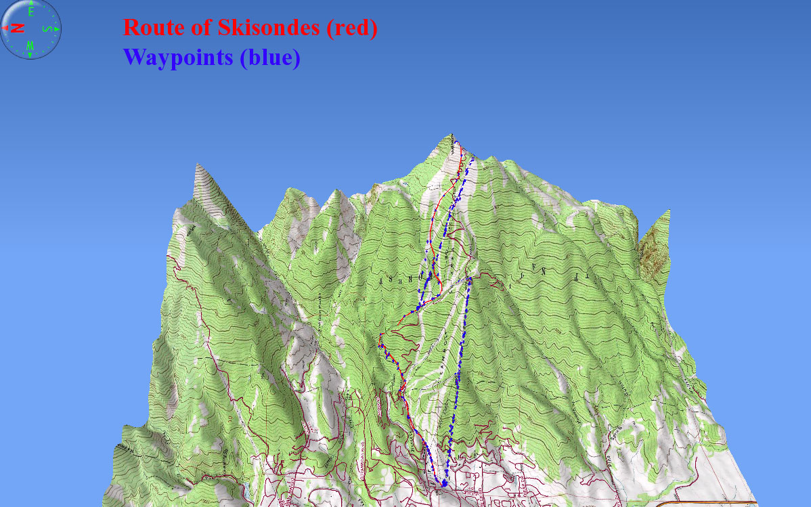
Skisondes!

Slide 13
Birth of a “side” project
Extend the dataset to 2002-current storms
Challenge – design an automated algorithm to parse the radial profiles so that is no longer has to be done by hand
Initially preserve the methodology and functionality of the Willoughby-Rahn dataset (including the legacy output format – uggh!)
Eventually reprocess all storms (1977-current) with consistent methodology and improved output format
This will be version 1.1

Slide 14
Modern code and improved output format
Coding accomplished with NCAR Command Language (NCL)
  Free (eventually open source?)
  Improved, standardized time coordinate
  Data processing and visualization tasks unified
  Codes to read, manipulate, and plot dataset can be provided to dataset users
Extended dataset will be in netCDF output format
  Readable by Matlab, IDL, NCL, etc.
  All metadata included in same file (no need for separate ASCII index files)
  Flexible data structure – no rigid file formats

Slide 15
More incremental data processing
Several levels of data processing:
  Level 0 – “native” raw data files (ASCII, non-QC’d netCDF, standard tape format) for each flight
  Level 1 – raw flight level data converted into a common netCDF format for the entire era (individual files by flight, one big file for each storm) – a format useful for data assimilation!
  Level 2 – ALL processed flight level data translated to the moving storm center (netCDF)
  Level 3 – Processed flight level data parsed into “good” radial legs (netCDF)

Slide 16
Enhanced, extended dataset (v2.0)
Improved center-finding method (??)
  Willoughby/Chelmow method is useful, but performance suffers from cases of strong eye convection, eye mesovortices
Improved radial binning method
  Narrower frequency response
More consistent data structure
  Don’t allow variable bin widths
  Do allow radial legs longer than 150 km
  Possibility of including SFMR
Could include aerosonde and other mobile platforms

Slide 17
Speculative Timeline
Initial coding thrust was a very intense 2 ½ week period before AMS hurricane conference in April
Spent several more weeks over summer scoping and planning project, figuring out data issues
Prototype code structure hopefully completed in another 3-4 weeks
Extended dataset for 2002-current available to me whenever HRD gets the data to me
I’ll move onto the science aspects and HRD may hire a student to handle reprocessing of 1977-2001 dataset
Official V1.1 release unknown (next Spring?)
V2.0 sometime in the future

Slide 18
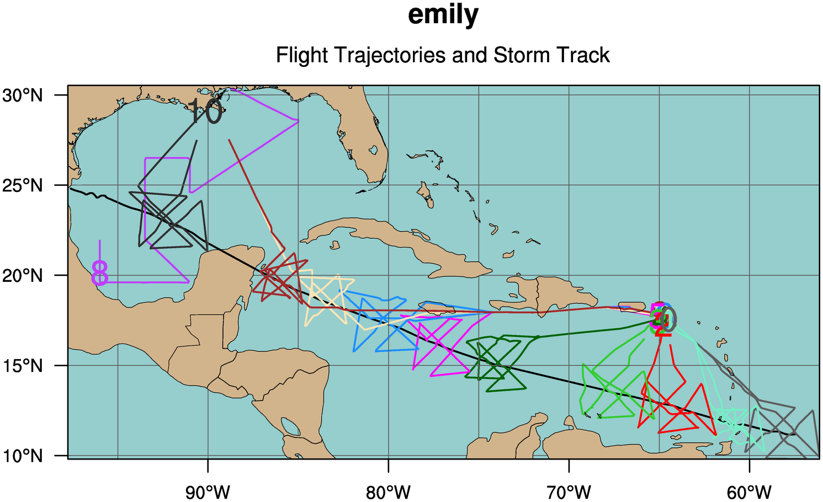

Slide 19
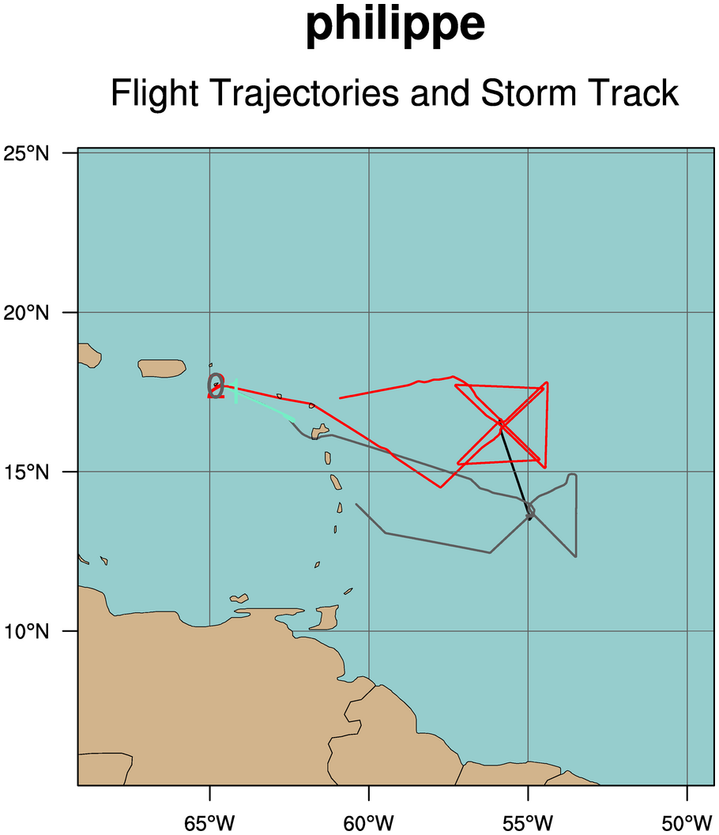

Slide 20
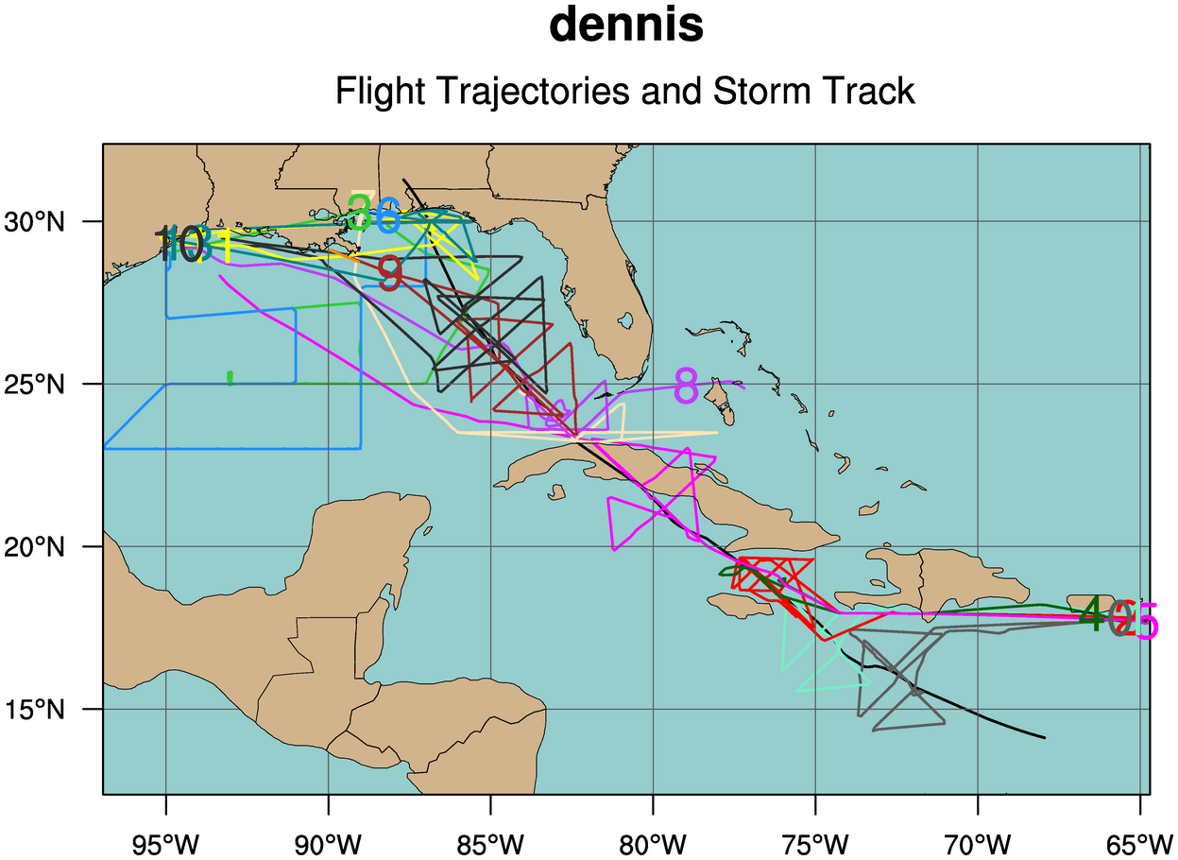

Slide 21
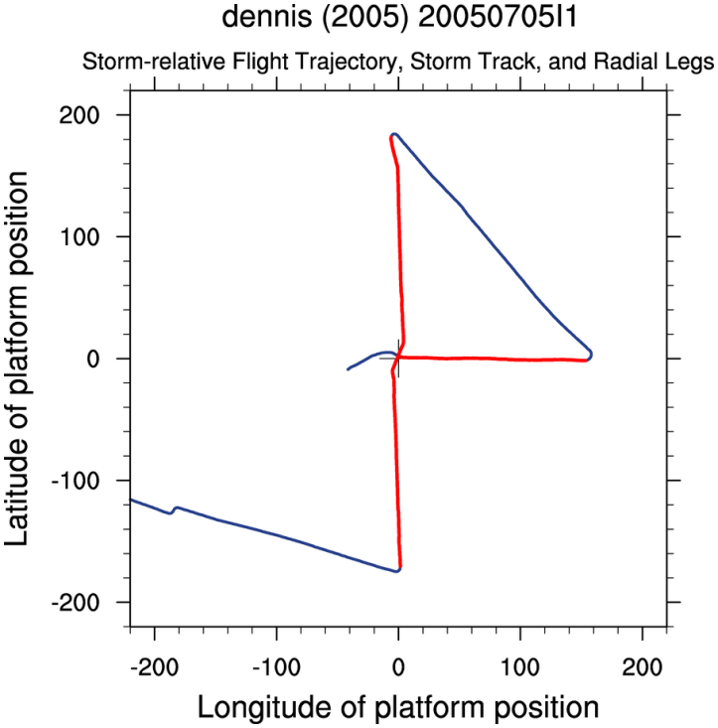
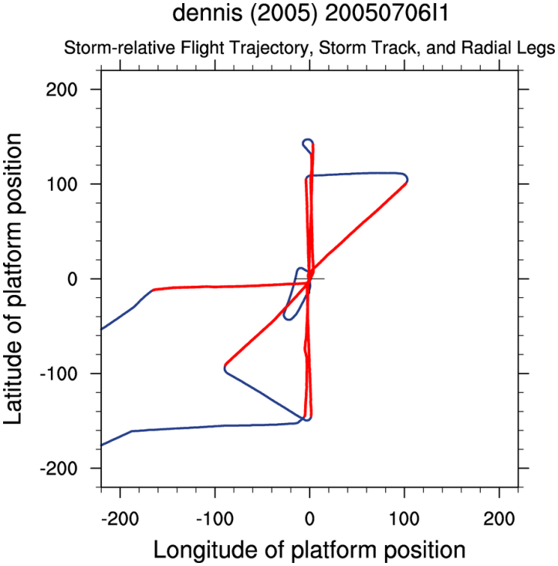
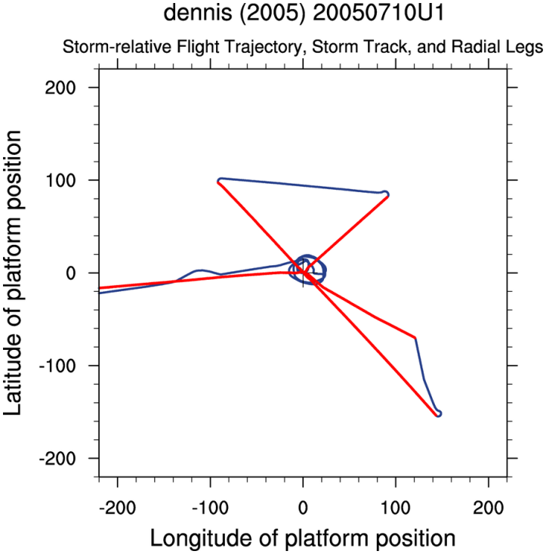
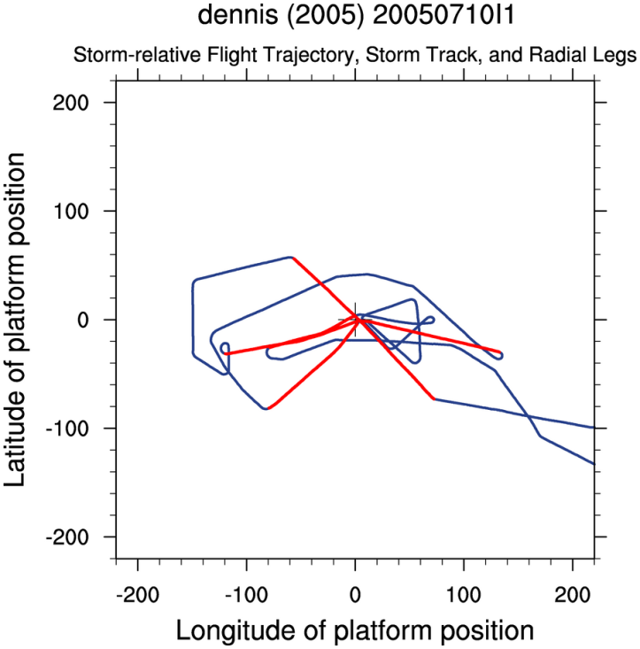
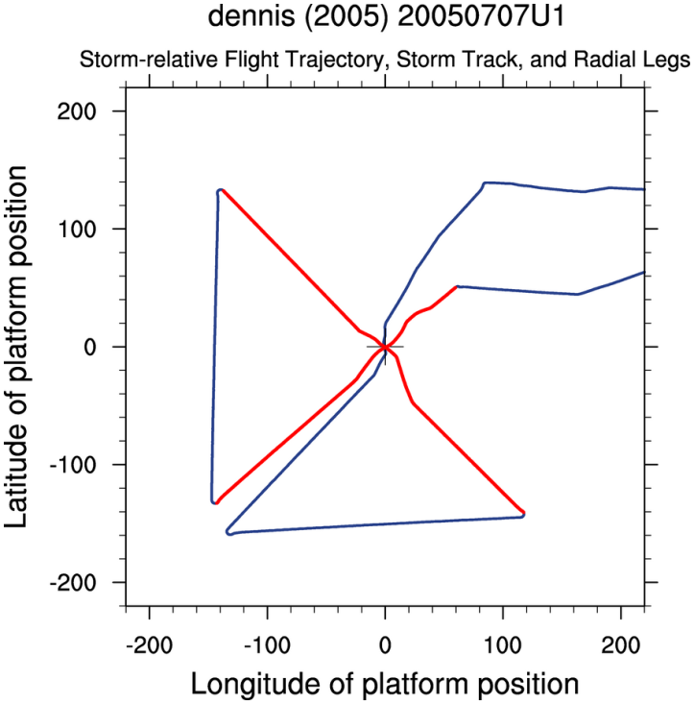
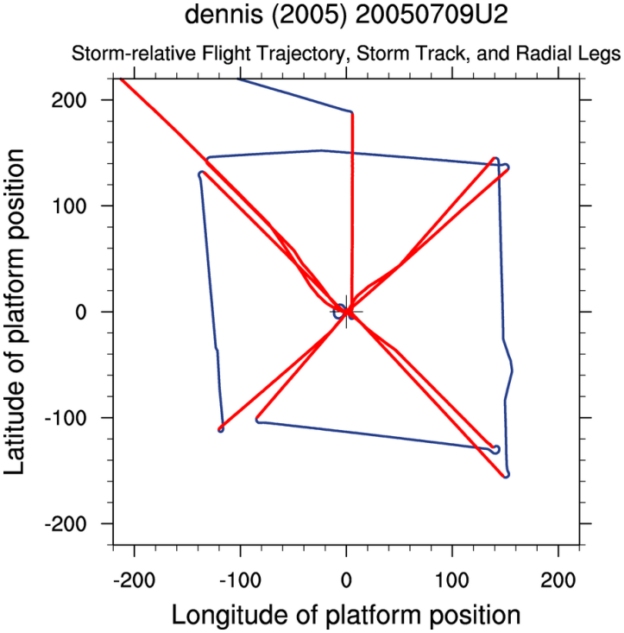

Slide 22
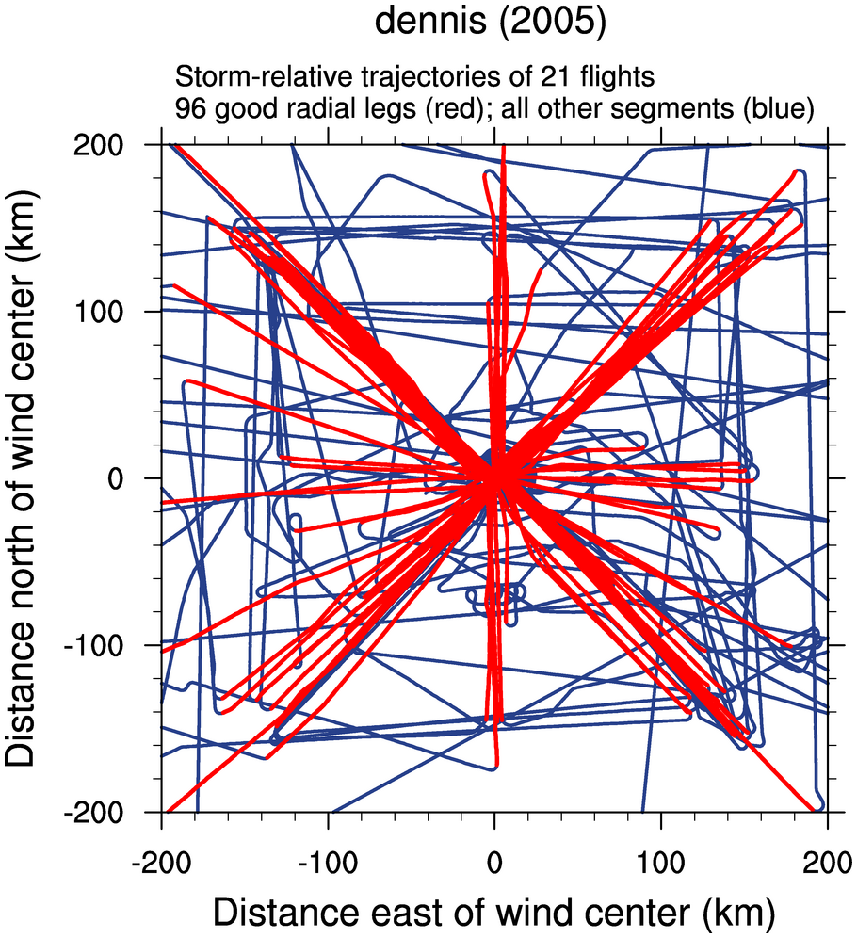

Slide 23
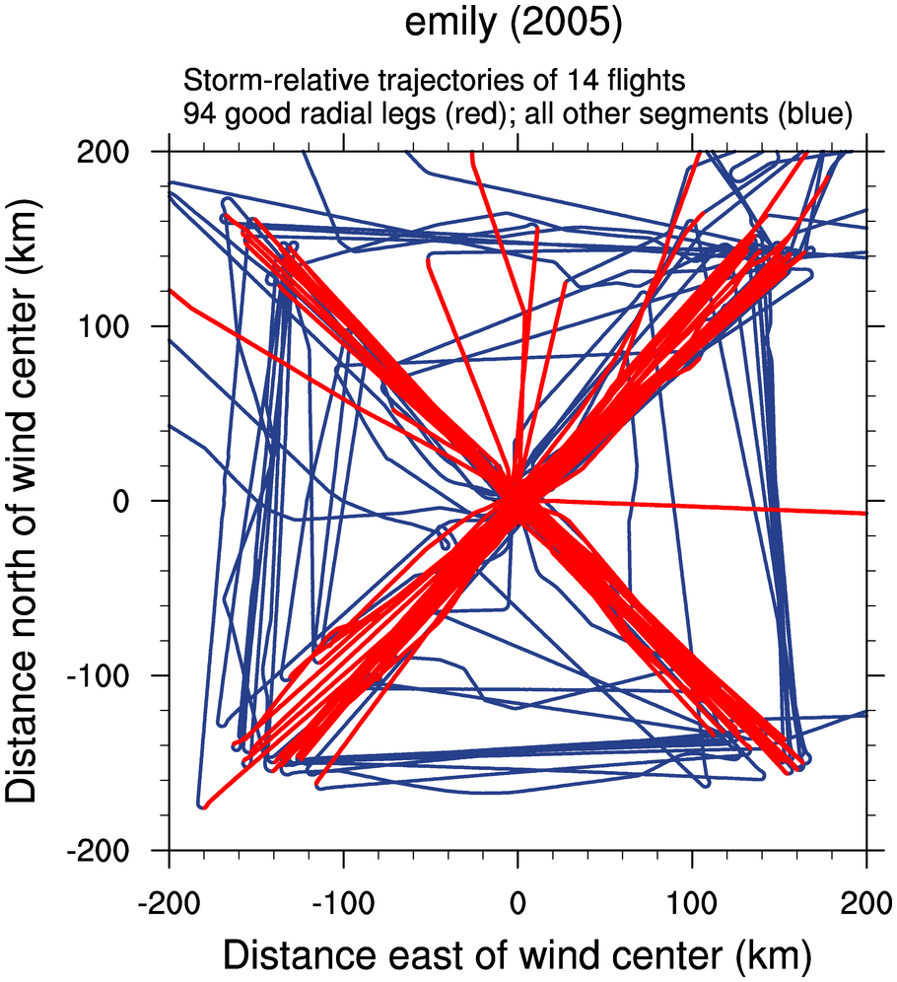

Slide 24
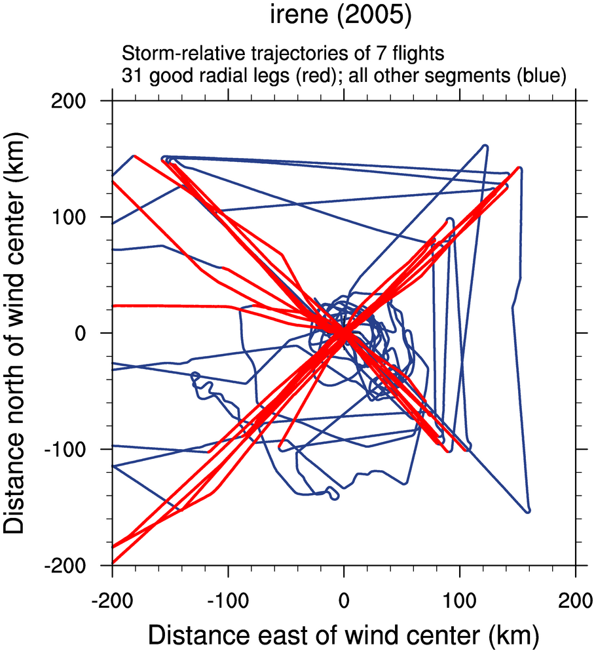

Slide 25
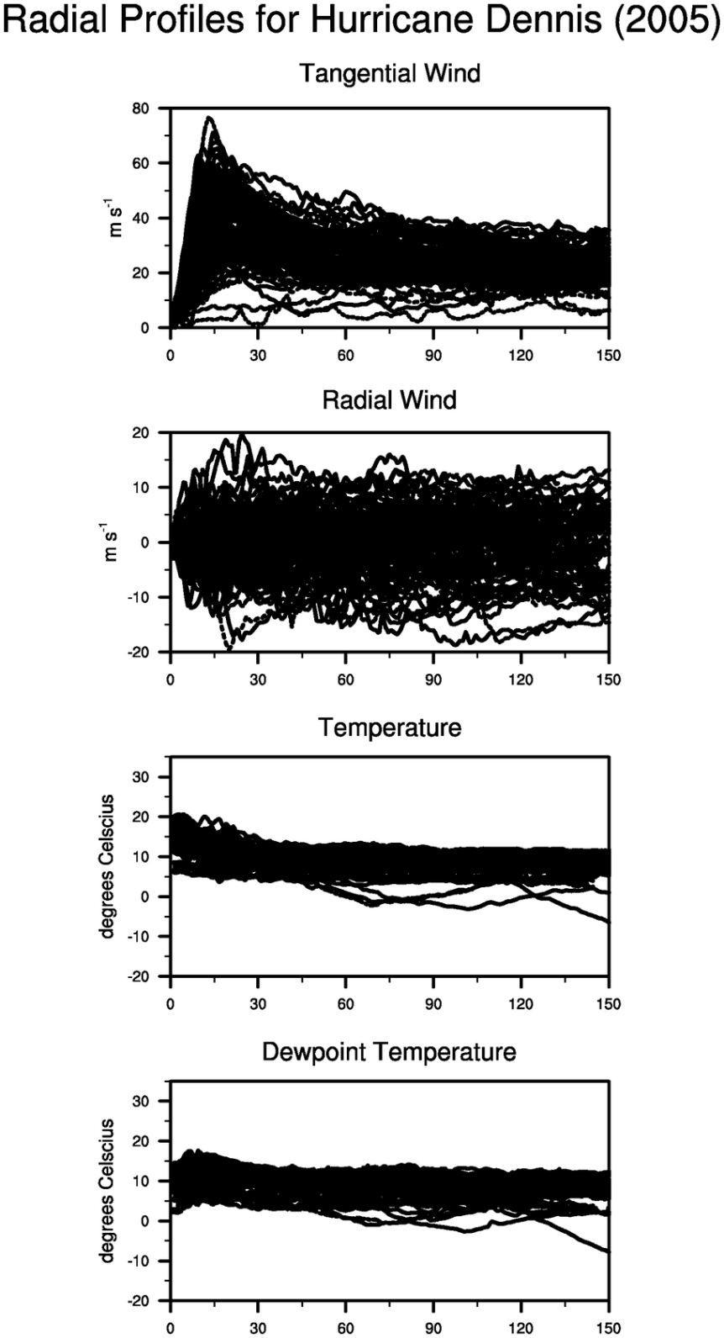

Slide 26
Goals beyond the dataset
It will be up to the user to do additional processing of data.
Write paper with Dr. Willoughby and Dr. Marks on eye formation
Calculate derived quantities
  Vorticity
  Inertial stability
  Baroclinity
  Tendencies of tangential and radial winds
  Tendencies of temperature, dew point temperature
  ??
Real-time visualization of storm-relative flight level data onboard the NOAA aircraft

Slide 27
Comments/Feedback
Ideas on better center-finding?
Special needs for radial binning method?
Other data formats?
Suitability for data assimilation?
Any other concerns or feedback?

Slide 28
The End
Stop here or you’ll be sorry . . .

Slide 29
Goals
Isolate conditions under which a warm-core thermal structure can rapidly develop.
Understand role of warm core in stabilizing the storm.
Sawyer-Eliassen transverse circulation and associated geopotential tendency equation
2nd order PDE’s containing the diabatic forcing and three spatially varying coefficients:
  Static stability, A
  Baroclinicity, B
  Inertial Stability, C
The large radial variations in inertial stability are typically most important.

Slide 30
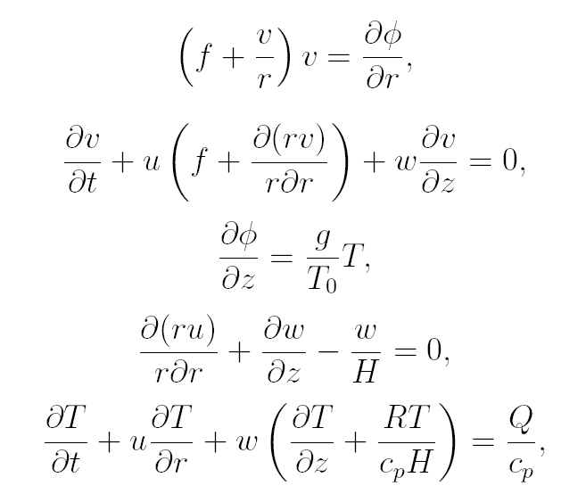
Balanced Vortex Model
Inviscid, axisymmetric, quasi-static, gradient-balanced motions of a stratified,
compressible atmosphere on an f-plane.
Log pressure vertical coordinate: z = H log (p₀ /p) Scale height: H = RT₀ /g ~ 8.79 km
Gradient wind balance
Tangential momentum
Hydrostatic balance
Continuity
Thermodynamic

Slide 31
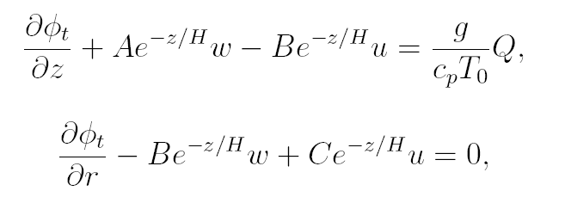
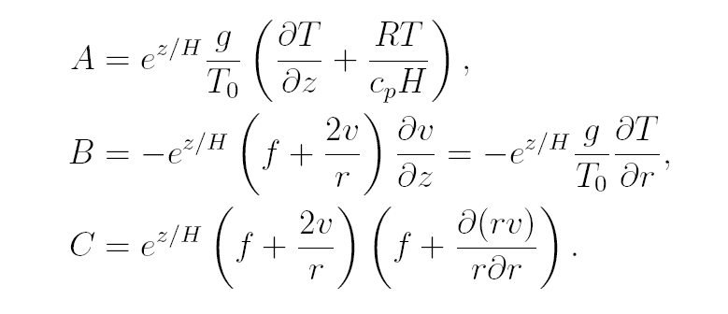



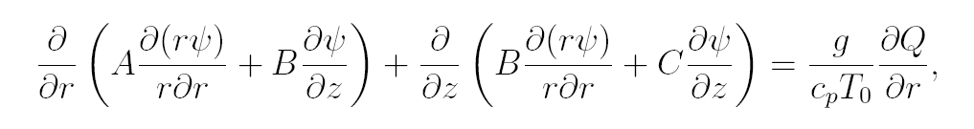
Combine tangential wind equation x (f + 2v/r)
with the thermodynamic equation x (g/T₀),
then make use of hydrostatic and gradient relations:
Eliminate geopotential
Introduce streamfunction:
Boundary conditions:
Ψ= 0 at z = 0
Ψ= 0 at z = z_{t}
Ψ= 0 at r = 0
rΨ= 0 as r→∞
Use mass conservation principle:
Sawyer-Eliassen Transverse Circulation Equation
To ensure an elliptic
equation, only consider
AC – B² > 0

Slide 32
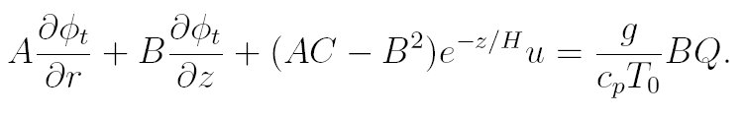
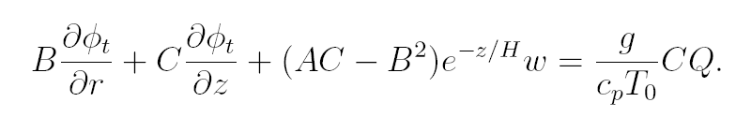
Combine tangential wind equation x (f + 2v/r)
with the thermodynamic equation x (g/T₀),
then make use of hydrostatic and gradient relations:
Boundary conditions:
∂φ_{t}/∂r → 0 at r = 0
∂φ_{t}/∂z → 0 at z = 0
∂φ_{t}/∂z → 0 at z = z_{t}
Φ_{t} → 0 as r → ∞
Eliminate w:
Eliminate u:
Use mass continuity to eliminate u and w:
D = AC – B²
Geopotential Tendency Equation

Slide 33

Simplifications to allow analytic solution
Barotropic vortex (B = 0)
Constant static stability
Piecewise-constant inertial stability:
Separate the vertical and radial structure: ODEs.
Dirac delta function heating.
Key differences from Eliassen’s original treatment:
  We include the spatial variation of inertial stability.
  We use the entire Greens function, not just the principle part.
  The full effects of circular geometry are included.

Slide 34
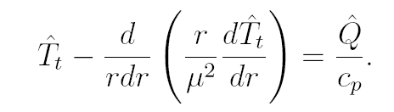

Does local temperature change occur in region of diabatic heating or get spread over larger area?
Solutions have the integral property:
Integrated local temperature change is equal to integrated diabatic heating.
Heating outside RMW (or heating in weak vortex):
small effective Coriolis parameter, large Rossby length (μ⁻¹), small μ.
Curvature term is small so temperature tendency is spread out over a wide area
compared to the area where Q is confined -> entire vortex warms slightly.
Heating inside RMW (or heating in a strong vortex):
large effective Coriolis parameter, small Rossby length, small μ.
Curvature term is large to temperature tendency is confined to a small area
-> local region warms significantly with little warming elsewhere.
Rapid development of warm core ensues.

Slide 35
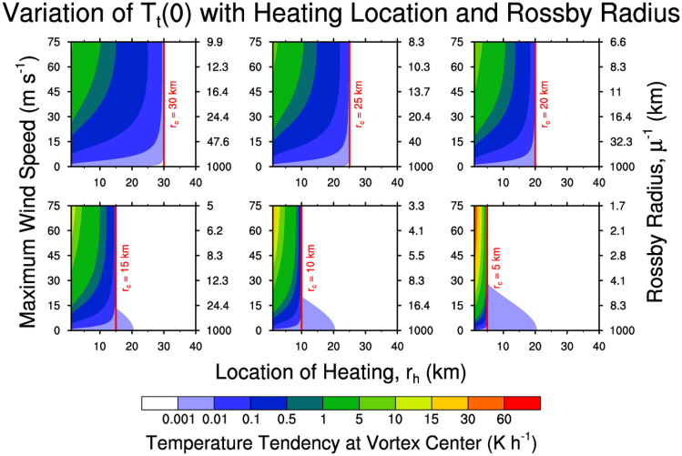
Temperature Tendency at r = 0

Slide 36


The Cyclogensis Function
Geopotential Tendency Equation
The PV Principle
PV definition

Slide 37


Slide 38
Cyclogenesis Function translated:
The forcing for the geopotential tendency is proportional to the product of PV with the θ-derivative of along an absolute angular momentum surface.
As Hausman et al. (2006) show, as a TC approaches the mature state, the PV and heating fields lock together in a thin, leaning hollow tower on the inner eye edge.
-> production of PV is exactly balanced by advection out
-> no net production of PV
Geopotential tendency goes to zero and intensification ceases.

Slide 39
Summary
The inertial stability plays a crucial role in determining the storm’s response to latent heating.
  Heating in the region of high inertial stability strongly localizes the warming response resulting in rapid development of the warm core.
  Heating outside the RMW has almost no effect, no matter how small the Rossby radius becomes in the core.
The development of the warm core acts as a brake on further intensification.
  Diabatic heating is locked out of the region of high inertial stability.
  m-surfaces slope outward and PV and heating become “locked”, shutting down PV production in the eyewall.

Slide 40
But what about real storms?
Real storms aren’t barotropic
Real storms don’t have a Dirac delta function of heating
Real storms don’t always have sharply peaked profiles of tangential wind
What IS the distribution of inertial stability in the storm?

Slide 41
The End
Stop here!
Or you’ll be sorry . . .

Slide 42
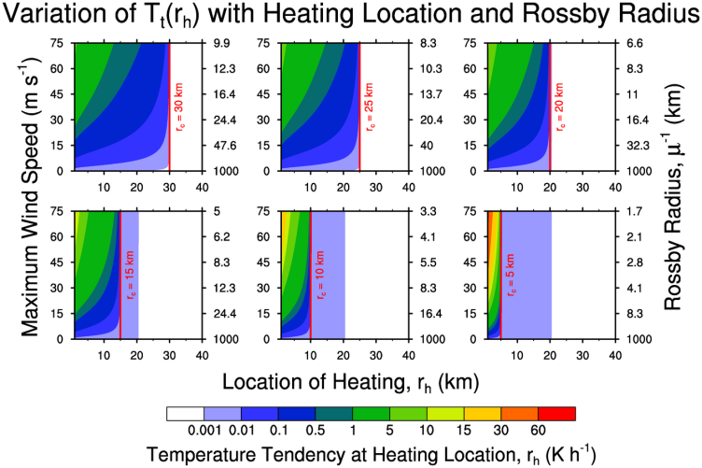
Temperature Tendency at r = r_{h}

Slide 43
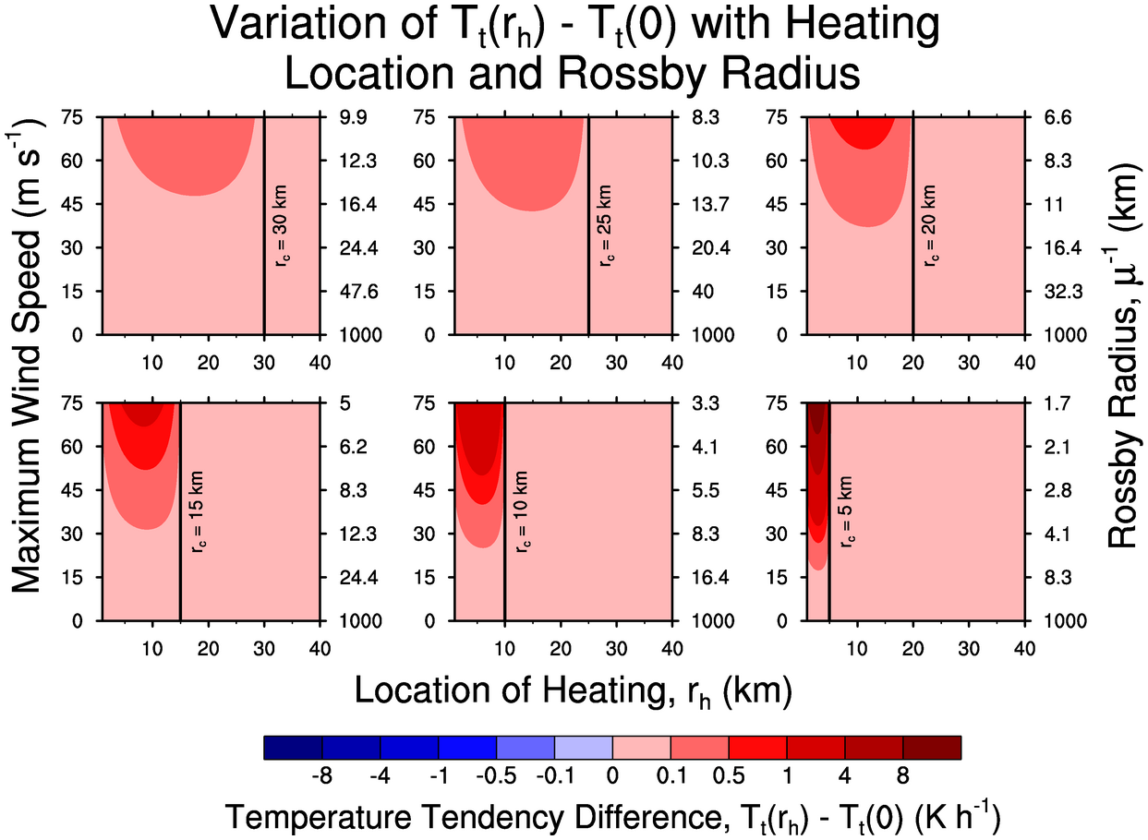
Differences between T_{t} at heating location and the center

Slide 44
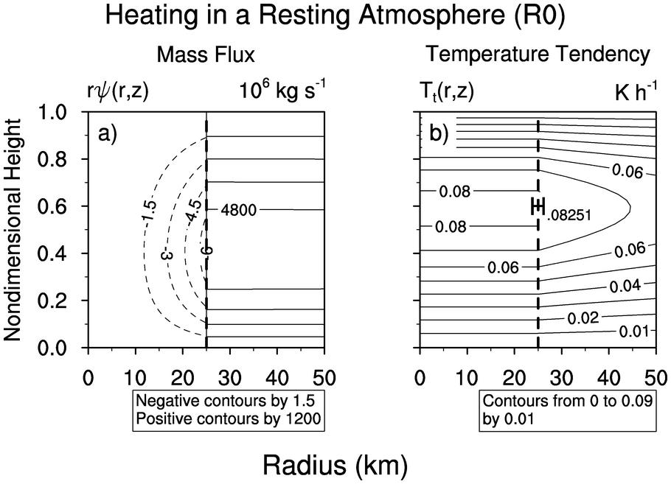

Slide 45
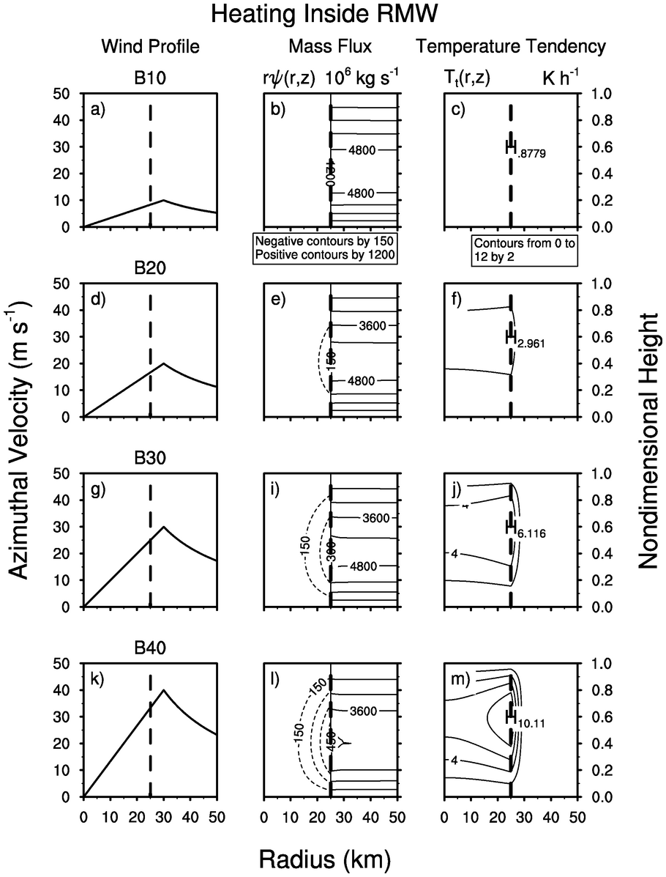

Slide 46
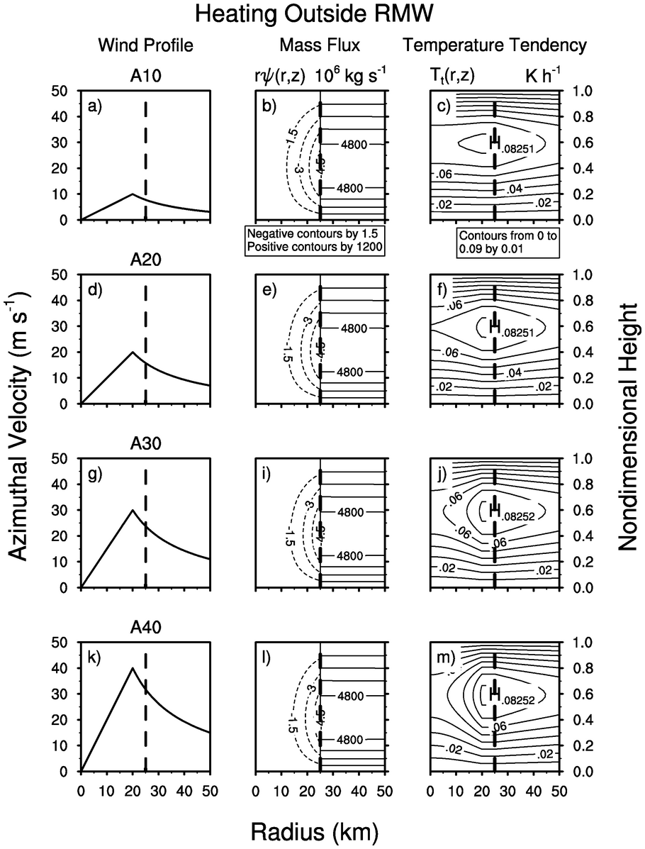

Slide 47
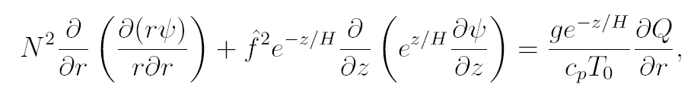
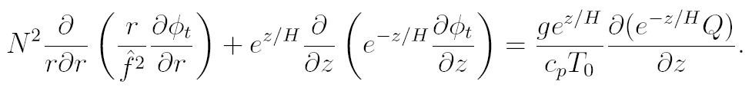
Simplifications to allow analytic solution
Consider a barotropic vortex (B = 0)
Constant static stability,
Piecewise-constant inertial stability:
S-E equation becomes:
Geopotential tendency equation becomes:

Slide 48





Separating vertical and radial structure for S-E equation
Assume diabatic heating and streamfunction have separable forms:
Where
The S-E equation reduces to the ODE:

Slide 49


Separating vertical and radial structure for geopotential tendency equation
Similarly, the temperature and geopotential tendencies have separable forms:
The geopotential tendency equation reduces to the ODE:
These solutions have the integral property:
Integrated local temperature change is equal to integrated diabatic heating.

Slide 50
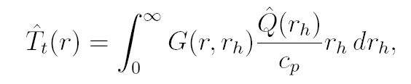

General solution using Green function
has a solution which can be written as
where the Green function G(r,r_{h}) satisfies the differential equation:
(r – r_{h}) denotes the Dirac delta function localized at r = r_{h}
G(r,r_{h}) gives the radial distribution of temperature tendency when the diabatic
heating is confined to a very narrow region at r = r_{h.}
It can be solved analytically only if μ(r) takes some simple form.
We consider two cases:
a) constant μ (resting atmosphere)
b) piecewise constant μ (high inertial stability in core, weak in outer regions)

Slide 51
Major conclusion
When diabatic heating lies inside the radius of maximum wind, the response to the heating becomes very localized
Reduced Rossby Radius and geometry both play a role in focusing the heating
Rapid development of the warm core results
Do observations and/or full physics models support this premise?
Next we plan to use a multigrid solver to compare the analytic results with more realistic vortices (spatially-varying A and nonzero B).

Slide 52
What happens in real storms?
Warm core structure causes baroclinicity to become very large -> frontogenesis
From a PV perspective, the warm core causes Θ surfaces to align with M surfaces
Diabatic PV production matches net advection out
Cyclogenisis function vanishes everywhere -> storm reaches a steady state
Warm core ultimately stabilizes the storm by removing the diabatic heating from the region of high inertial stability and shutting down PV growth in the eyewall

