Slide 1
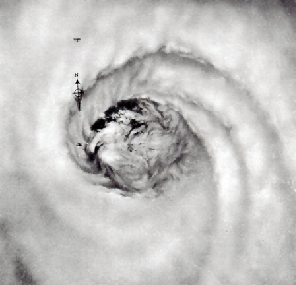
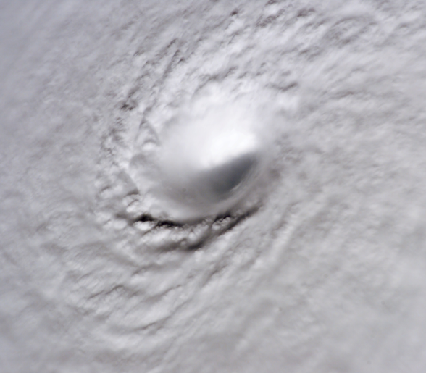
Hurricane Eye Formation
Jonathan Vigh
Colorado State University
PhD Defense Seminar
1:30 PM 29 January 2010

Slide 2
Acknowledgments
Advisor: Dr. Wayne Schubert
PhD Committee:
  Dr. William Cotton
  Dr. Takamitsu Ito
  Dr. Mark DeMaria
  Dr. David Krueger
  Dr. Michael Montgomery (former committee member)
Schubert Research Group
My wonderful officemate Levi Silvers
NCL folks: Mary Haley, David Brown, Dennis Shea
Dr. John Knaff, Dr. Greg Holland, Dr. Christopher Rozoff, Margie Kieper, Dr. Christopher Landsea, Dr. James Kossin, Dr. Eric Hendricks, Dr. Frank Marks, Jr., Dr. Neal Dorst, Dr. John Beven, Dr. Chris Fogarty, Dr. Naomi Surgi
VDM data: Hurricane Hunters, CARCAH and NHC, Mark Zimmer, Jonathan Talbot, Eric Blake, Nicholas Carasco
Family, church, friends, God (Job 38:1)

Slide 3
Outline
Basics of Eye Formation
  Causes of central subsidence
Theory for Rapid Warm Core Development
Observations of Eye Formation
  Vortex Data Message data set
  Intensity trends, structure changes
  Paradox of eye formation
Shortcuts?
Conclusions

Slide 4
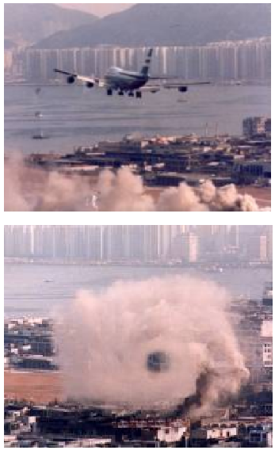
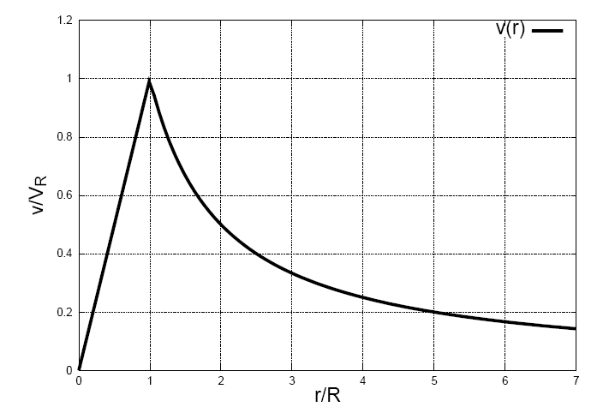
Leonardo da Vinci’s
“Vortex within a vortex”
Inner vortex
Outer vortex
rotational
irrotational
r_{m}
Giaiotti and Stel (2006)

Slide 5
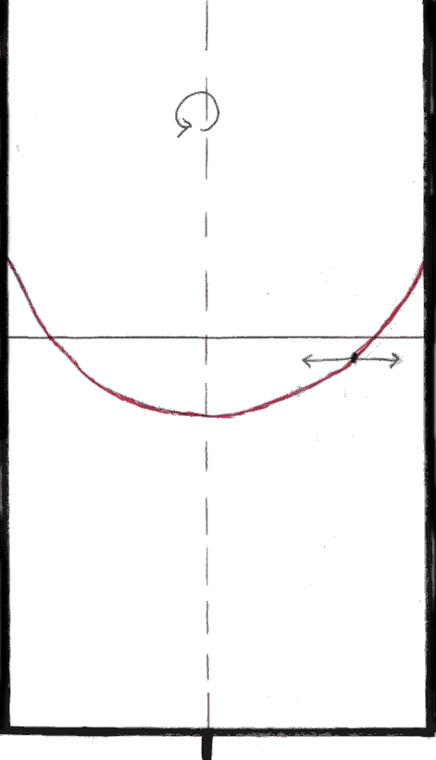
Spin Table Vortex
ω

Slide 6
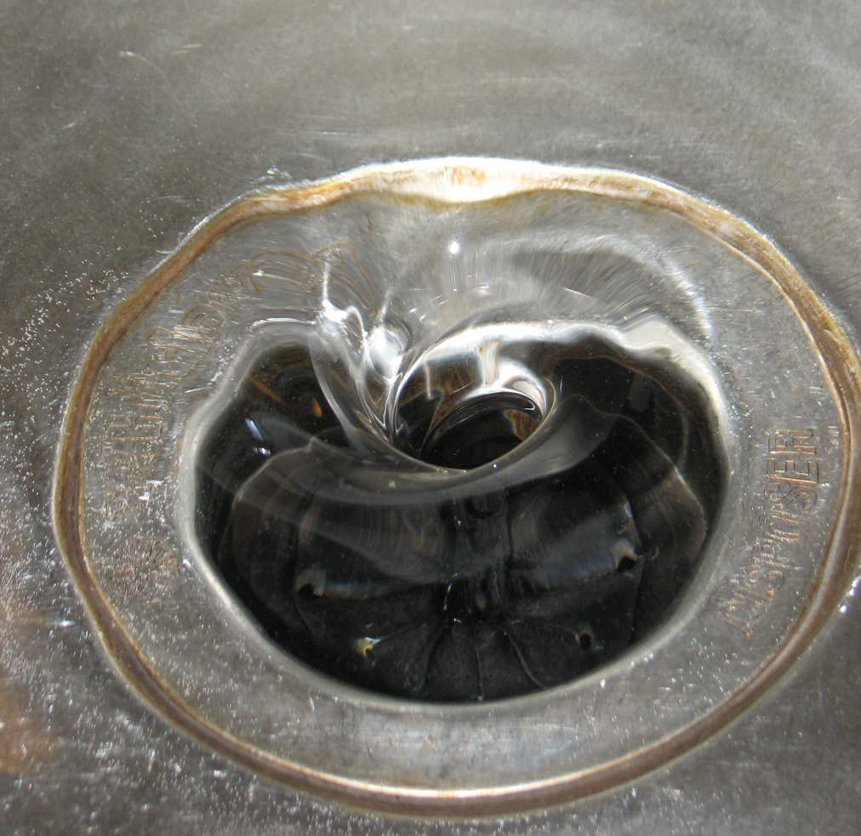
Kitchen sink vortex: upside-down eye?
Mass sink introduces radial
inflow:
but v cannot increase to infinity
even if the central pressure is
a vacuum -> a limiting radius
exists, beyond which the inflow
cannot penetrate

Slide 7
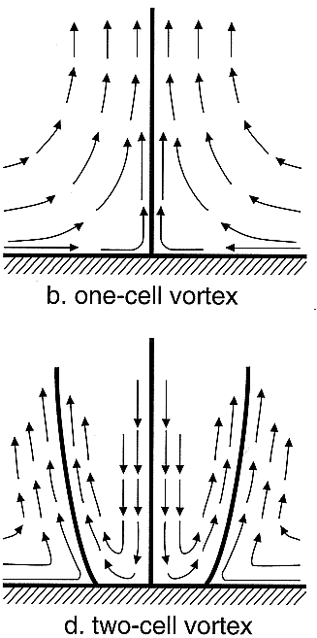
The Essence of Eye Formation
Involves a vertical rearrangement of mass to maintain balance in the vortex
Arises due to conservation of angular momentum and mass continuity and a balance relation
  Limiting radius (Kuo 1959)
Eye formation occurs when the vortex transitions from a one-cell regime to a two-cell regime

Slide 8
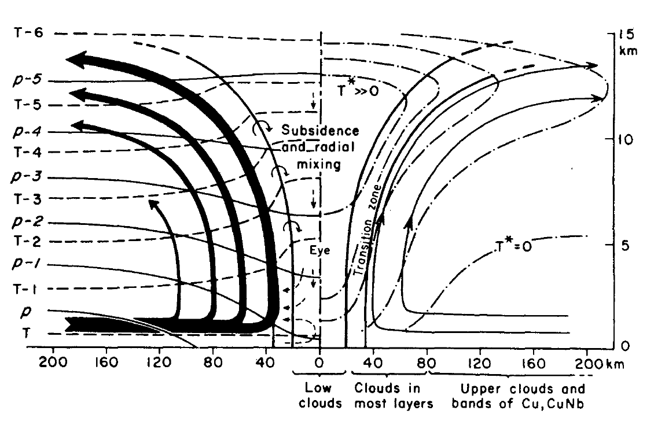
Eye Phenomenon in Hurricanes
Convectively-driven
Boundaries:
  lower (surface)
  upper (tropopause)
  r=0, far-field
Boundary layer:
  turbulence
  friction
  Ekman pumping
  fluxes of sensible and latent heat
Radiation
Environment
Palmen and Newton (1969)

Slide 9
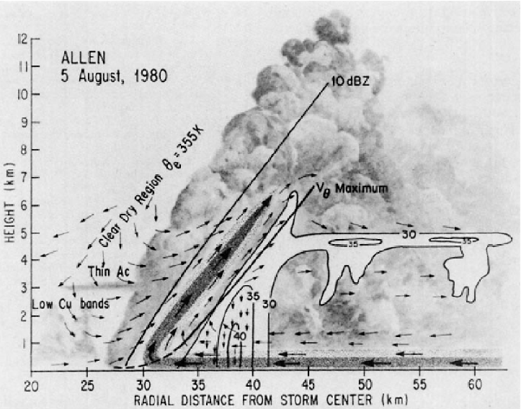
Centrifugal
hypothesis
  Mechanically- driven due to decreased vertical shear in eyewall
  Frontogenetic collapse
  Convectively-forced
Jorgensen 1984b

Slide 10
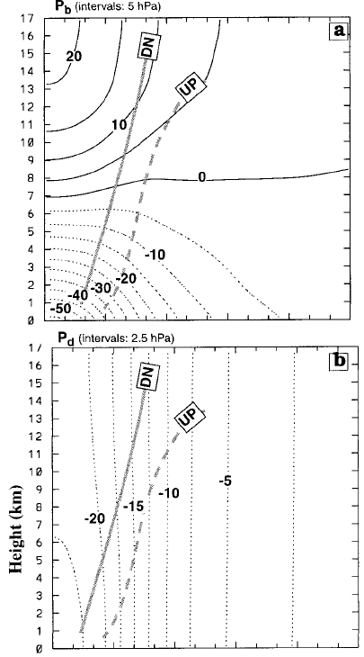
Zhang, Liu, Yau 2000
The answer??????
  Split PGF into a mean and perturbation component
  Split the perturbation part into dynamic part and a buoyant part
  70% of Δp due to buoyancy force (eyewall heating and eye subsidence)
  30% of Δp due to centrifugal effect
  Negative vertical shear caused by subsidence warming, not other way around
  Subsidence due to positive radial shear of tangential wind
    (not vertical shear)
  Eye forms when perturbation PGF causes deep subsidence throughout the center column

Slide 11
Rapid Development of the Warm Core
Isolate conditions under which a warm-core thermal structure can rapidly develop.
Understand role of warm core in stabilizing the storm.
Sawyer-Eliassen transverse circulation and associated geopotential tendency equation
2nd order PDE’s containing the diabatic forcing and three spatially varying coefficients:
  Static stability, A
  Baroclinicity, B
  Inertial Stability, C
The large radial variations in inertial stability are typically most important.

Slide 12
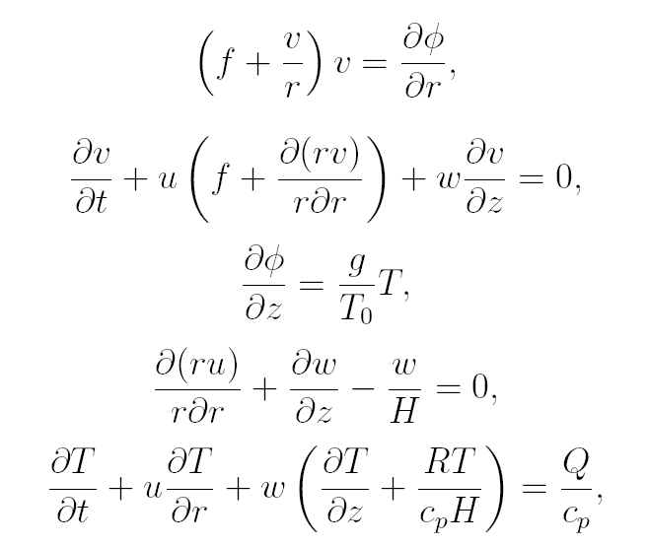
Balanced Vortex Model
Inviscid, axisymmetric, quasi-static, gradient-balanced motions of a stratified,
compressible atmosphere on an f-plane.
Log pressure vertical coordinate: z = H log (p₀ /p) Scale height: H = RT₀ /g ~ 8.79 km
Gradient wind balance
Tangential momentum
Hydrostatic balance
Continuity
Thermodynamic

Slide 13
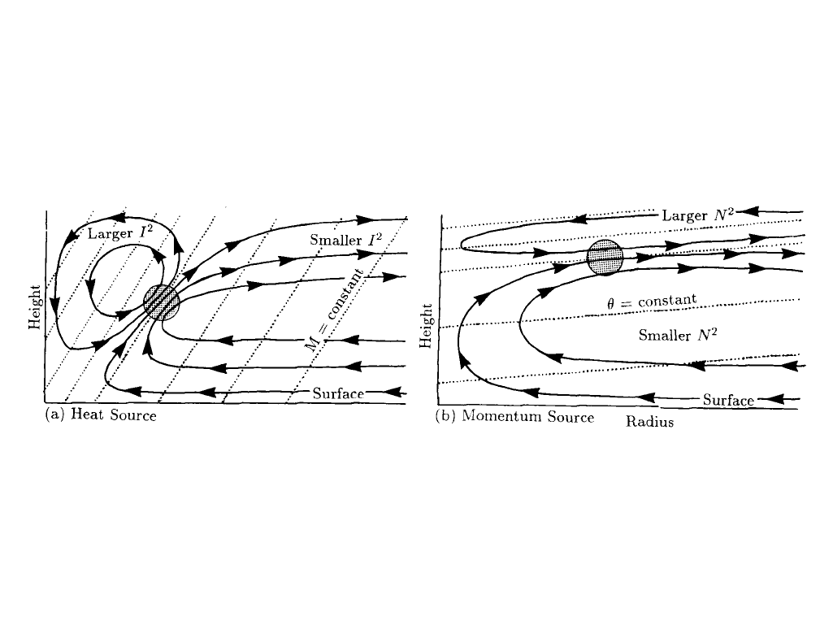
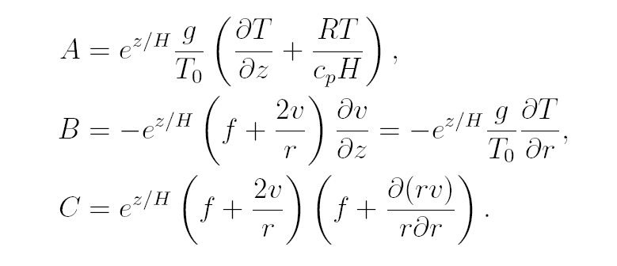
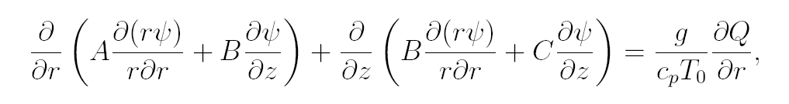
Combine tangential wind equation x (f + 2v/r)
with the thermodynamic equation x (g/T₀),
then make use of hydrostatic and gradient relations:
Eliminate geopotential
Introduce streamfunction:
Boundary conditions:
Ψ= 0 at z = 0
Ψ= 0 at z = z_{t}
Ψ= 0 at r = 0
rΨ= 0 as r→∞
Use mass conservation principle:
Sawyer-Eliassen Transverse Circulation Equation
To ensure an elliptic
equation, only consider
AC – B² > 0
Use mass continuity to eliminate u and w:
Geopotential Tendency Equation

Slide 14

Simplifications to allow analytic solution
Barotropic vortex (B = 0)
Constant static stability
Piecewise-constant inertial stability:
Separate the vertical and radial structure: ODEs.
Dirac delta function heating.
Key differences from Eliassen’s original treatment:
  We include the spatial variation of inertial stability
  We use Bessel functions to solve the radial ODEs, not Greens function
  The full effects of circular geometry are included!

Slide 15
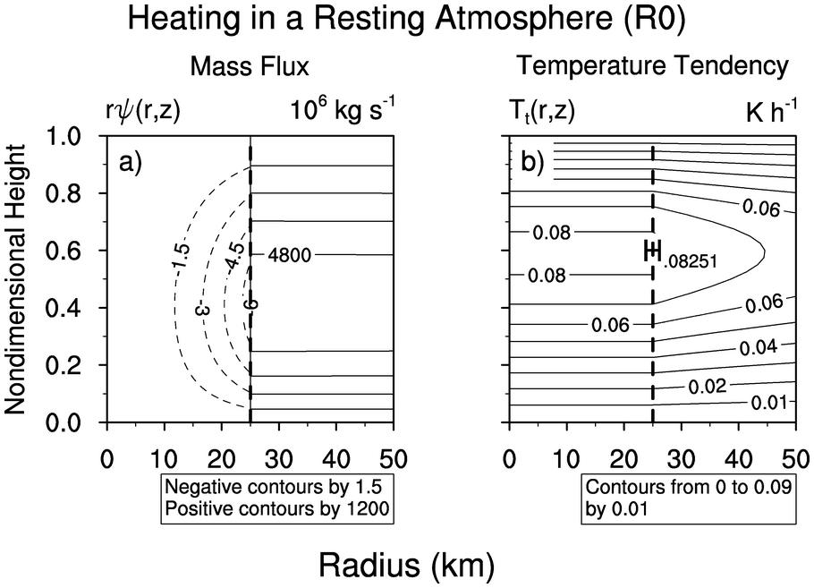

Slide 16
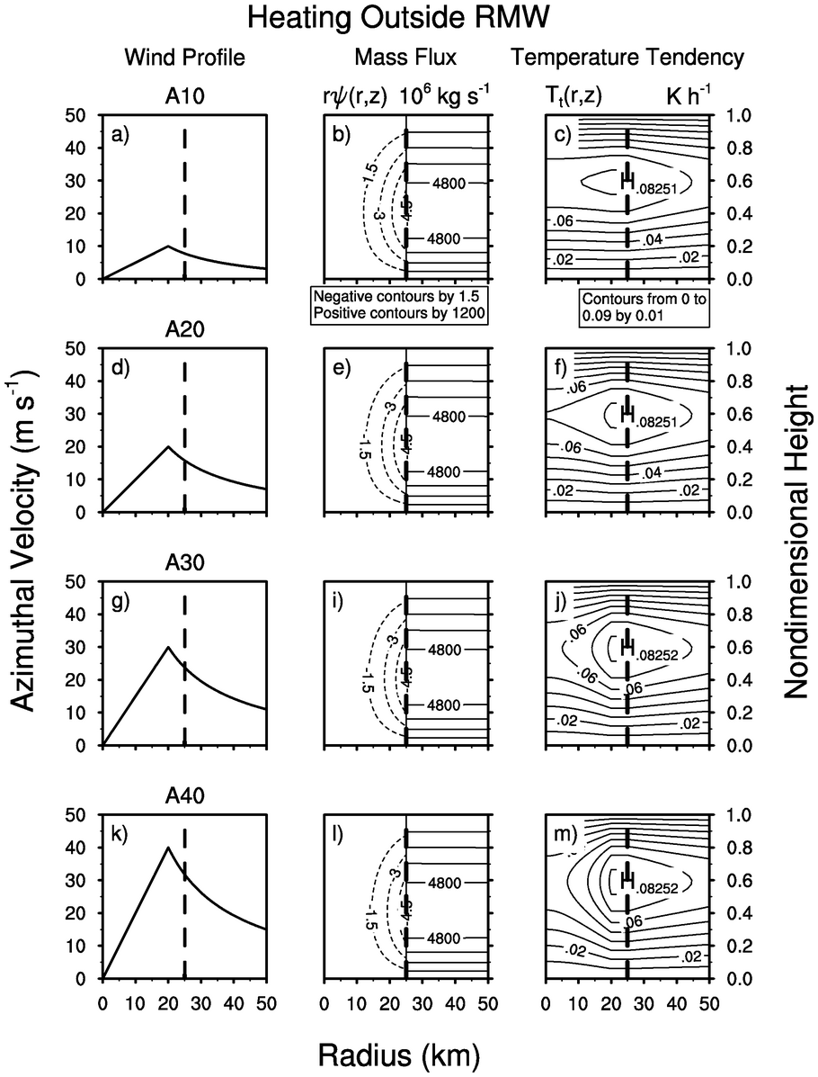
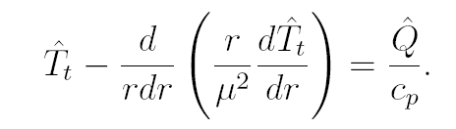
Heating Outside
Rossby radius large (μ is small)
Middle term large
Temperature tendency small
Influence of diabatic heating spread over large area

Slide 17
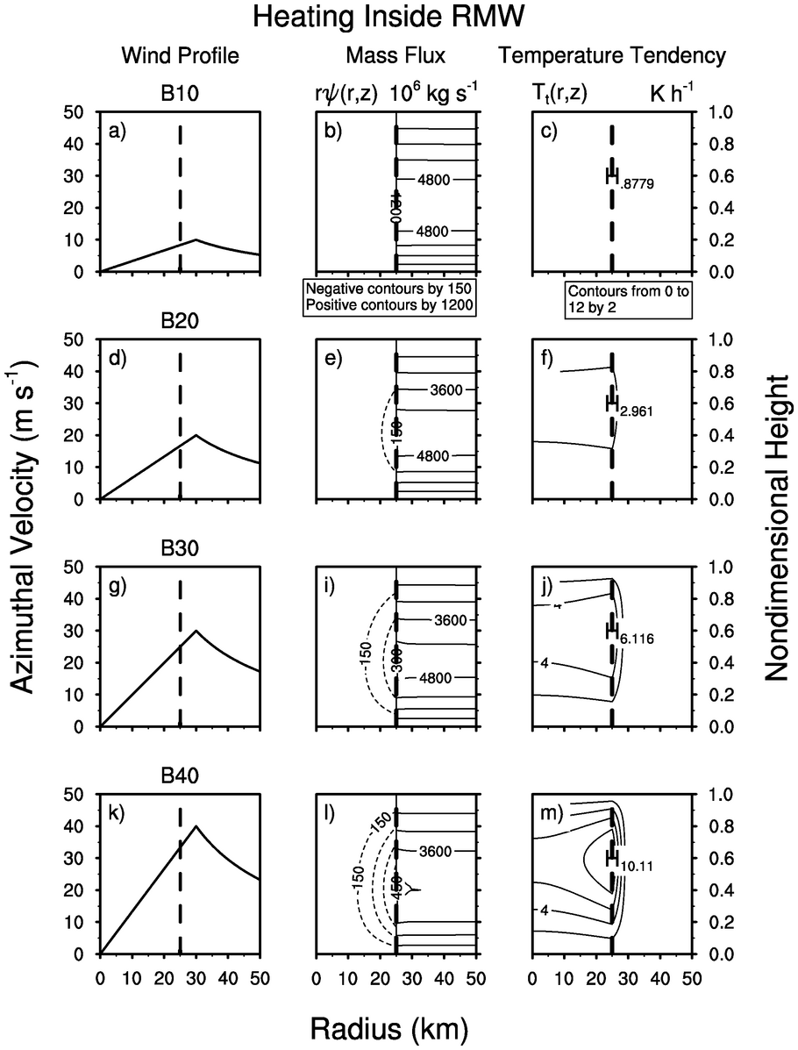
Heating Inside
Rossby radius small (μ is large)
Curvature term small
Temperature tendency large
Influence of diabatic heating confined to small area
-> rapid warm core development

Slide 18

Cyclogenesis Function:
Forcing of geopotential tendency proportional to product of PV with the θ-derivative of along absolute angular momentum surface.
Hausman et al. (2006) show as a TC approaches mature state, PV and heating fields lock together in a thin, leaning hollow tower on the inner eye edge.
-> production of PV is exactly balanced by advection out
-> no net production of PV
Geopotential tendency goes to zero and intensification ceases.
Heating “locked down” and “locked out” of efficient region

Slide 19
Observations: VDM Data set
URNT12 KNHC 061722 header, office, transmission day/time
VORTEX DATA MESSAGE AL172008 stormid
A. 06/17:07:10Z day/time of fix
B. 15 deg 51 min N latitude of fix
081 deg 54 min W longitude of fix
C. 850 mb 1398 m minimum height at standard level
D. 49 kt estimate of maximum surface wind observed (visual or SFMR)
E. 291 deg 8 nm bearing and range from center of maximum surface wind
F. 031 deg 041 kt maximum flight level wind near center
G. 293 deg 008 nm bearing and range from center of maximum flight level wind
H. 997 mb minimum sea level pressure computed from dropsonde or extrapolated
I. 16 C/ 1524 m maximum flight level temperature/altitude OUTSIDE eye
J. 19 C/ 1521 m maximum flight level temperature/altitude INSIDE eye
K. 16 C/ NA dew point temperature/sea surface temperature inside eye
L. CLOSED eye character (closed wall, poorly defined, open SW)
M. C18 eye shape/orientation/diameter (C18, CO8-14, E09/15/5)
N. 12345/8 fix determined by/fix level
O. 0.02 / 1 nm navigational accuracy/meteorological accuracy
P. AF303 0317A PALOMA1 OB 08 aircraft number/wx mission identifier/stormname/ob/correction
MAX FL WIND 41 KT NW QUAD 17:04:40 Z <- time of maximum wind noted with quadrant
MAX OUTBOUND FL WIND 61 KT SE QUAD 17:11:40 Z <- if max outbound wind exceeds inbound
MAX FL TEMP 20 C 129 / 07 NM FROM FL CNTR <- bearing and range if not within 5 nm of center

Slide 20
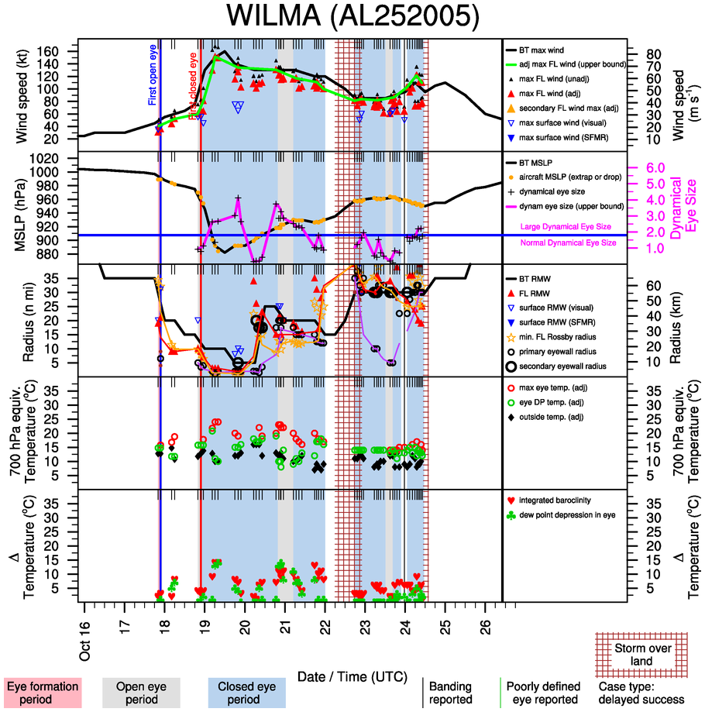

Slide 21
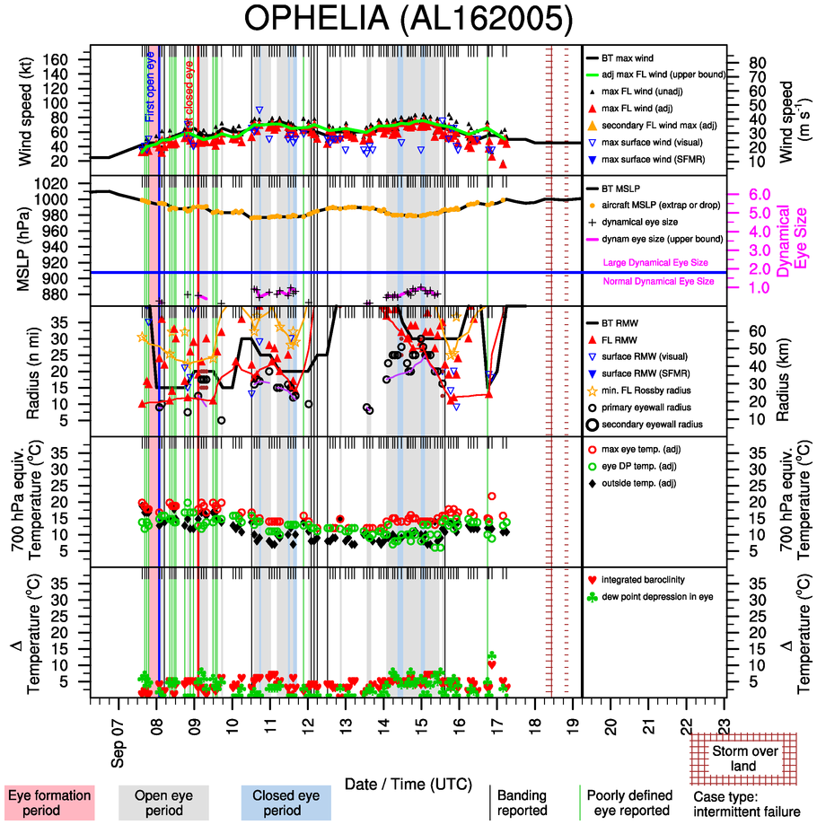

Slide 22
Observational Methodology
Flight level winds reduced to surface
Thermodynamic temperatures adjusted to 700 hPa equiv.
Land mask
Eye formation baselines determined
  first aircraft eye (A)
  first IR eye (IR3)
  first persistent (>6 h) IR eye (IR4)
  first strong IR eye (IR5)
Intensity and structure data interpolated to a 6-day window centered on the time the eye formed
70 cases stratified into categories:
  a) complete failure (17 cases)
  b) intermittent failure (24 cases)
  c) delayed success (12 cases)
  d) complete success (17 cases)

Slide 23
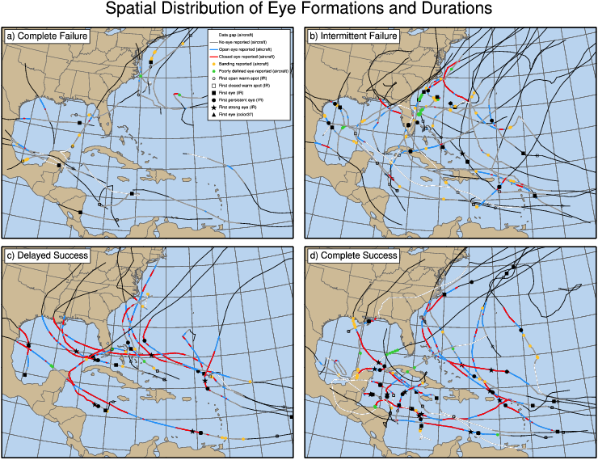

Slide 24
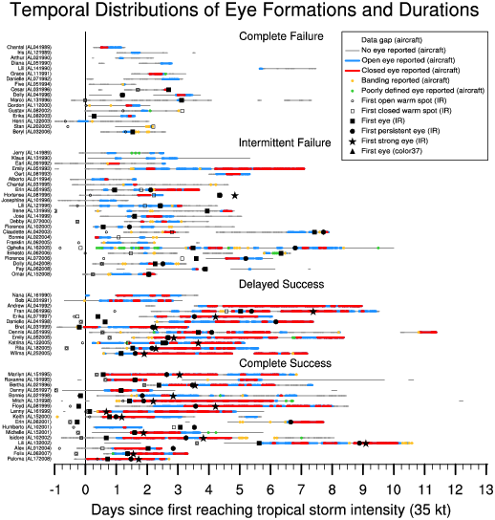
1-day window where things can happen quickly

Slide 25
Frequency of eye formation
Aircraft eye reported in 59% of reconnoittored storms
  58% Open eye (A1)
  47% Closed eye (A2)
  61% IR eye (IR3)
  43% Persistent IR eye (IR4)
  21% Strong IR eye (IR5)
In storms well observed by both satellite and aircraft:
  IR3 eye more common (67%) than aircraft eye (58%) (surprise)
Banding a precursor to eye formation
  Reported in just 43% of storms, but when it was reported 79% of those storms went on to form an eye

Slide 26
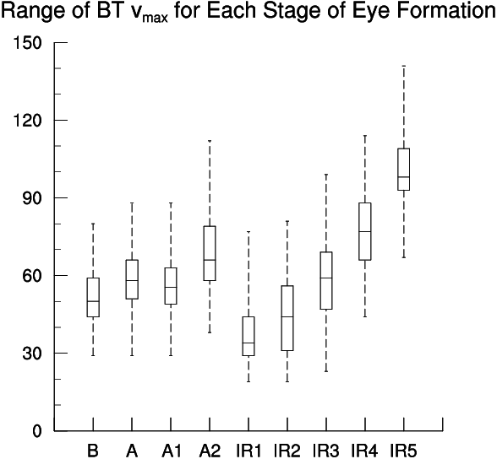
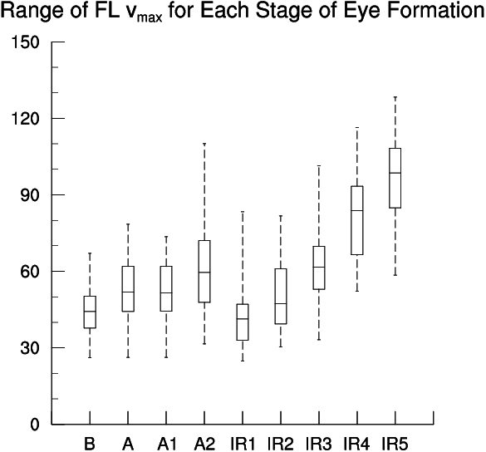
Intensity Ranges for Eye Formation
First aircraft eye (A) forms at 58 kt (BT) or 54 kt (rFL)
Note large range!! No trigger?
First IR eye (IR3) forms at 58 kt (BT) or 64 kt (rFL)
First persistent IR eye (IR4) forms at 77 kt (BT) or 82 kt (rFL) – no surprise here (T4.5)!

Slide 27
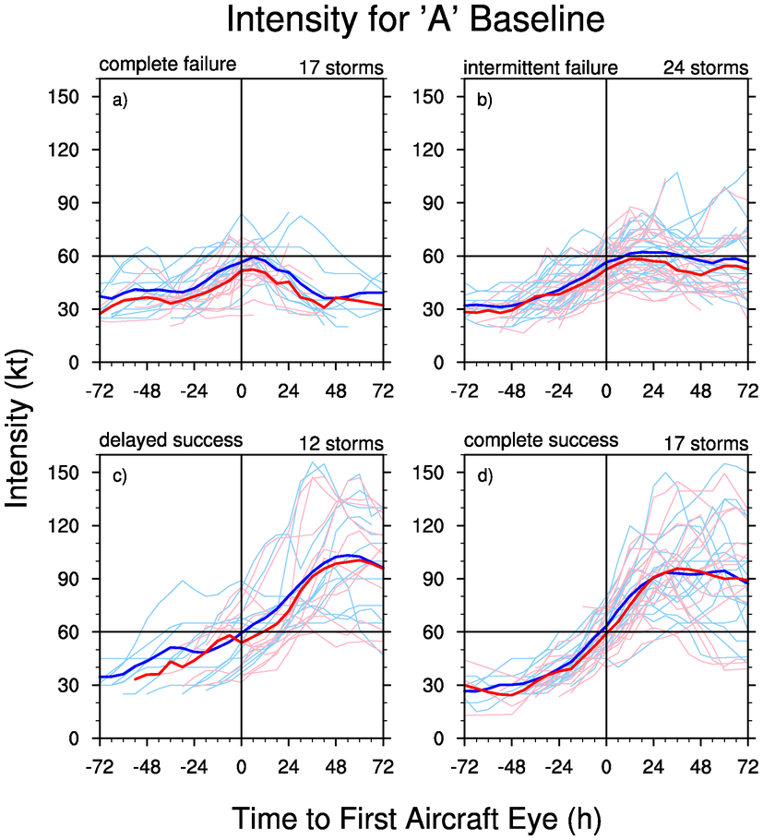
Intensity Stratified by Eye Success
Complete failure cases quickly weaken after forming an eye
Intermittent failure cases often have steady intensity during their attempts
Delayed success cases often form eyes early, are stymied, then rapidly intensify to reach highest intensities
Complete success cases rapidly intensify, peak sooner
If failures are removed, storms intensify most rapidly right near the time of ‘uninhibited’ eye formation

Slide 28
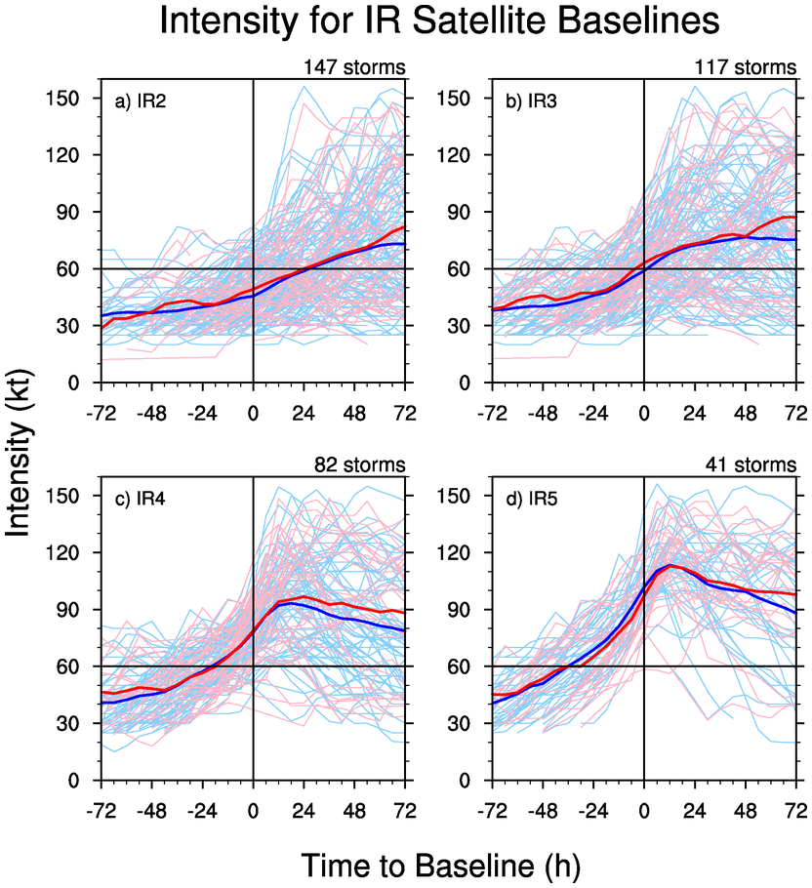
Intensity for Satellite Baselines
Intensification rate increases about 24-h prior to the first satellite eye
Storms intensify most rapidly once a persistent eye has formed
Peak intensity reached within 12-h or displaying a strong eye

Slide 29
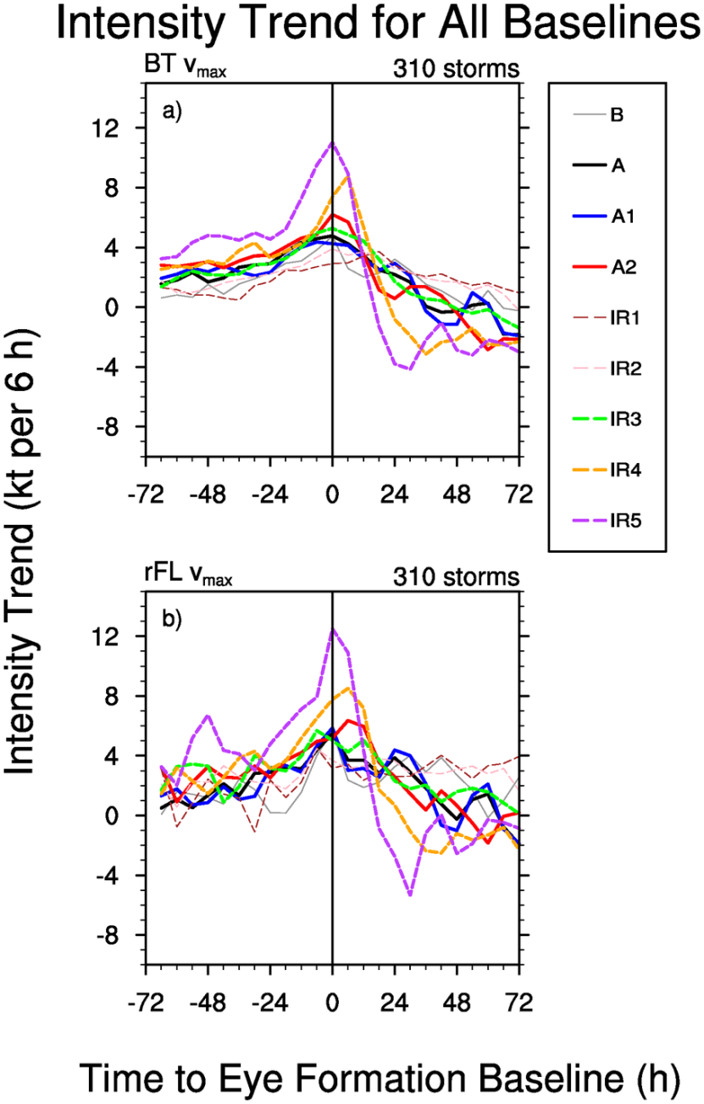
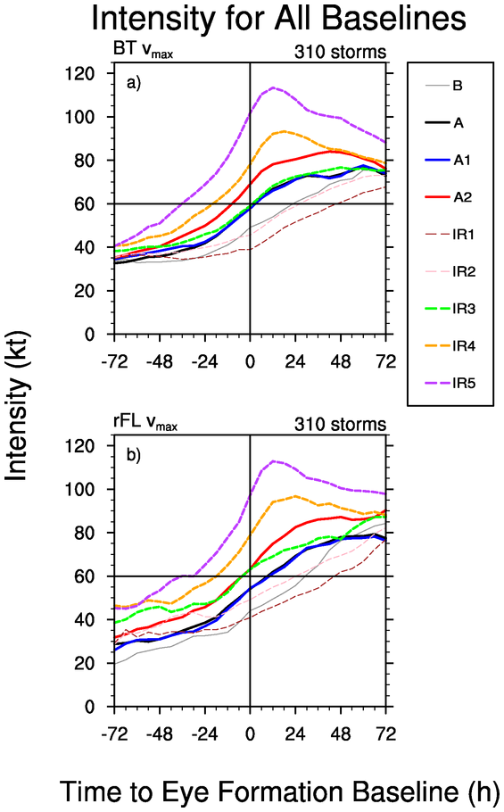
Intensity Intensification

Slide 30
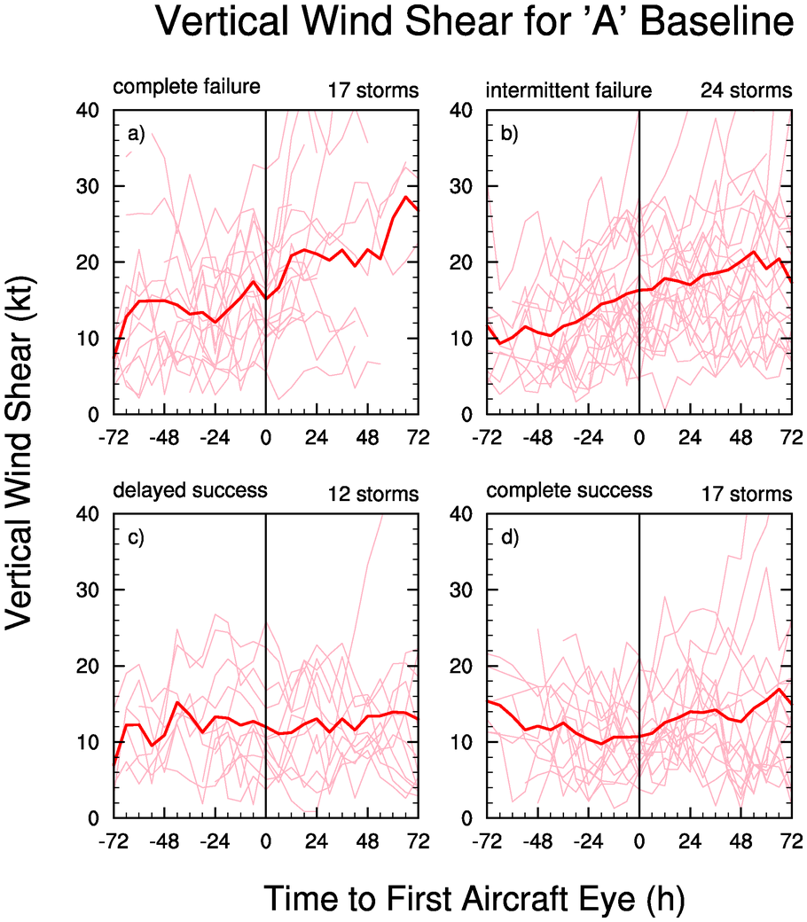
Impact of Vertical Shear
Shear highly disruptive to eye formation
Why?

Slide 31
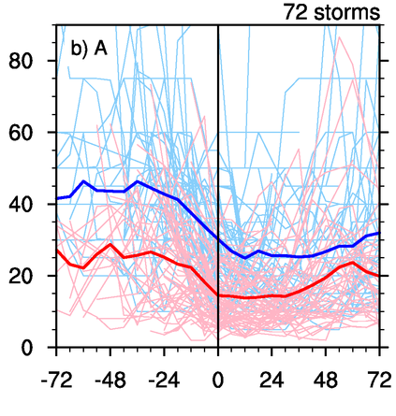
Radius of Maximum Winds
BT r_{m} found to have large high bias!
~ half of storms studied undergo large contraction in the 24-h before eye formation
FL r_{m} contracts from >40 nm to ~17 nm in that period
Minimum FL r_{m} reached soon after -> supports Kuo’s idea of limiting radius

Slide 32
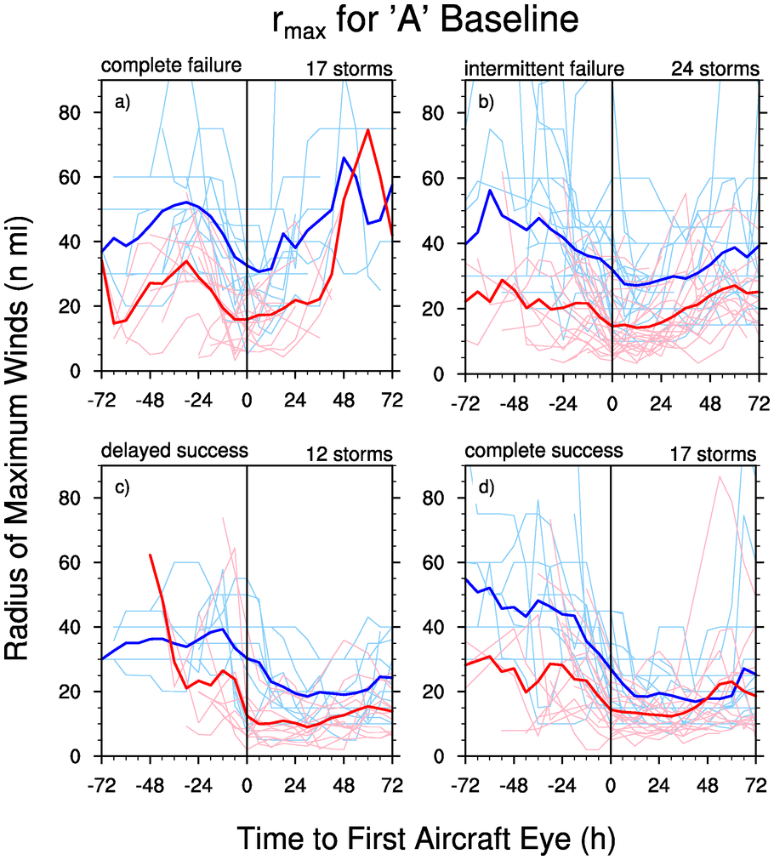
RMW stratified by cases
r_{m} decreases, then rapidly increases for failures
increases more slowly for intermittent failures
stays low for success cases

Slide 33
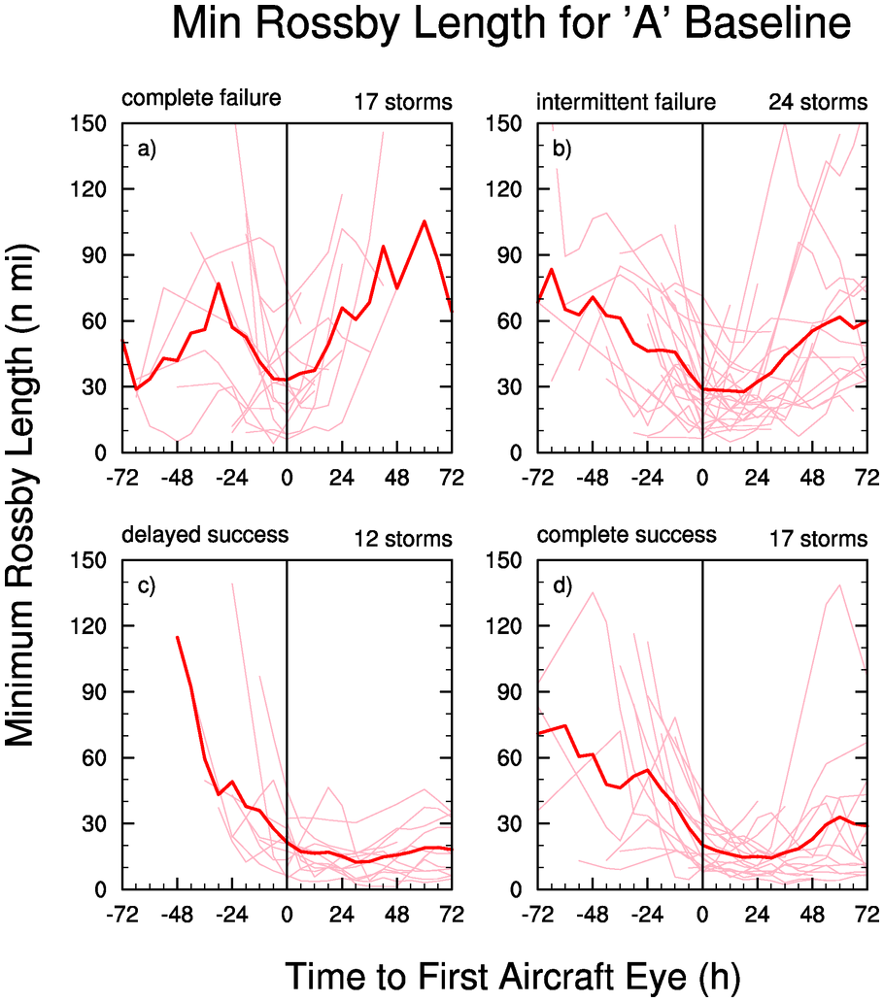
Minimum Rossby Length
Undergoes sharp contraction in 24-h before formation
Some storms form eyes with large value however
Continues to contract for intensifying storms
Reaches 10 nm for strong eye storms
No absolute value that triggers eye formation

Slide 34
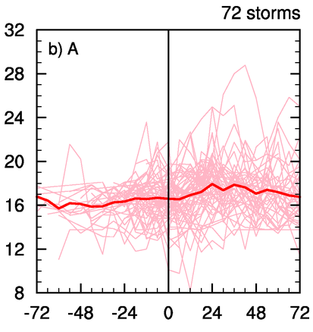
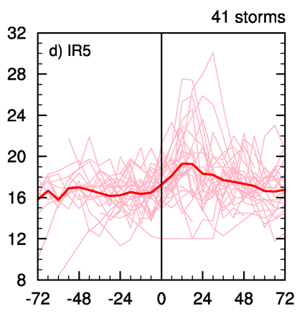
Temperature Trends
18-36 h “spike” period of peak eye warming, timing varies for aircraft baseline
Timing of most rapid warming begins right when the strong eye appears

Slide 35
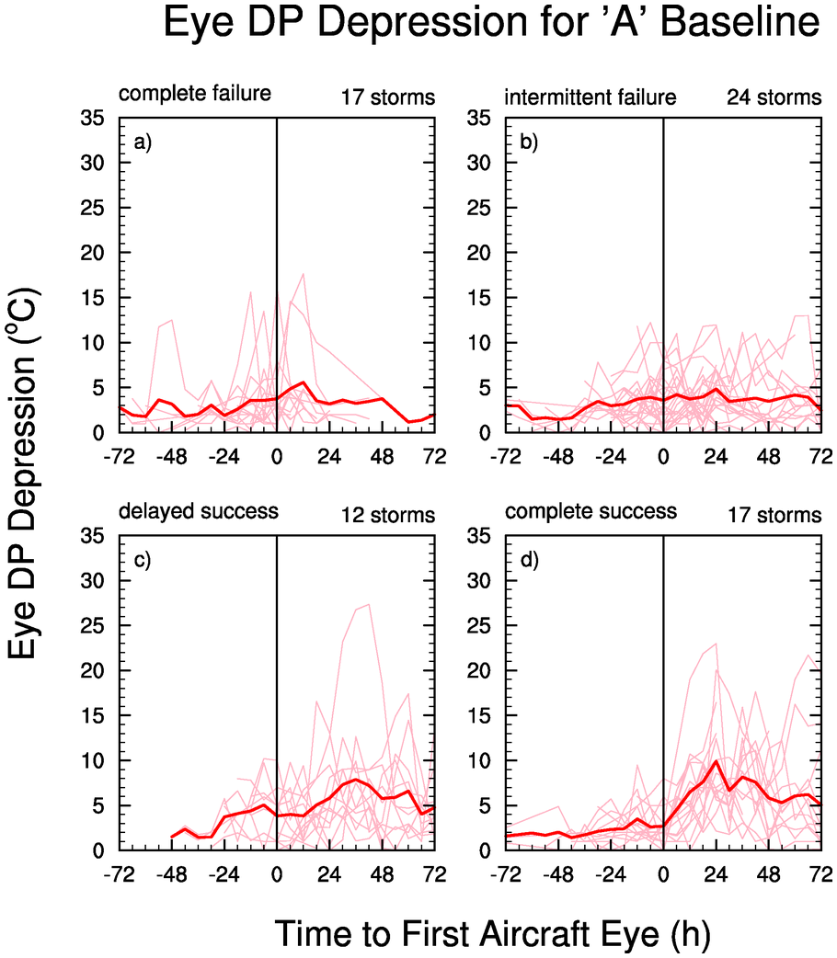
Dew Point Temperature Depression
Max DP T depression ALWAYS observed at 700 hPa
Max value appears to correlate well with maximum intensity
In some cases values >8ºC occur BEFORE eye formation -> central subsidence precedes eye formation by 12 to 24 h for these cases (subsidence triggers eye formation??)
Extraordinary DP depressions not a requirement for high intensity

Slide 36
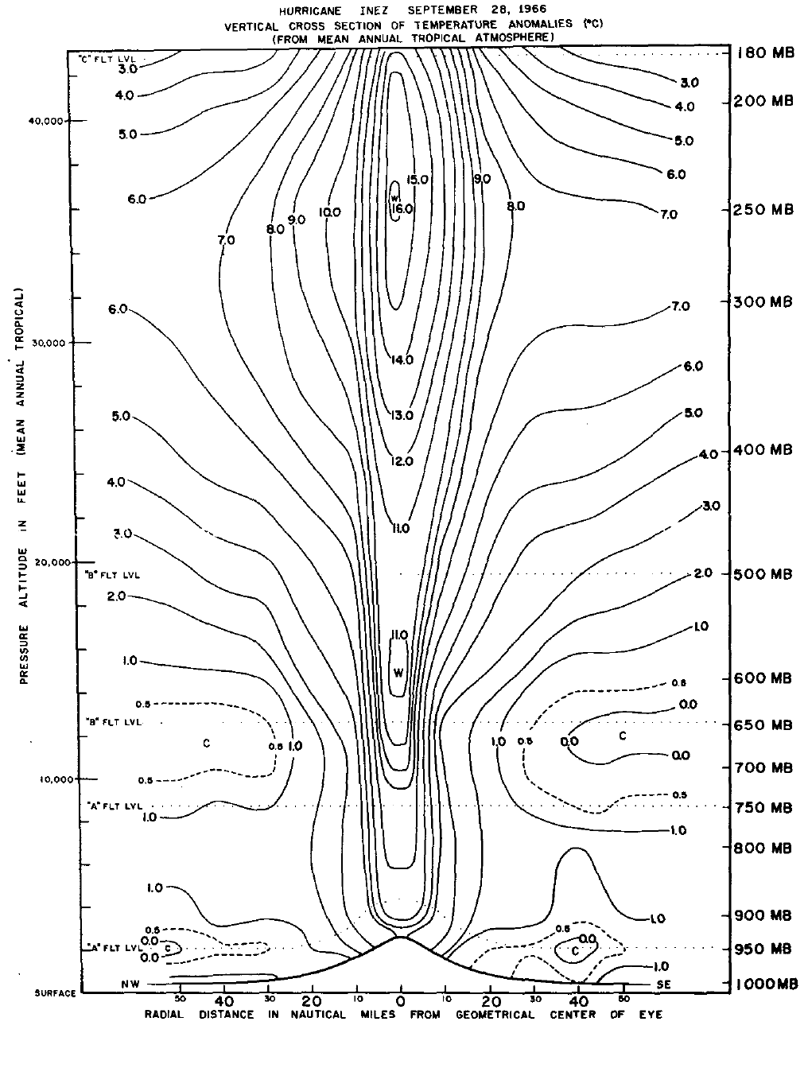
Inez (1966)
Perhaps momentum diffusion pump / centrifugal hypothesis is significant for some storms
May be responsible for the lower warming
“Breaks” when eye undergoes mixing event (Jordan 1961, Kossin and Eastin 2001)
Would be expected when wind profile is very sharp, U-shaped in eye
Small, compact storms like pinhole eyes (Wilma, Beta, Charley, Dennis)
Hawkins and Imbembo (1976)

Slide 37
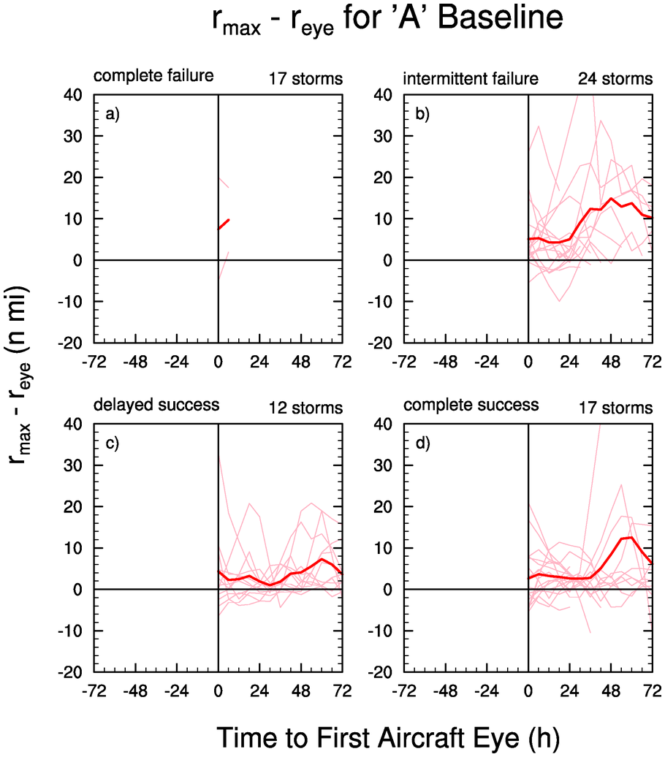
The Paradox of Eye Formation
Schubert and Hack (1982): eye formation removes diabatic heating from high inertial stability of core by squeezing the area of efficient heating -> stabilizes storm
Yet, many storms intensify most rapidly at eye formation or afterwards. Why?

Slide 38
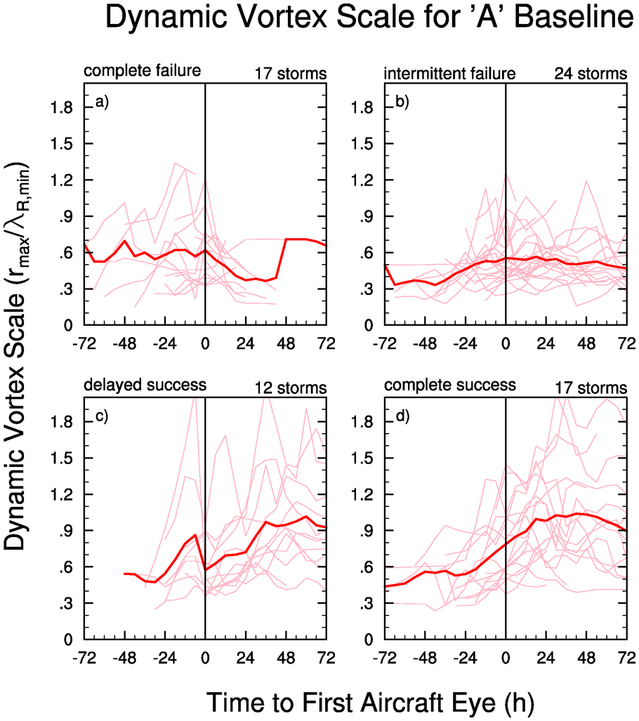
Paradox Resolved?
Divide radius of maximum winds by minimum Rossby length -> dynamic scale of the eyewall
Tends to be about 0.6 at time of eye formation, but higher for complete success cases, rises to about unity
-> As physical area of efficient heating shrinks during eyewall contraction, efficiency increases more than counteract this -> storm can keep intensifying

Slide 39
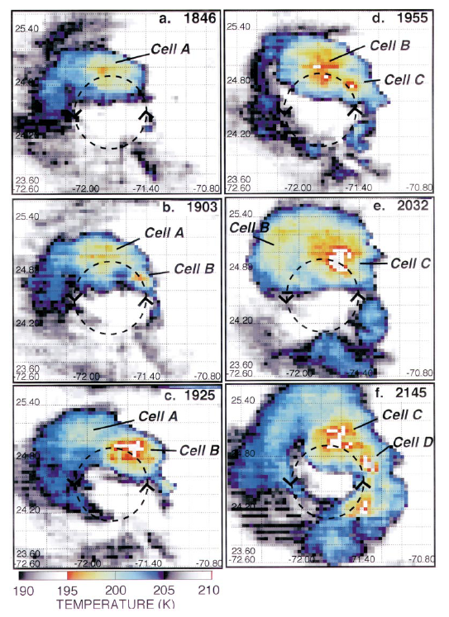
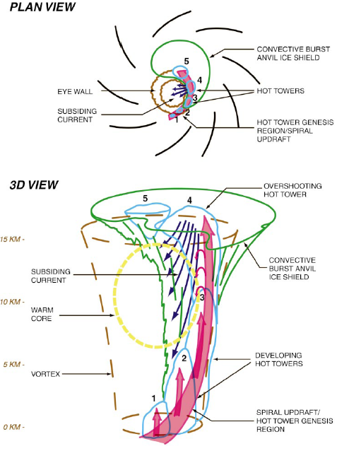
Shortcuts??

Slide 40
Conclusions - Fundamentals
Eye formation results because of conservation of angular momentum, mass continuity, to maintain balance in vortex
As vortex spins up, vertical rearrangement of mass necessary to maintain the vortex balance
Key factor is peakedness of tangential wind
Expressed locally, understood globally?

Slide 41
Conclusions - Theory
Inertial stability plays crucial role in determining the storm’s response to latent heating.
  Heating in region of high inertial stability strongly localizes warming response resulting in rapid development of warm core.
  Heating outside has almost no effect, no matter how small the Rossby radius becomes in the core.
It seems development of warm core should act as brake on further intensification.
  Increased static stability of warming “locks down” buoyant convection
  Increased inertial stability “locks out” energetic air
  m-surfaces slope outward and PV and heating become “locked”, shutting down PV production in eyewall.

Slide 42
Conclusions – Intensity Changes
1-day window after TS in which storms seems primed to form an eye
Banding a precursor to eye formation
Satellite eyes more prevalent than aircraft eyes
Intensity at eye formation
  No threshold for eye formation!
  Average is 55-60 kt (30 kt to 85 kt)
Most rapid intensification occurs once persistent eye has formed
Eye formation doesn’t seem to stabilize storm!

Slide 43
Conclusions – Structure Changes
BT radius of maximum winds biased high
Radius of maximum winds rapidly contracts in 24-h before eye formation
  Min reached shortly after eye formation
  -> supports idea of limiting radius
Minimum Rossby length also contracts
  no trigger
  -> supports idea that of the radial shear of tangential wind being important for eye formation
Peak lower warming not well timed with aircraft eye, but is timed well with strong eye
  Signals most rapid intensification rate of storm, imminent peaking
Extraordinary DP depressions NOT needed to reach high intensity
  -> momentum diffusion pump may operate selectively, break at transition
Dynamic efficiency of eyewall increases as physical scale of eyewall becomes smaller
  -> Storm continues intensifying, eye formation does not stabilize storm

Slide 44
Closing thoughts
Eye formation an end result of genesis
  Bister and Emanuel (1997) discuss role of saturation of core
    cooling helps maintain thermal wind balance while vortex spins up
    helps core to be more convectively unstable when BL recovers
    Nolan (2007) finds rapid contraction in radius of maximum winds, formation of small shallow vortex
Is the eye/eyewall structure an manifold attractor of the system or due to stochastic interactions?
Multiple pathways exist to eyes, but the end result is always the same

Slide 45
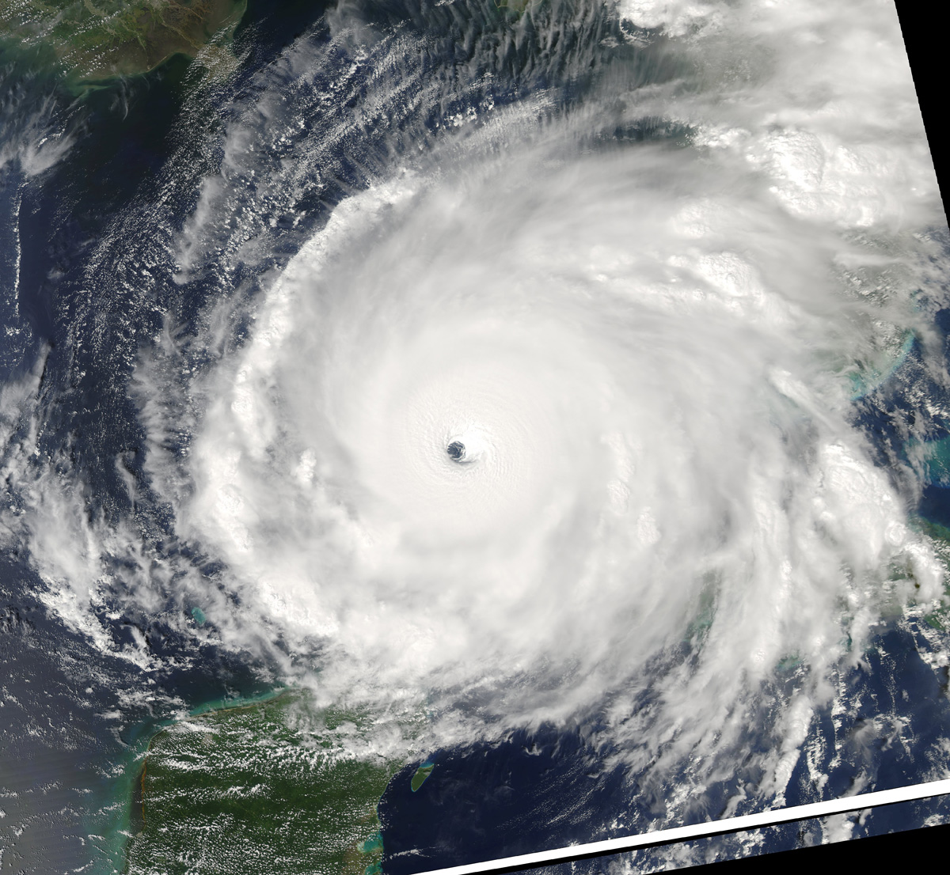

Slide 46
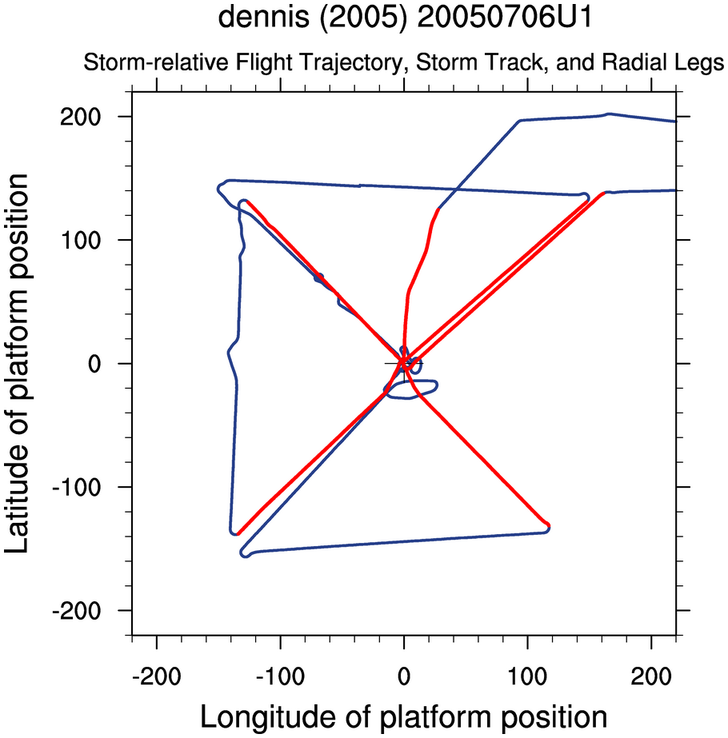
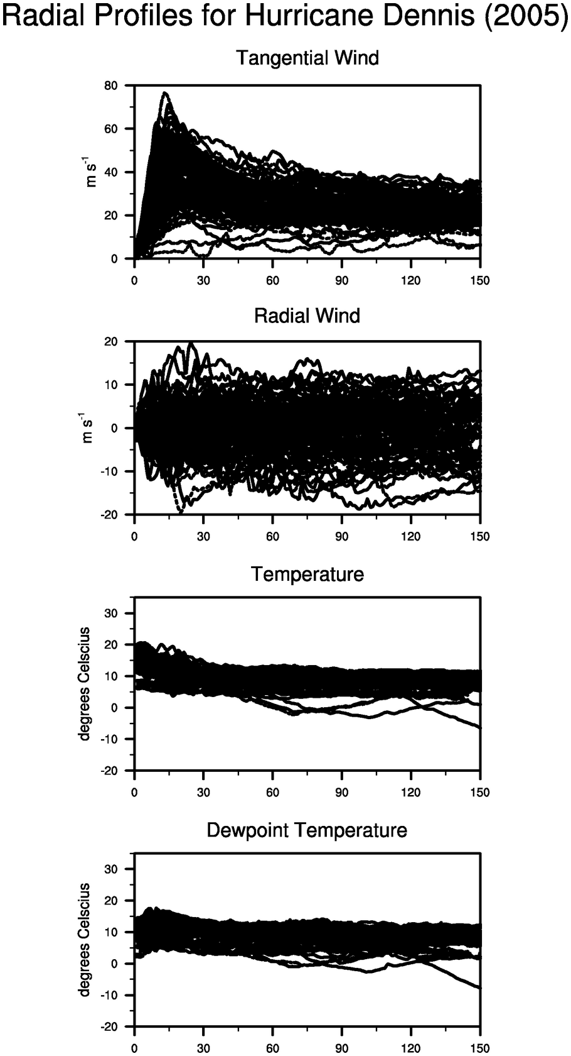
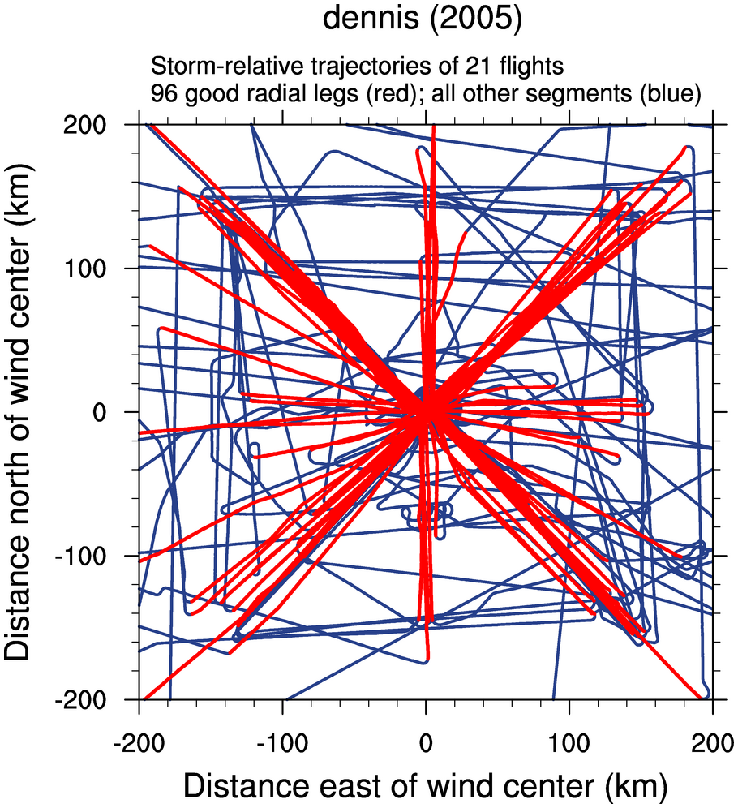
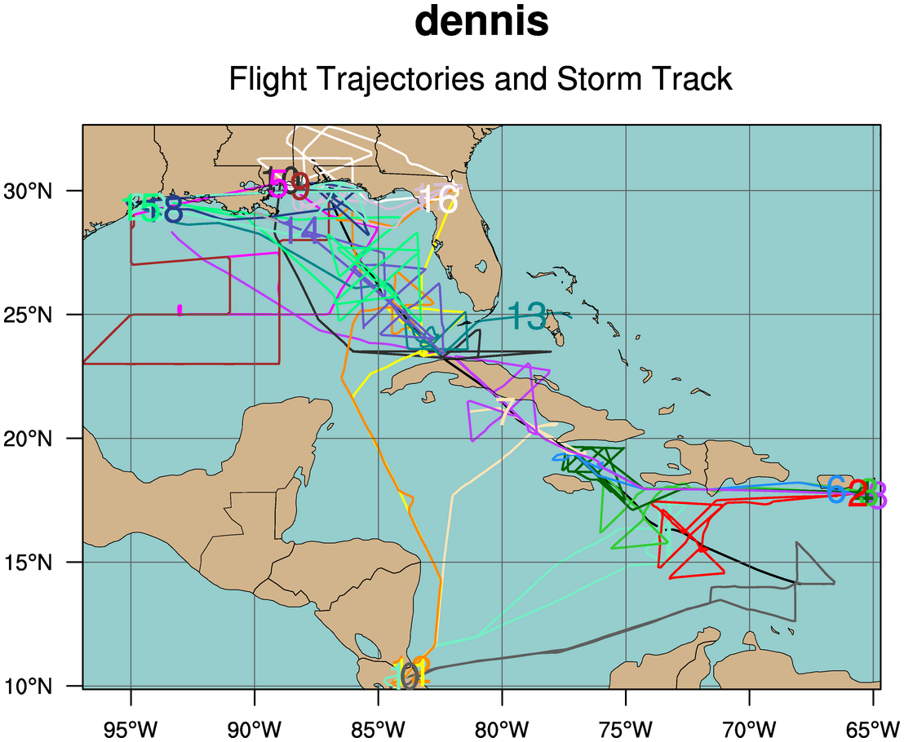
Future Work

Slide 47
Stop here or you’ll be sorry!
Dust devil video

Slide 48
Other formation mechanisms
Eliassen 1959
Primary band
Nolan 2007

Slide 49
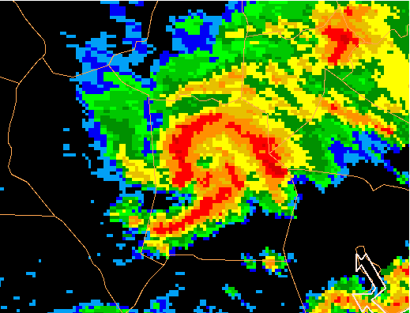
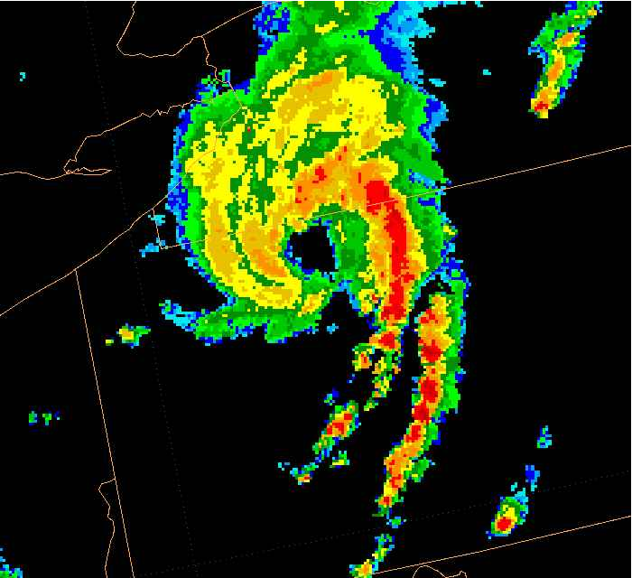
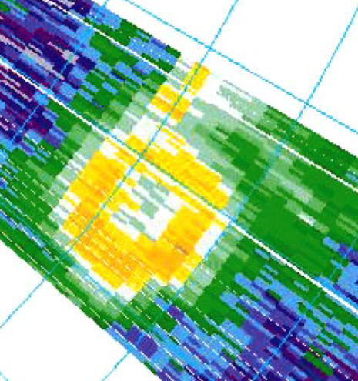
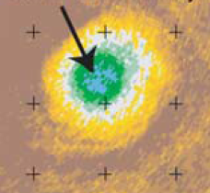
Eyes or eye-like?

Slide 50
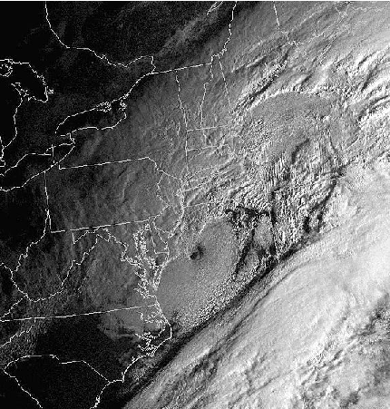



Slide 51
Theory Alert!
Isolate conditions under which a warm-core thermal structure can rapidly develop.
Understand role of warm core in stabilizing the storm.
Sawyer-Eliassen transverse circulation and associated geopotential tendency equation
2nd order PDE’s containing the diabatic forcing and three spatially varying coefficients:
  Static stability, A
  Baroclinicity, B
  Inertial Stability, C
The large radial variations in inertial stability are typically most important.

Slide 52
Balanced Vortex Model
Inviscid, axisymmetric, quasi-static, gradient-balanced motions of a stratified,
compressible atmosphere on an f-plane.
Log pressure vertical coordinate: z = H log (p₀ /p) Scale height: H = RT₀ /g ~ 8.79 km
Gradient wind balance
Tangential momentum
Hydrostatic balance
Continuity
Thermodynamic

Slide 53




Combine tangential wind equation x (f + 2v/r)
with the thermodynamic equation x (g/T₀),
then make use of hydrostatic and gradient relations:
Eliminate geopotential
Introduce streamfunction:
Boundary conditions:
Ψ= 0 at z = 0
Ψ= 0 at z = z_{t}
Ψ= 0 at r = 0
rΨ= 0 as r→∞
Use mass conservation principle:
Sawyer-Eliassen Transverse Circulation Equation
To ensure an elliptic
equation, only consider
AC – B² > 0

Slide 54


Combine tangential wind equation x (f + 2v/r)
with the thermodynamic equation x (g/T₀),
then make use of hydrostatic and gradient relations:
Boundary conditions:
∂φ_{t}/∂r → 0 at r = 0
∂φ_{t}/∂z → 0 at z = 0
∂φ_{t}/∂z → 0 at z = z_{t}
Φ_{t} → 0 as r → ∞
Eliminate w:
Eliminate u:
Use mass continuity to eliminate u and w:
D = AC – B²
Geopotential Tendency Equation

Slide 55
Simplifications to allow analytic solution
Barotropic vortex (B = 0)
Constant static stability
Piecewise-constant inertial stability:
Separate the vertical and radial structure: ODEs.
Dirac delta function heating.
Key differences from Eliassen’s original treatment:
  We include the spatial variation of inertial stability.
  We use the entire Greens function, not just the principle part.
  The full effects of circular geometry are included.

Slide 56

Does local temperature change occur in region of diabatic heating or get spread over larger area?
Solutions have the integral property:
Integrated local temperature change is equal to integrated diabatic heating.
Heating outside RMW (or heating in weak vortex):
small effective Coriolis parameter, large Rossby length (μ⁻¹), small μ.
Curvature term is small so temperature tendency is spread out over a wide area
compared to the area where Q is confined -> entire vortex warms slightly.
Heating inside RMW (or heating in a strong vortex):
large effective Coriolis parameter, small Rossby length, small μ.
Curvature term is large to temperature tendency is confined to a small area
-> local region warms significantly with little warming elsewhere.
Rapid development of warm core ensues.

Slide 57


The Cyclogensis Function
Geopotential Tendency Equation
The PV Principle
PV definition

Slide 59


Slide 60
Summary
The inertial stability plays a crucial role in determining the storm’s response to latent heating.
  Heating in the region of high inertial stability strongly localizes the warming response resulting in rapid development of the warm core.
  Heating outside the RMW has almost no effect, no matter how small the Rossby radius becomes in the core.
The development of the warm core acts as a brake on further intensification.
  Diabatic heating is locked out of the region of high inertial stability.
  m-surfaces slope outward and PV and heating become “locked”, shutting down PV production in the eyewall.

Slide 61
But what about real storms?
Real storms aren’t barotropic
Real storms don’t have a Dirac delta function of heating
Real storms don’t always have sharply peaked profiles of tangential wind
What IS the distribution of inertial stability in the storm?

Slide 62


Simplifications to allow analytic solution
Consider a barotropic vortex (B = 0)
Constant static stability,
Piecewise-constant inertial stability:
S-E equation becomes:
Geopotential tendency equation becomes:

Slide 63





Separating vertical and radial structure for S-E equation
Assume diabatic heating and streamfunction have separable forms:
Where
The S-E equation reduces to the ODE:

Slide 64


Separating vertical and radial structure for geopotential tendency equation
Similarly, the temperature and geopotential tendencies have separable forms:
The geopotential tendency equation reduces to the ODE:
These solutions have the integral property:
Integrated local temperature change is equal to integrated diabatic heating.

Slide 65


General solution using Green function
has a solution which can be written as
where the Green function G(r,r_{h}) satisfies the differential equation:
(r – r_{h}) denotes the Dirac delta function localized at r = r_{h}
G(r,r_{h}) gives the radial distribution of temperature tendency when the diabatic
heating is confined to a very narrow region at r = r_{h.}
It can be solved analytically only if μ(r) takes some simple form.
We consider two cases:
a) constant μ (resting atmosphere)
b) piecewise constant μ (high inertial stability in core, weak in outer regions)

Slide 66
What happens in real storms?
Warm core structure causes baroclinicity to become very large -> frontogenesis
From a PV perspective, the warm core causes Θ surfaces to align with M surfaces
Diabatic PV production matches net advection out
Cyclogenisis function vanishes everywhere -> storm reaches a steady state
Warm core ultimately stabilizes the storm by removing the diabatic heating from the region of high inertial stability and shutting down PV growth in the eyewall

Slide 68
More subsidence ideas . . .
Smith 1980
  Mechanically driven due to decreased vertical shear in eyewall
  radial pressure gradient decreases upward
  subsidence just what is required to maintain thermal wind balance at each level
Emanuel 1997
  Intensifying vortex causes discontinuity leading to frontogenetic collapse
  radial turbulent diffusion of momentum mechanically forces subsidence

Slide 69
General Summary of Data
5498 vortex data messages (including non-unique corrections, duplicates)
4969 unique fixes
132 storms for which aircraft observed an eye (in all three basins)
112 storms in Atlantic basin
# fixes flight level eye T outside T DP
1198 1500 ft 24.5 23.3 22.7
50 925 mb 22.8 21.1 20.2
1491 850 mb 20.8 17.5 17.0
2130 700 mb 16.6 10.8 10.9
7 500 mb 9.3 7.2 8.3

Slide 70
Wind Trend Methodology
Reduce flight level winds to surface equivalents using Franklin et al. (2003)
Select upper bound points by excluding all wind maxima which are relatively weaker than surrounding points
Linearly interpolate the upper bound points to reference points for each 6-h period from 72-h before to 72-h after eye formation
Compute actual trends for each 6-h period

