Slide 1
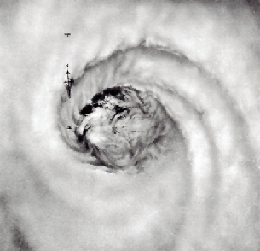
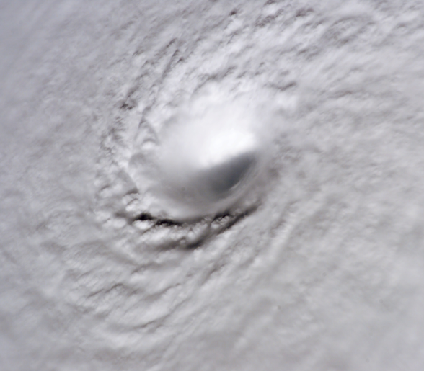
Intensification and Contraction:
Do They Always Go Together?
Jonathan Vigh
NCAR Earth Systems Laboratory &
Advanced Study Program
Joint Informal CSU/NCAR Hurricane Workshop
10:20 AM 07 October 2010 Riehl Room
NCAR is sponsored by the National Science Foundation

Slide 2
Intensification and Contraction:
Do They Always Go Together?
Jonathan Vigh
NCAR Earth Systems Laboratory &
Advanced Study Program
Joint Informal CSU/NCAR Hurricane Workshop
10:20 AM 07 October 2010 Riehl Room
NCAR is sponsored by the National Science Foundation

Slide 3
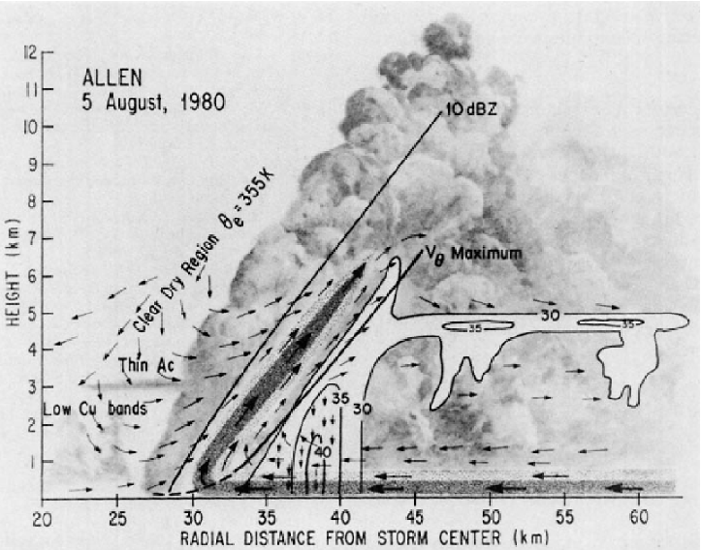
Jorgensen 1984b

Slide 4
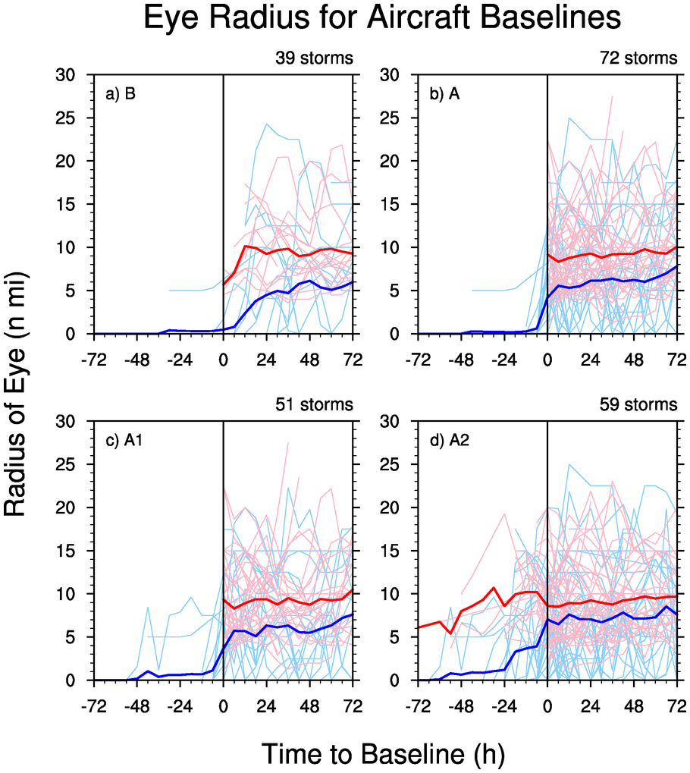
The Contraction “Myth”
It has been commonly believed that storms contract as they intensify
  angular momentum considerations
  Weatherford and Gray (1988)
  Willoughby (1990)’s contracting ring model
Eye radius (nm) centered on time of first report of an aircraft eye =>

Slide 5
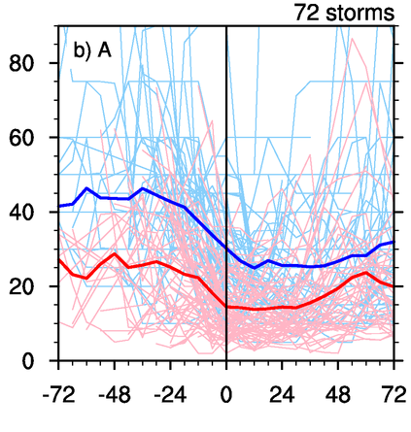
Radius of Maximum Winds
Vigh et al. (2046) found that ~ half of storms undergo a large and substantial contraction in the 24-h before eye formation
Eye formation appears to halt the contraction of r_{m}
  Corroborates recent modeling work by Stern and Nolan (2011)

Slide 6
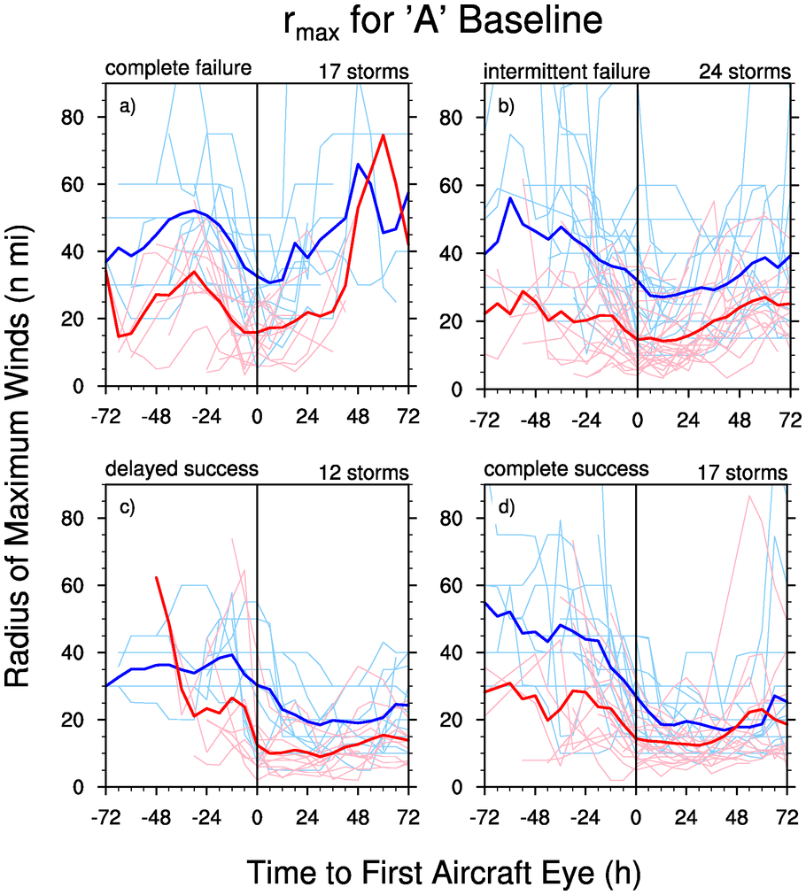
RMW stratified by cases
Now stratify results succes of the eye formation
  r_{m} decreases, then rapidly increases for failures
  increases more slowly for intermittent failures
  remains low for success cases, but with steady or just slow contraction

Slide 7
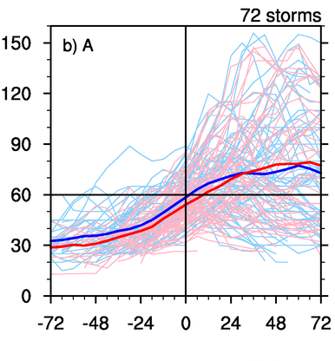
Intensity composite
Results for intensity (reduced flight level wind speed):
  storms are often intensifying rapidly just before and during eye formation
  rapid intensification sometime continues to Major Hurricane
  bulk of contraction happens before the strongest intensification in RI cases

Slide 8
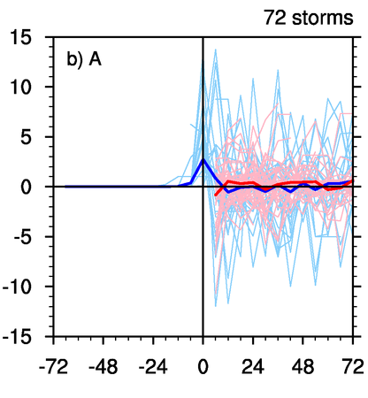
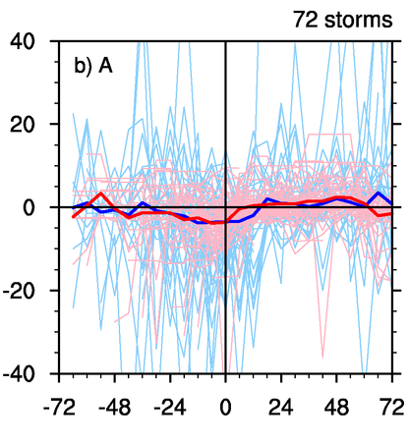
Trend (change per 6 hr) based on aircraft baseline
Eye radius
RMW

Slide 9
Qualitative Analysis Strategy
Examine data storm-by-storm
Focus on main intensification period between eye formation and peak intensity
  use RMW rather than eye radius
    a more dynamically-significant proxy for inner core size than eye radius
  also look at secondary intensity peaks
Stratify cases into 3 types:
  intensification with contracting RMW
  intensification with steady RMW
  intensification with expanding RMW

Slide 10
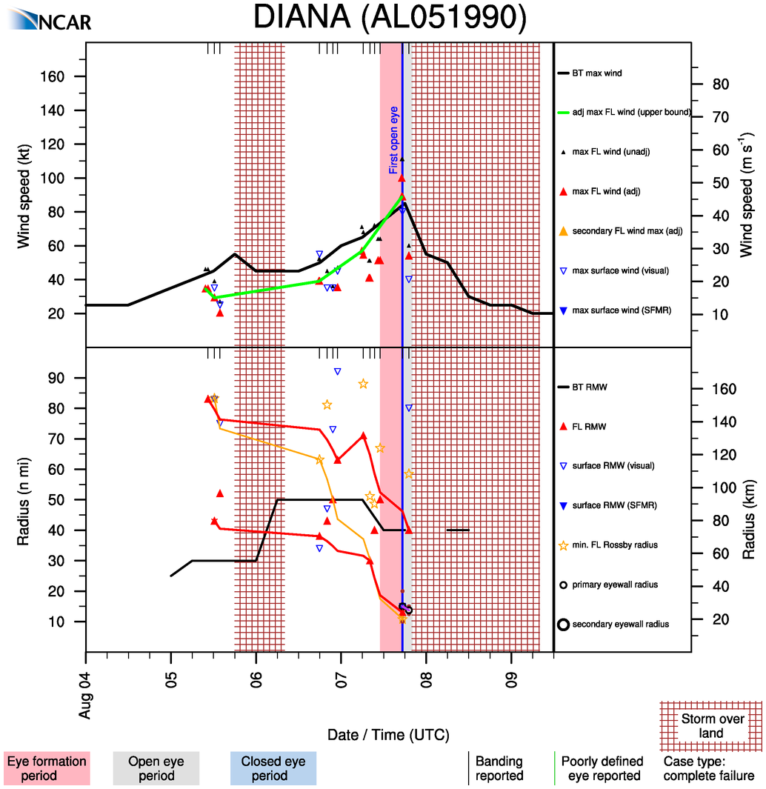
New simpler, plot style
Upper and lower bounds of RMW!

Slide 11
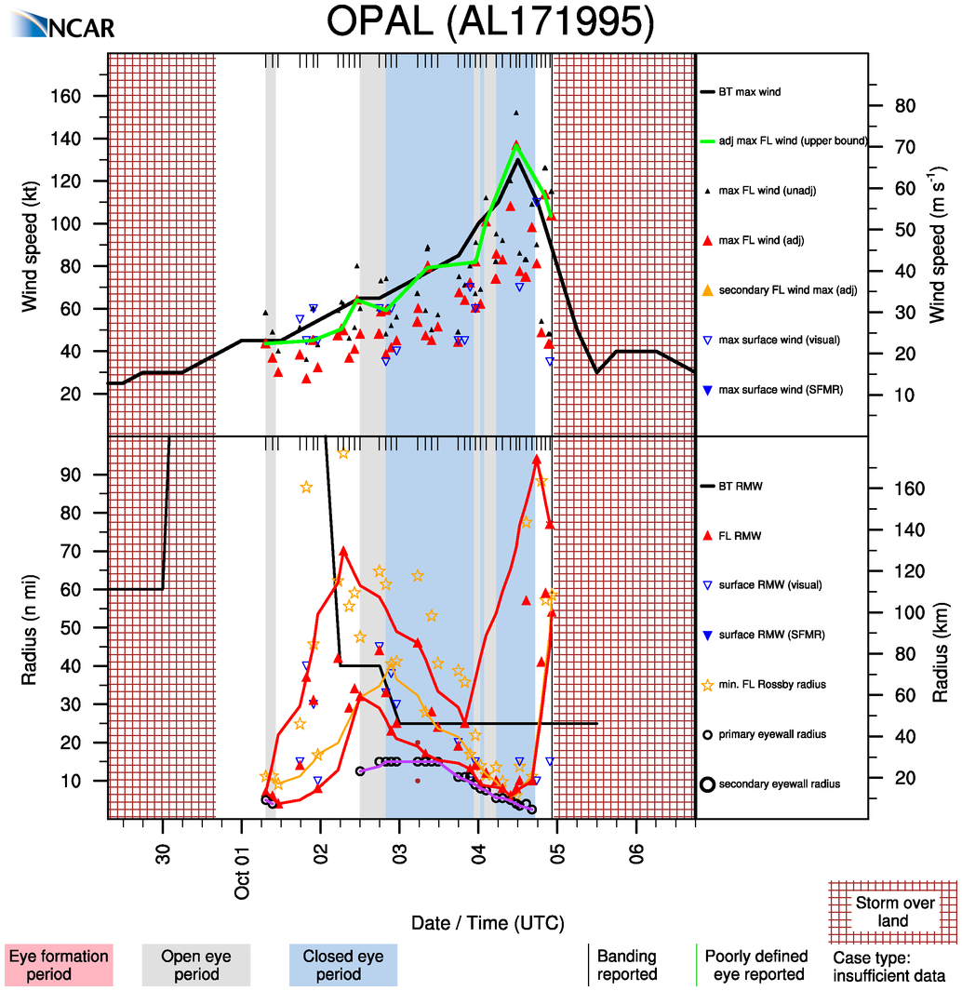
Intensification with
contraction

Slide 12
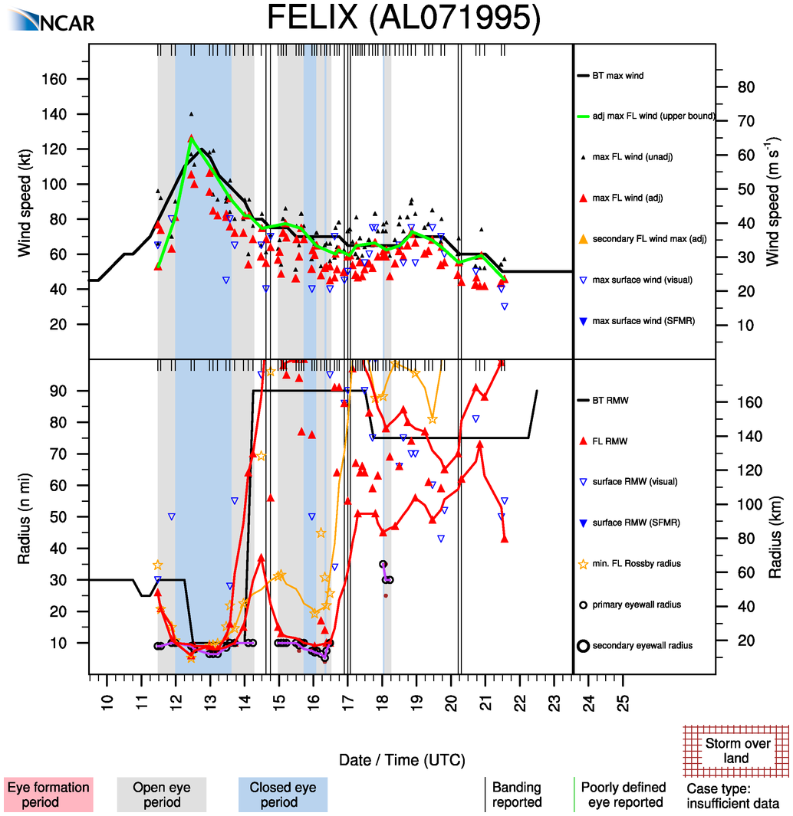
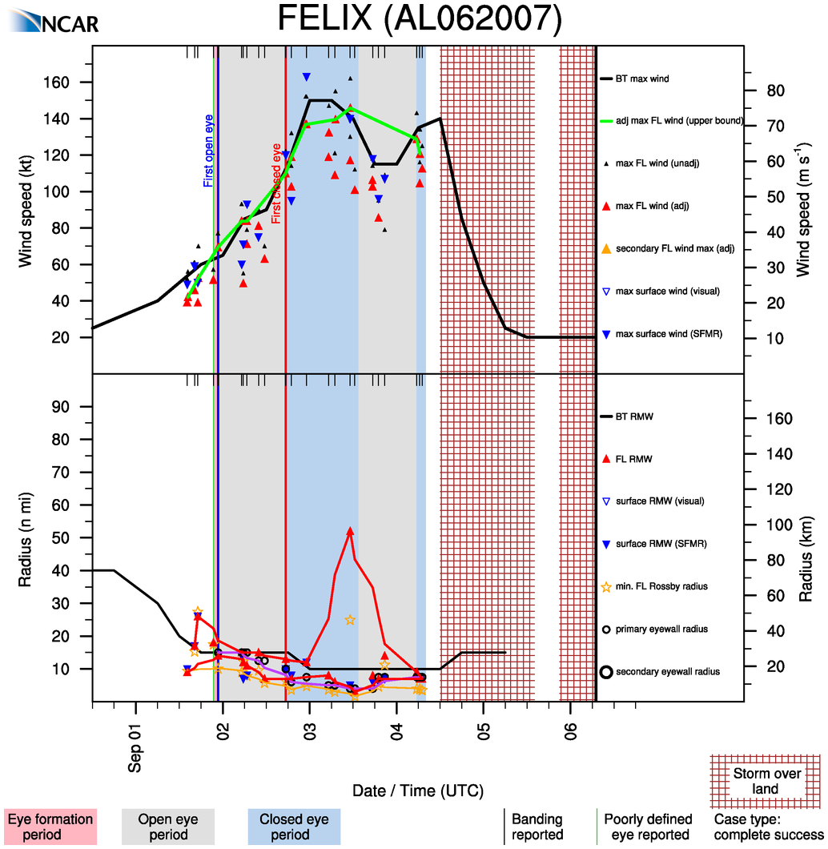

Slide 13
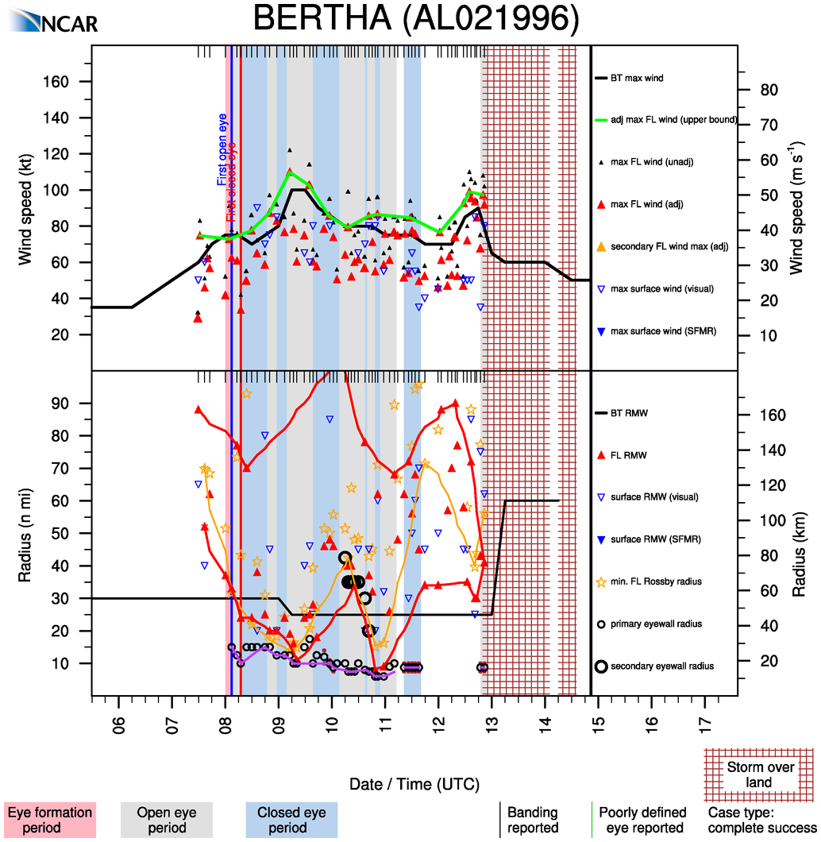

Slide 14
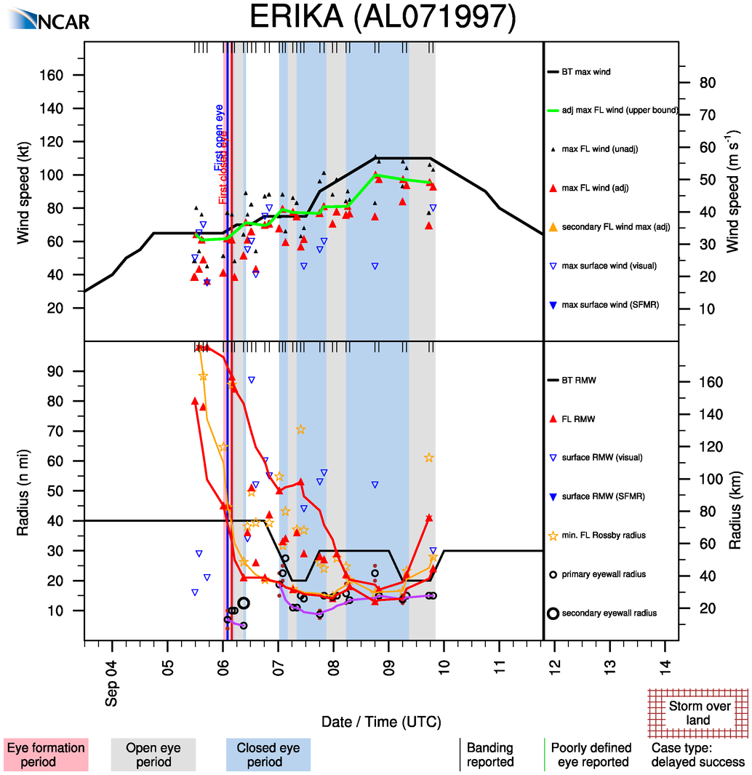

Slide 15
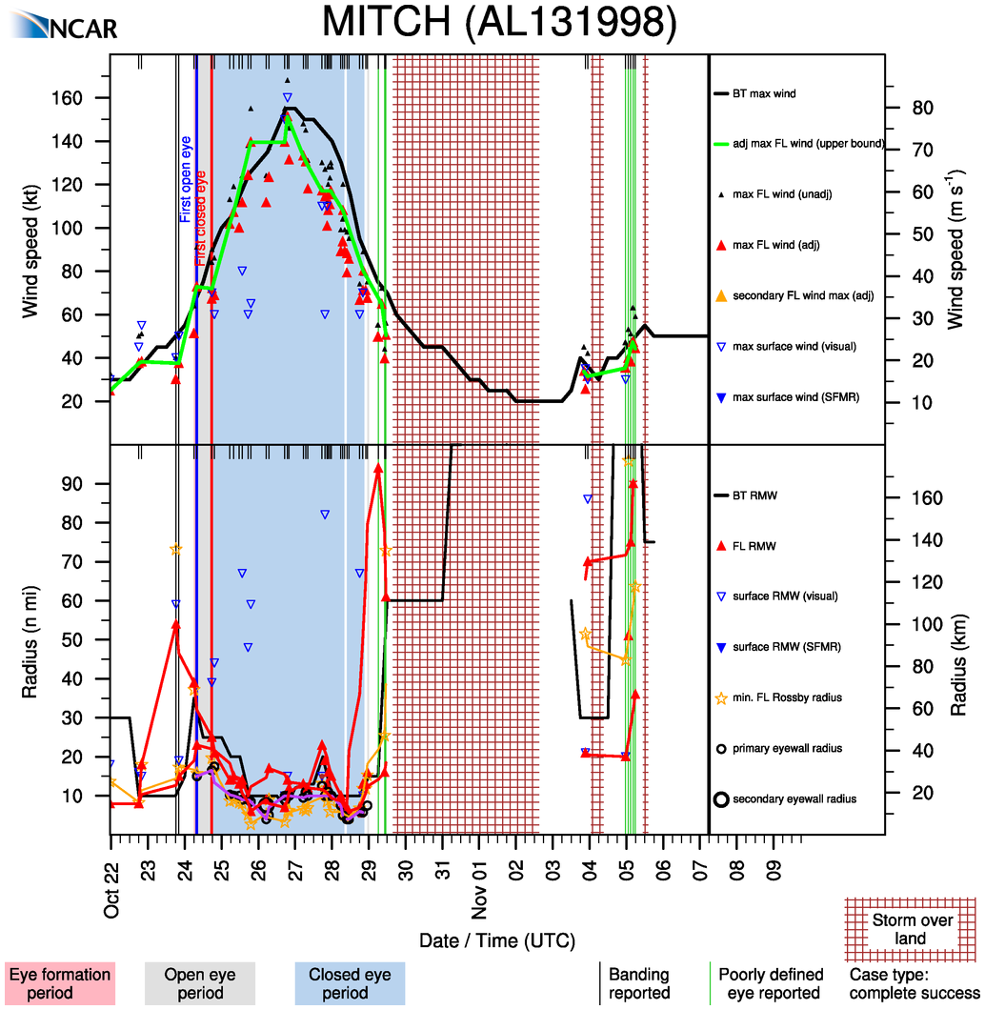

Slide 16
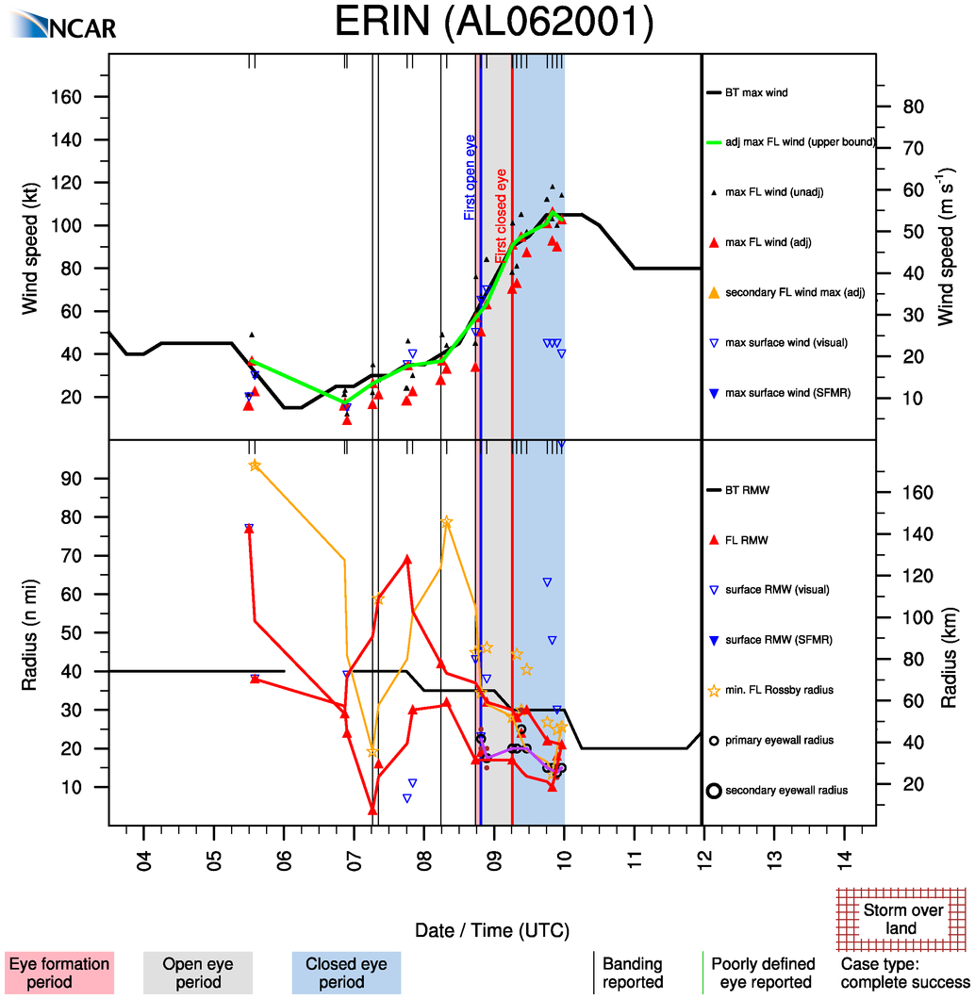

Slide 17
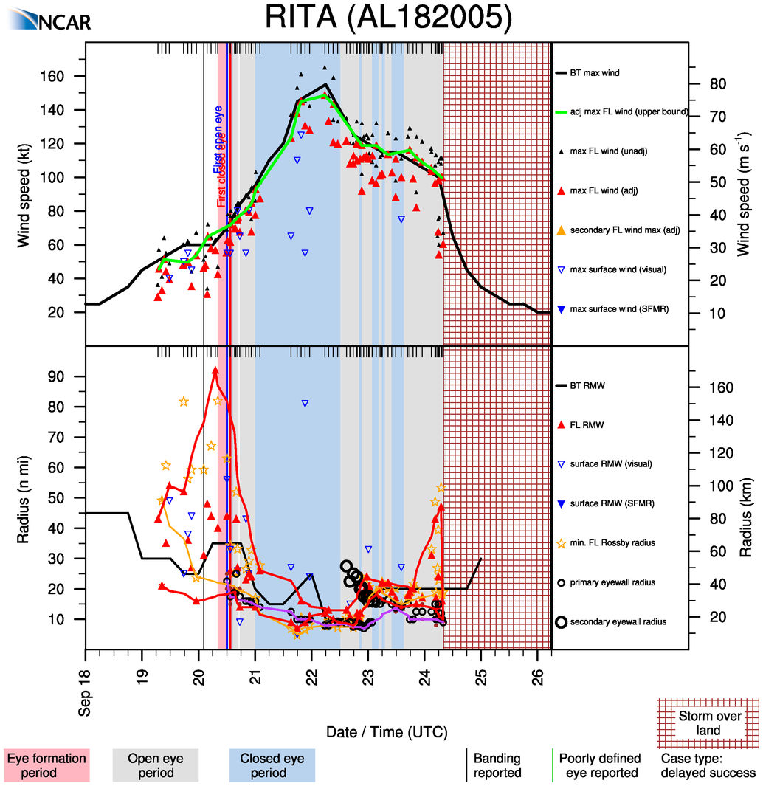

Slide 18
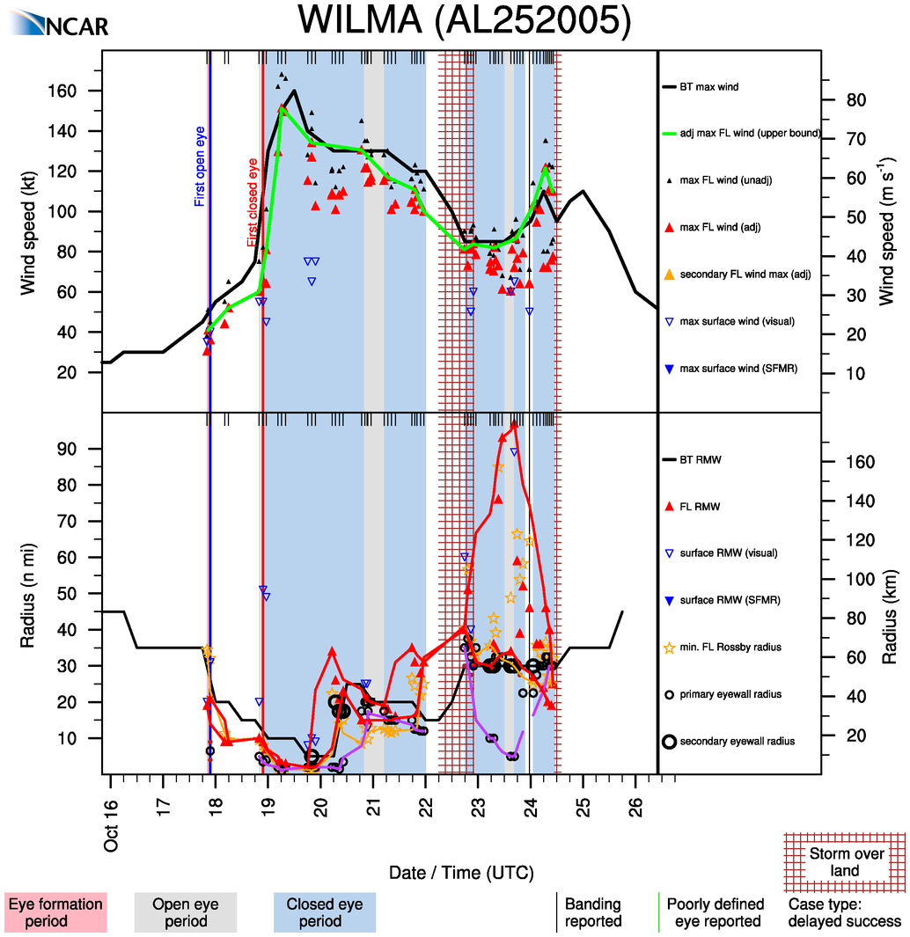

Slide 19
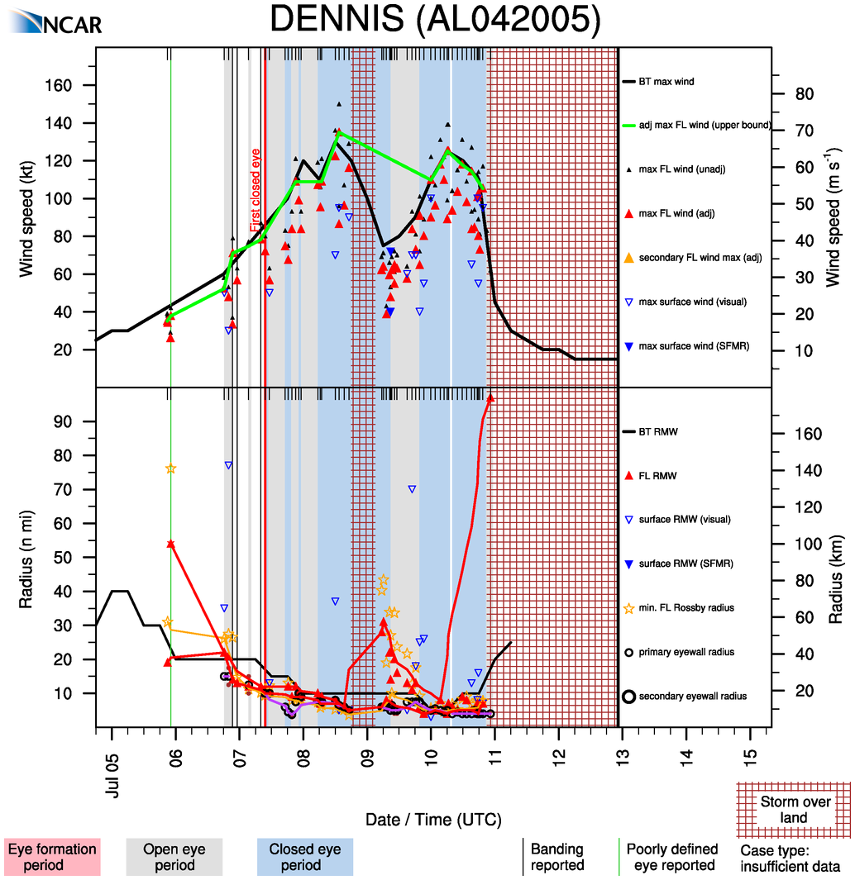

Slide 20
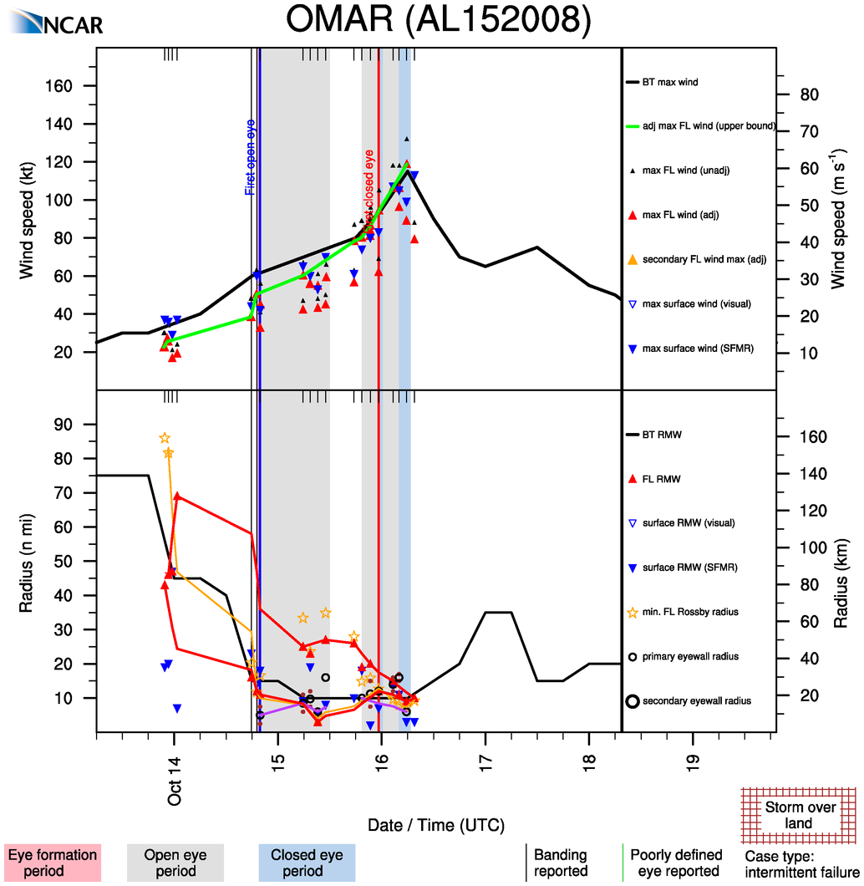

Slide 21
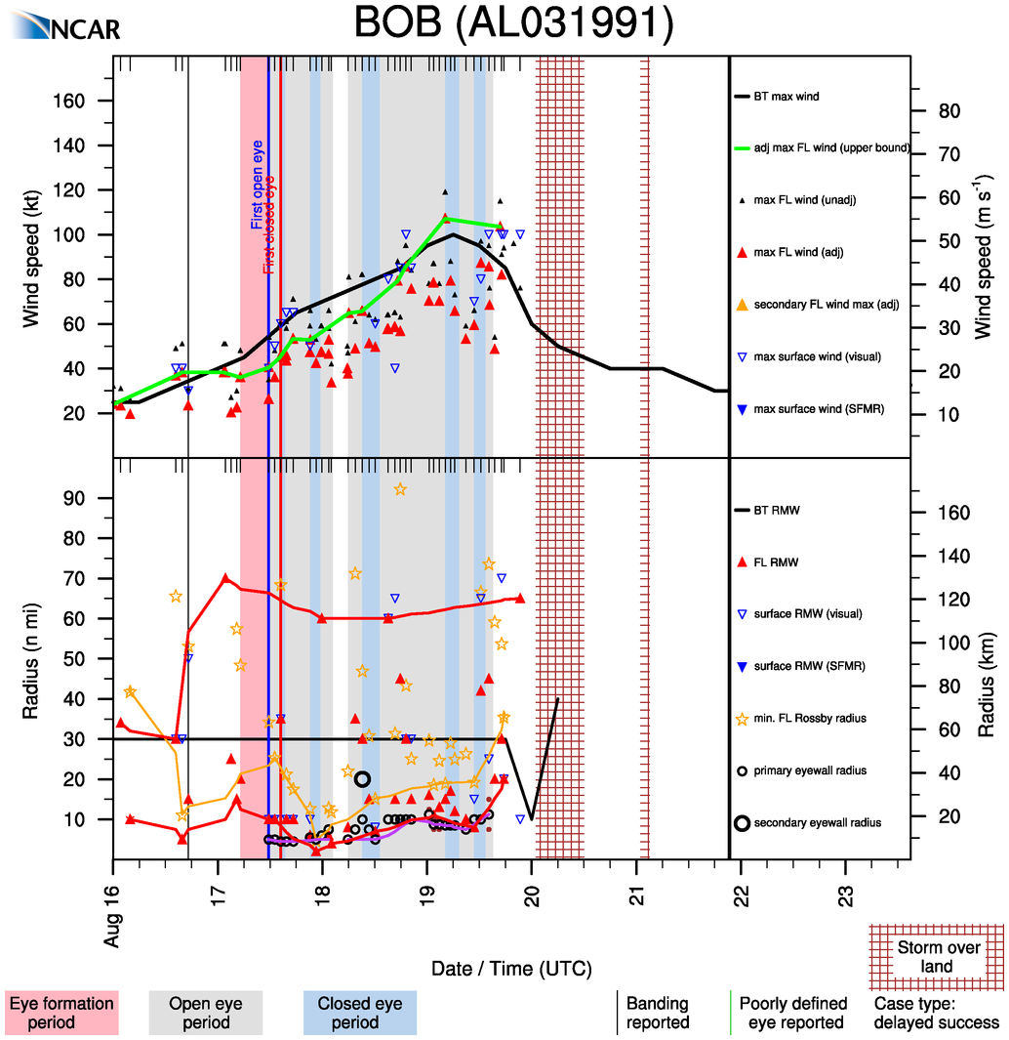
Intensification without
contraction

Slide 22
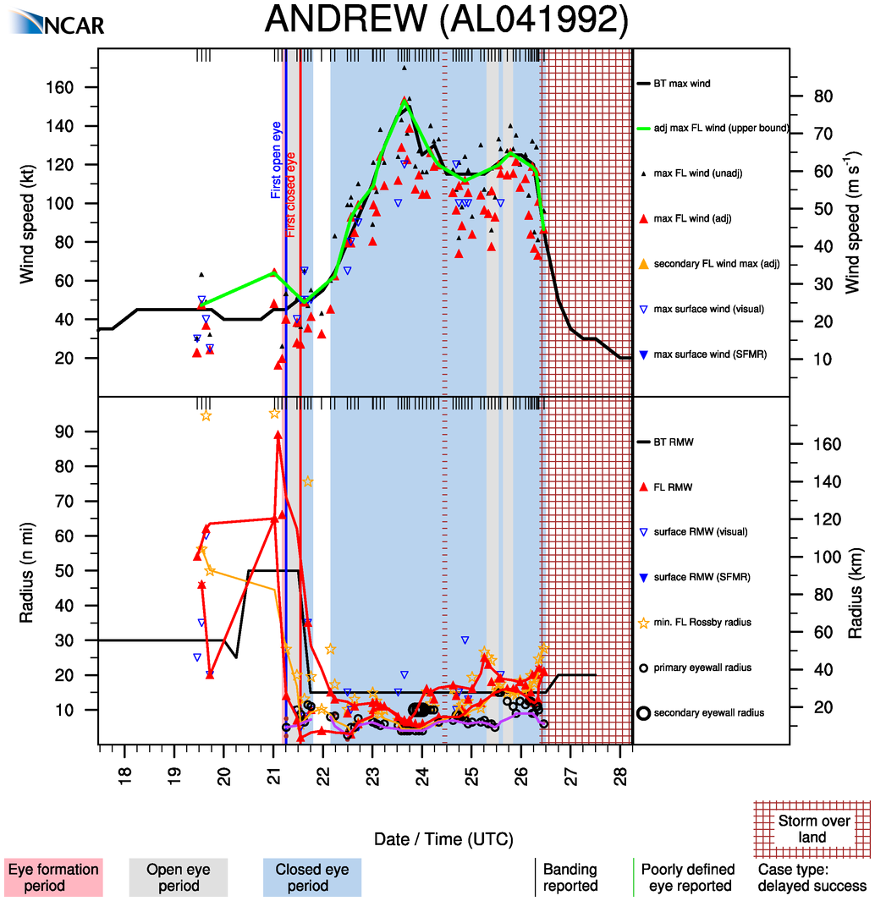

Slide 23
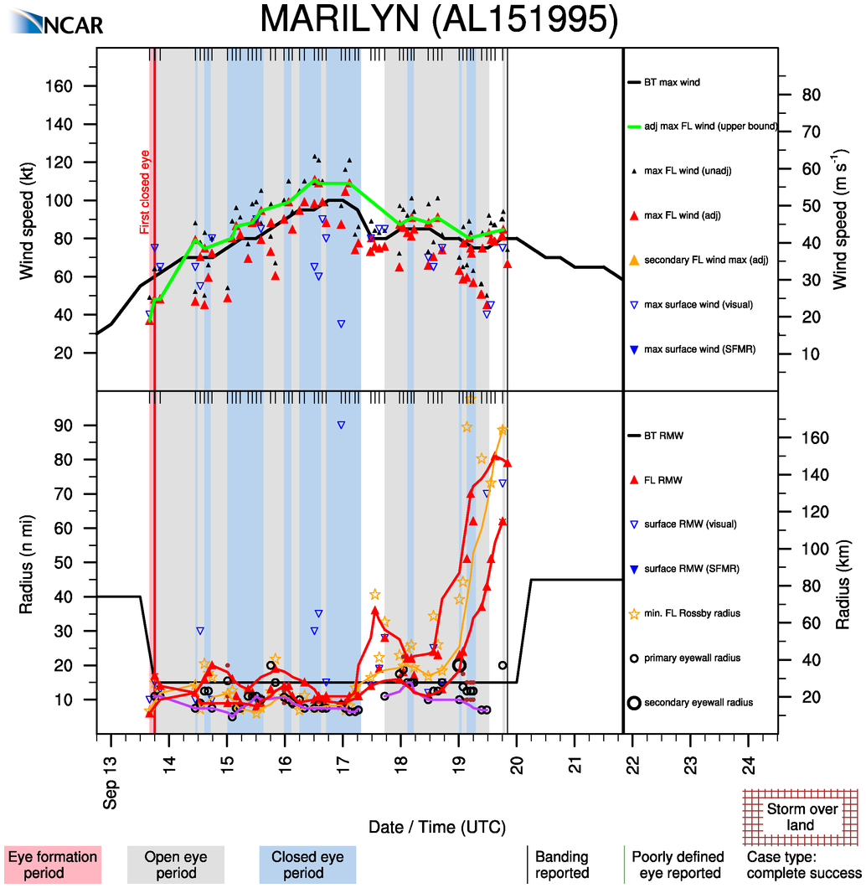

Slide 24
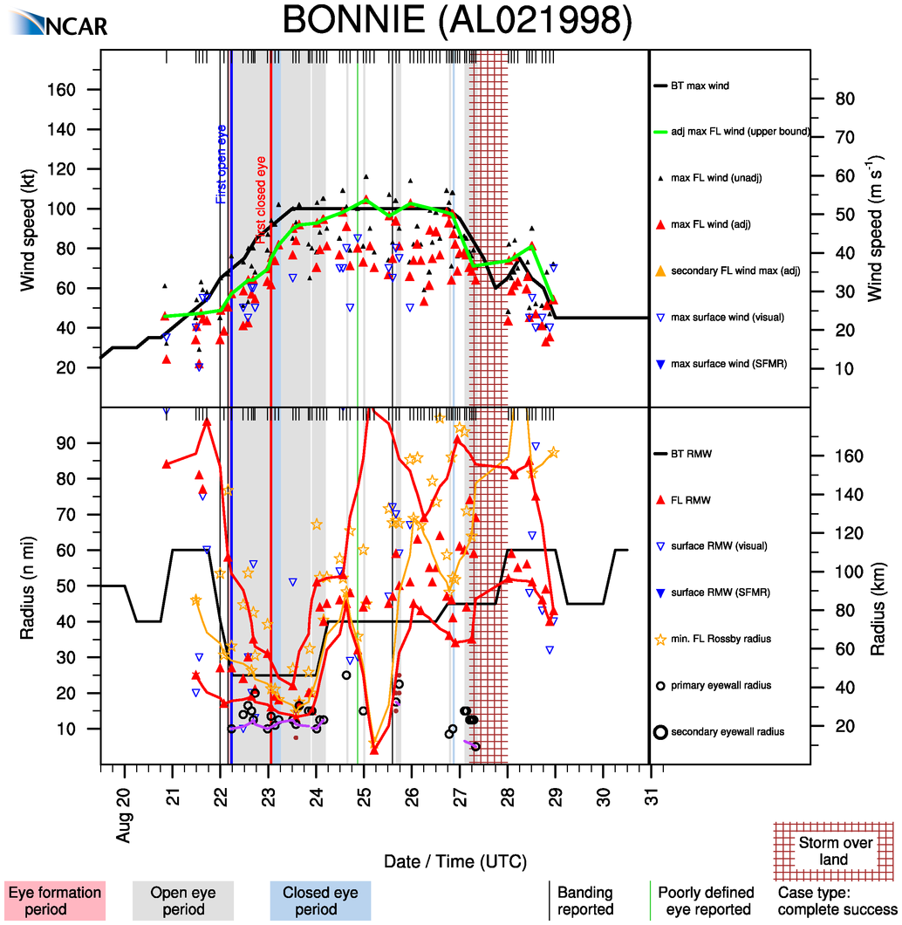

Slide 25
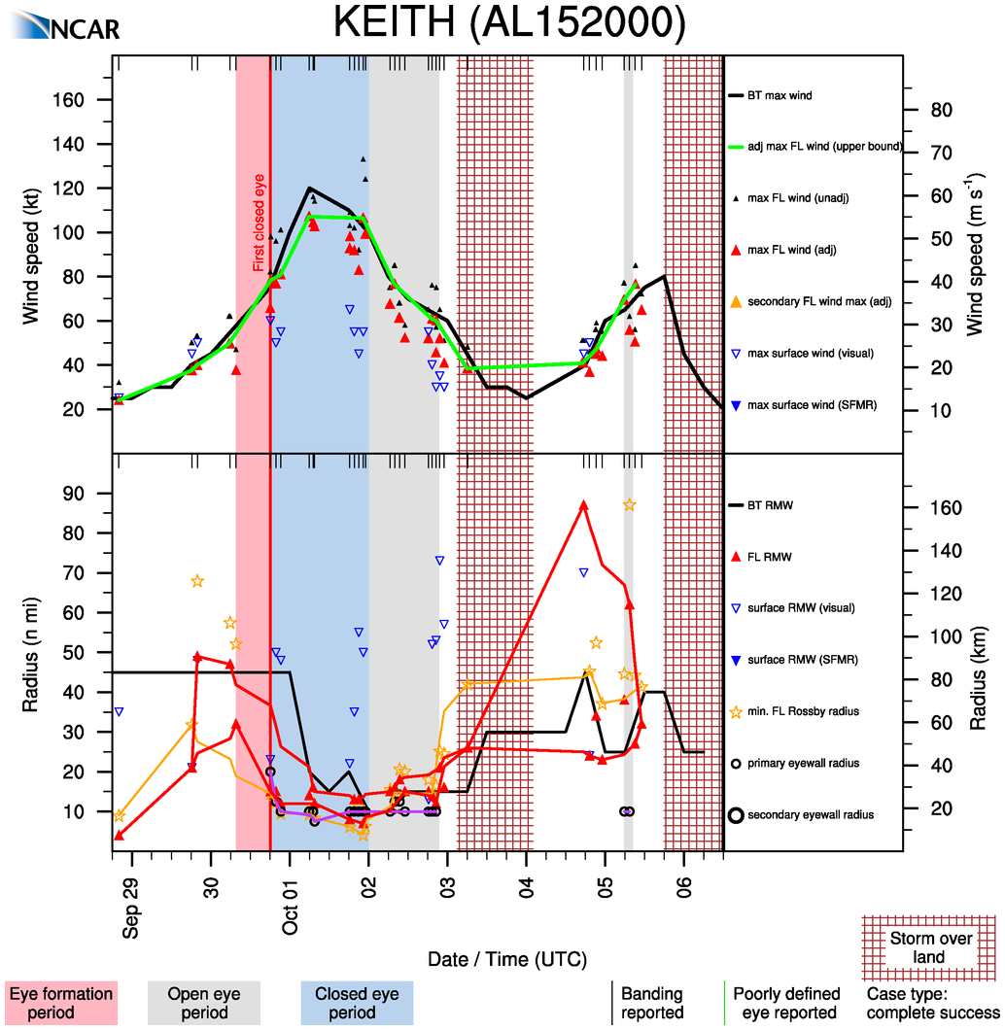

Slide 26
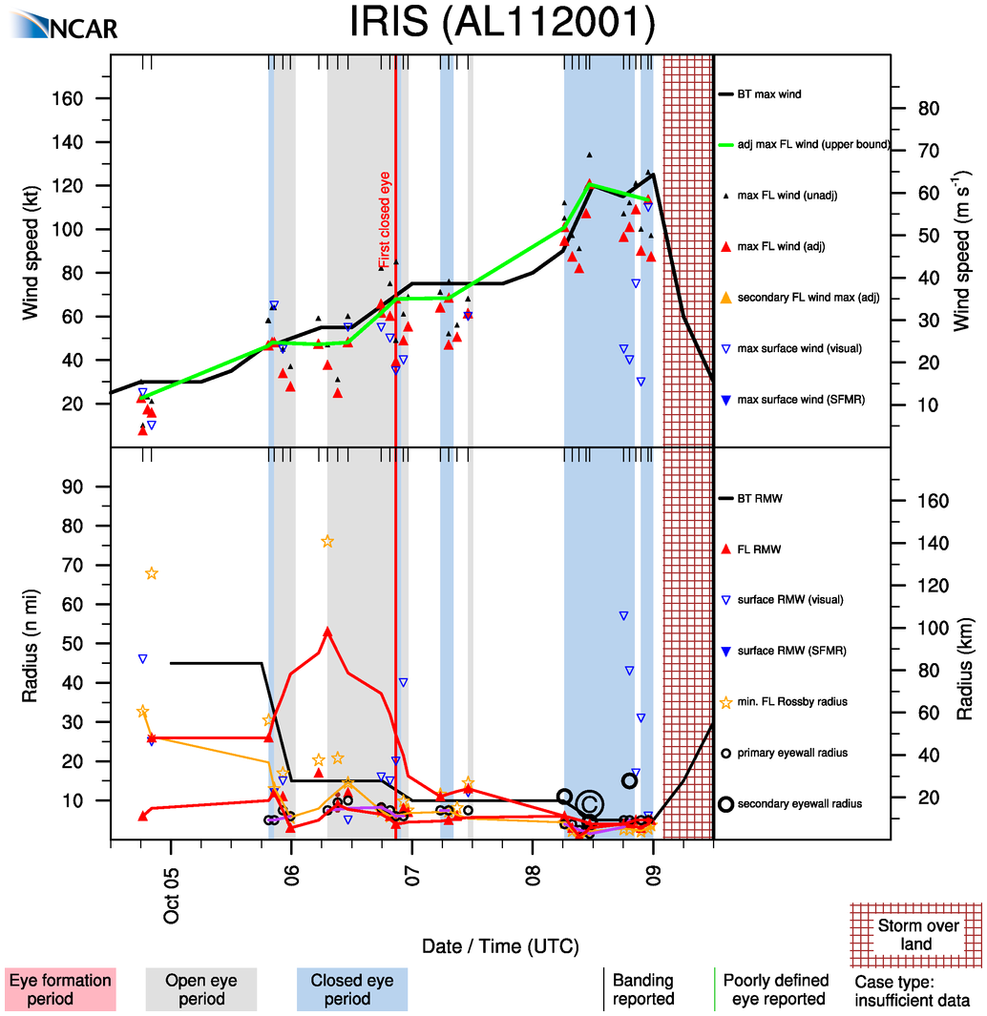

Slide 27
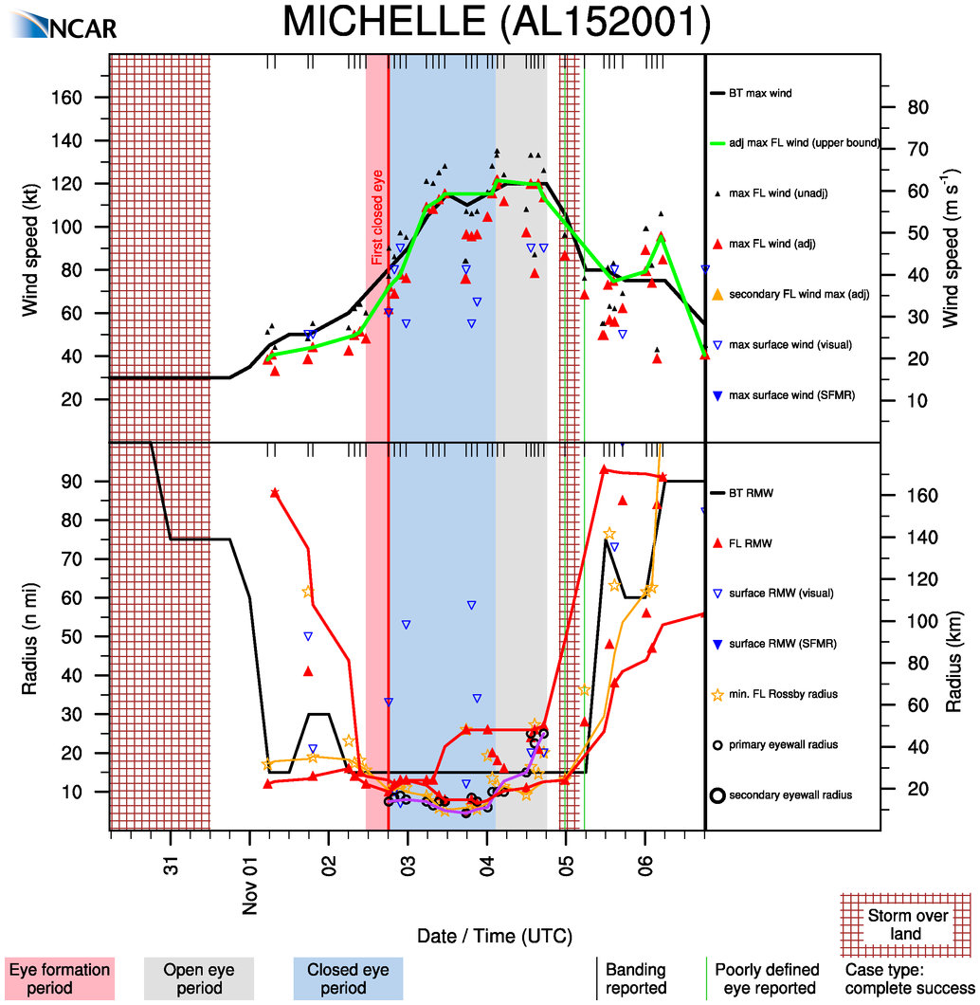

Slide 28
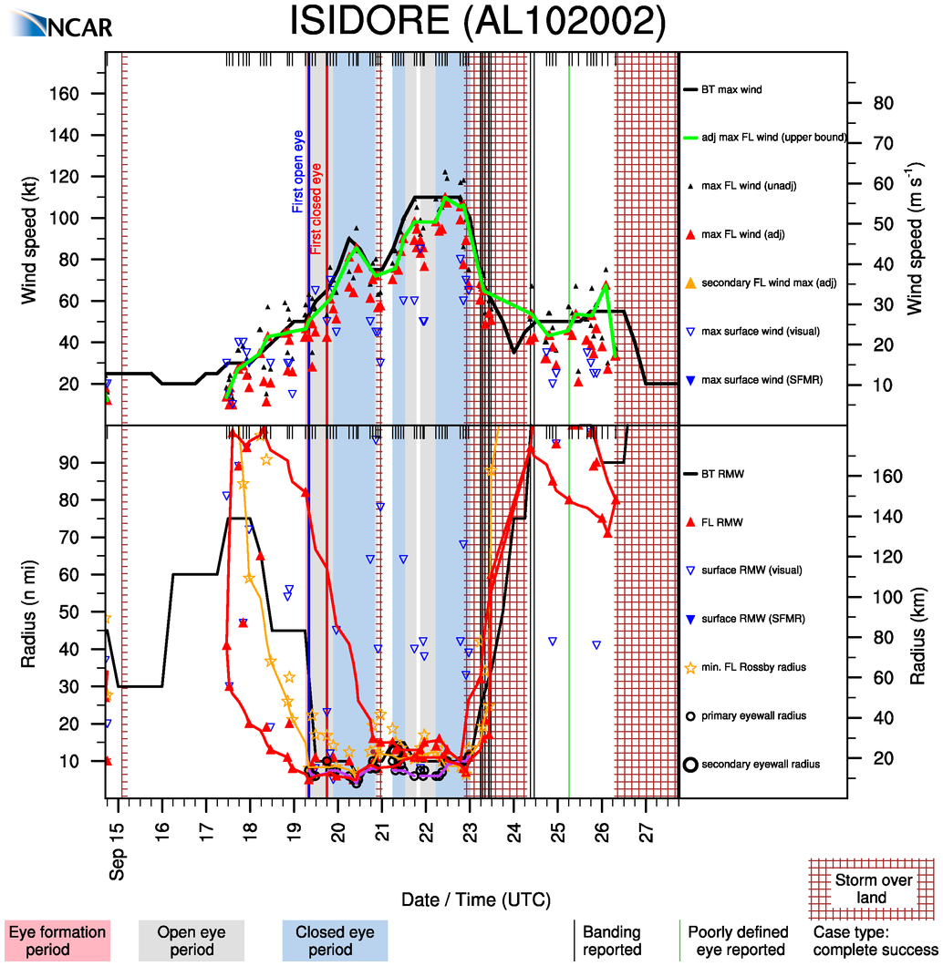

Slide 29
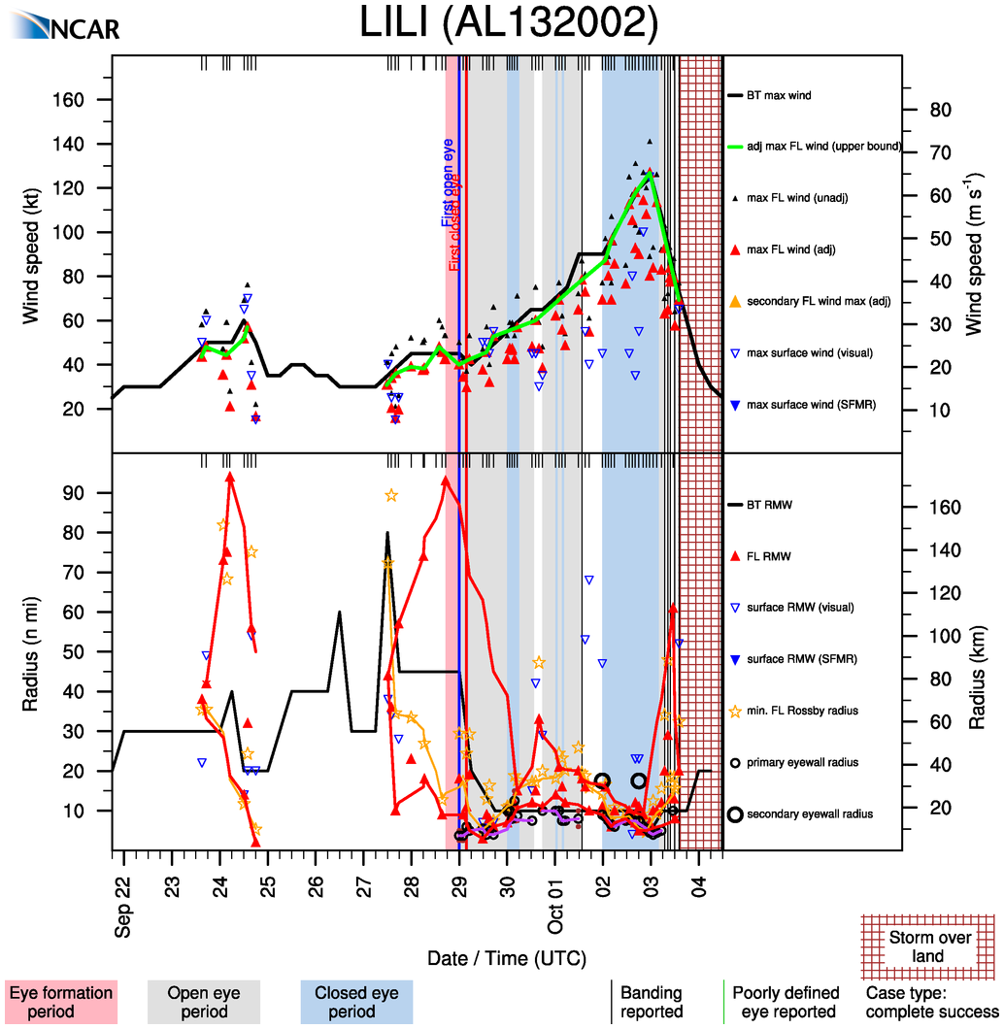

Slide 30
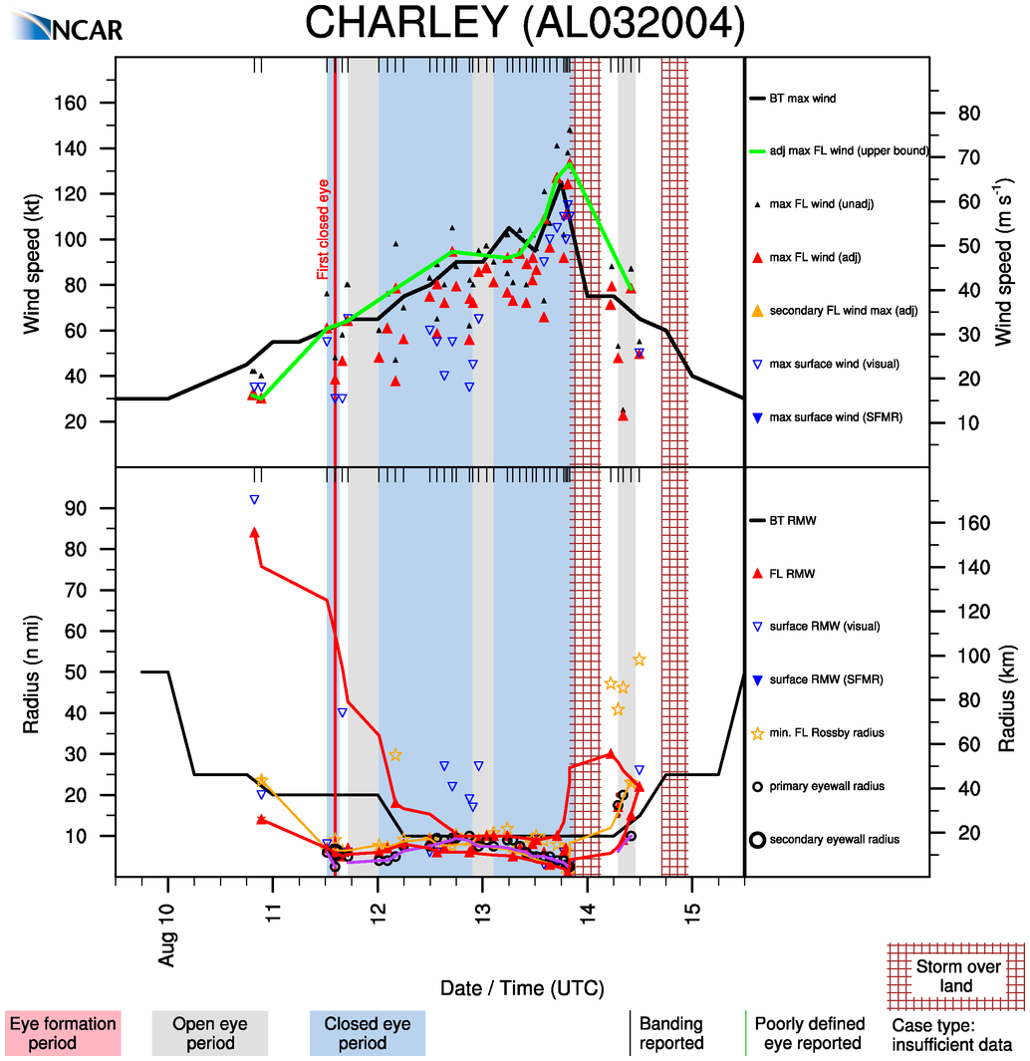

Slide 31
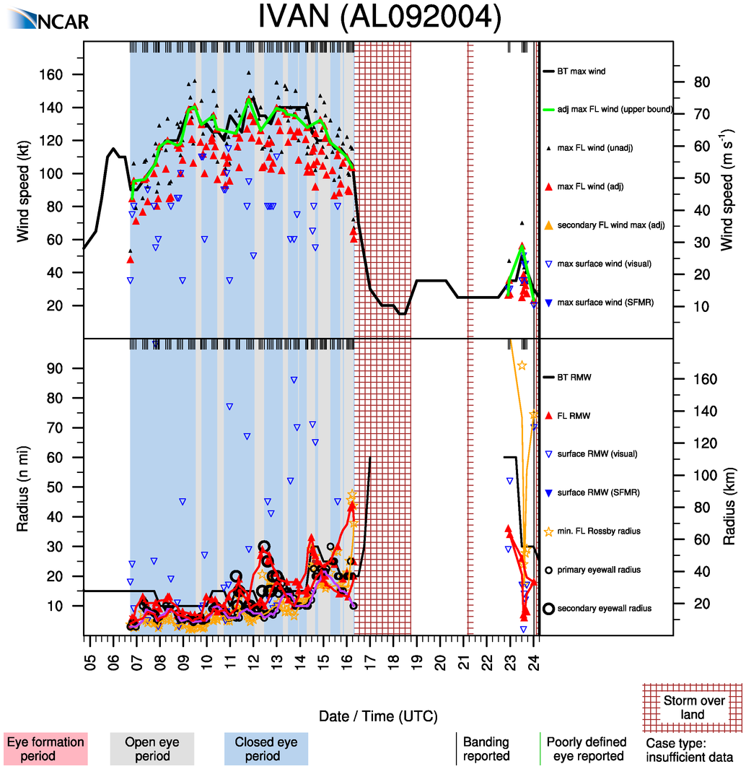

Slide 32
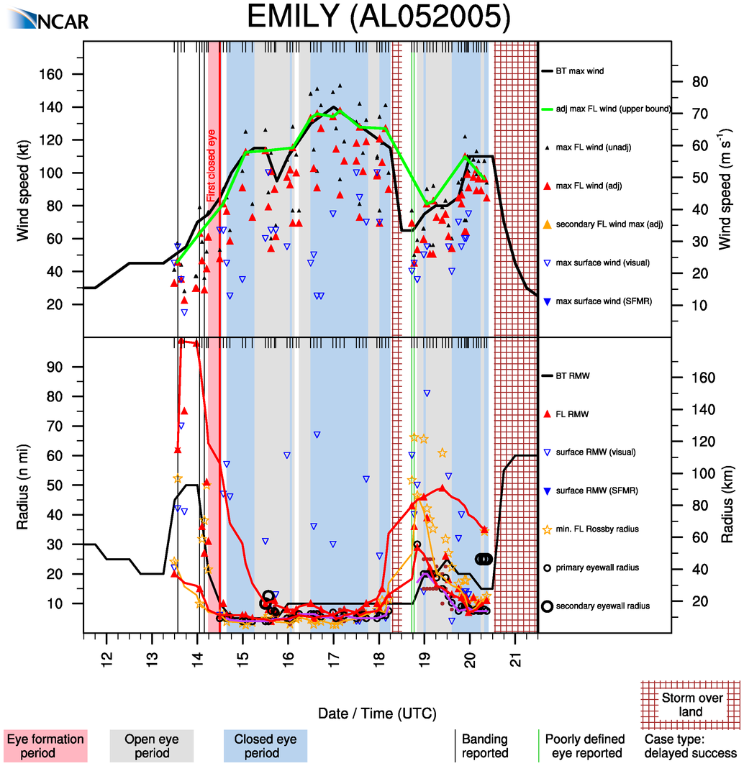

Slide 33
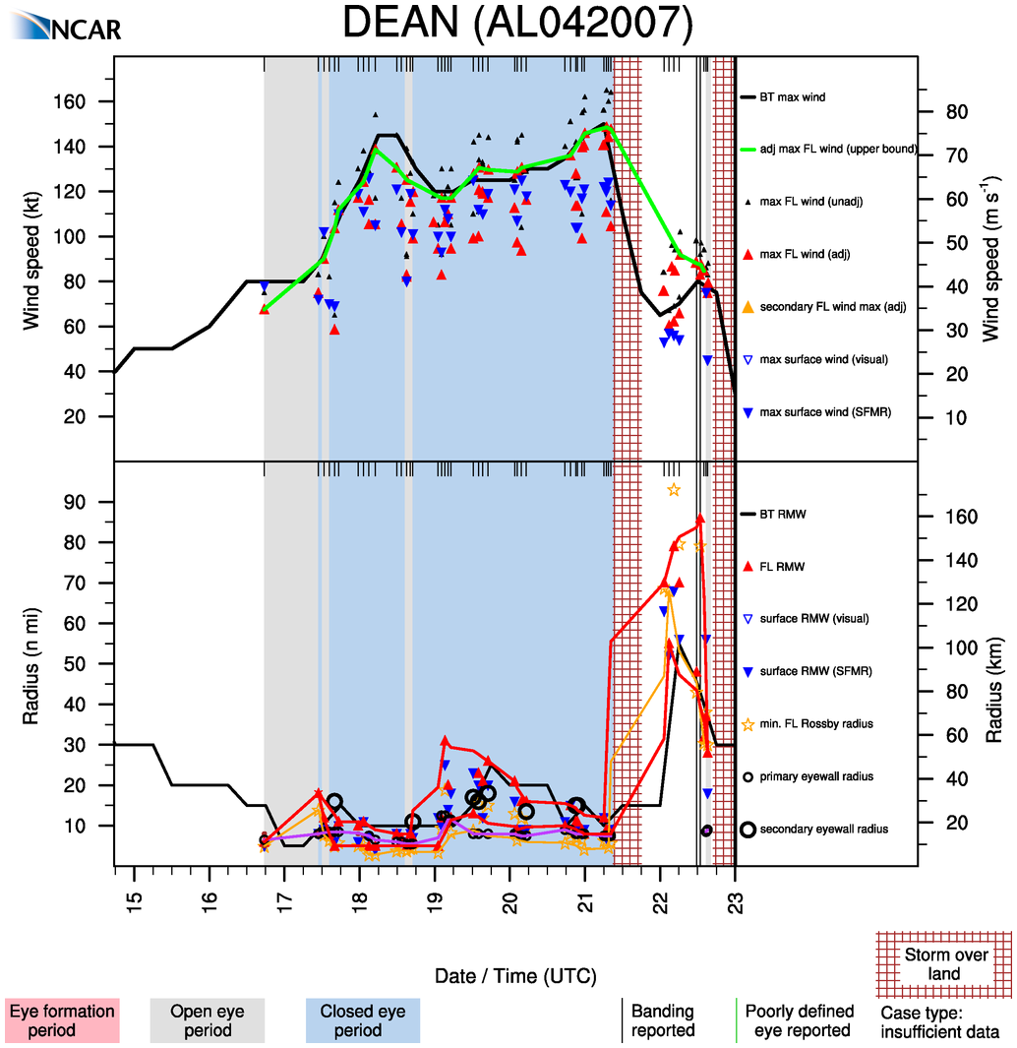

Slide 34
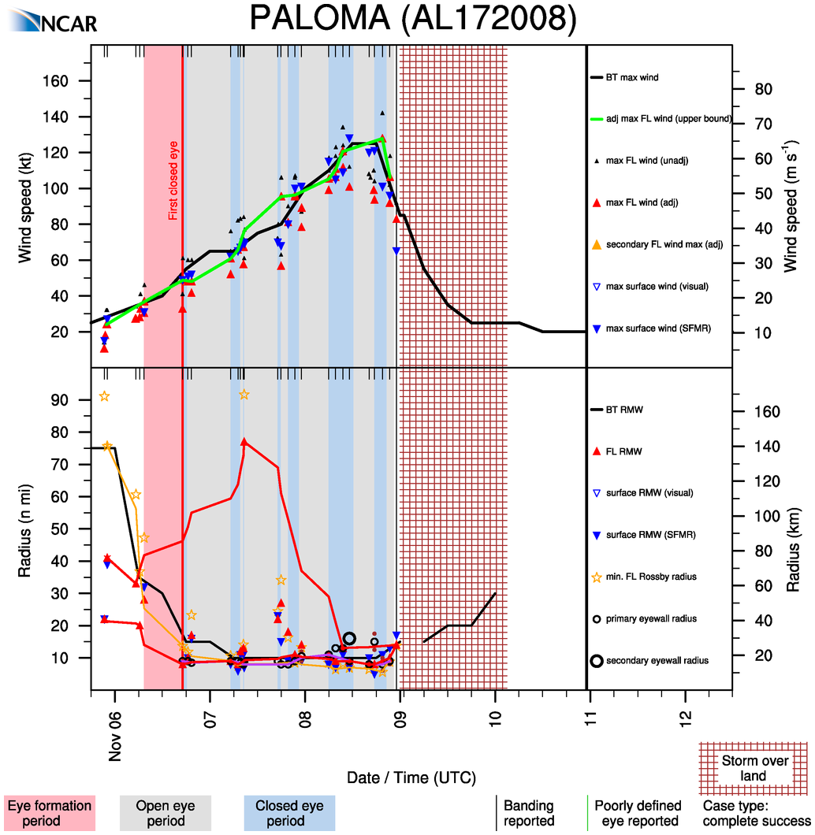

Slide 35
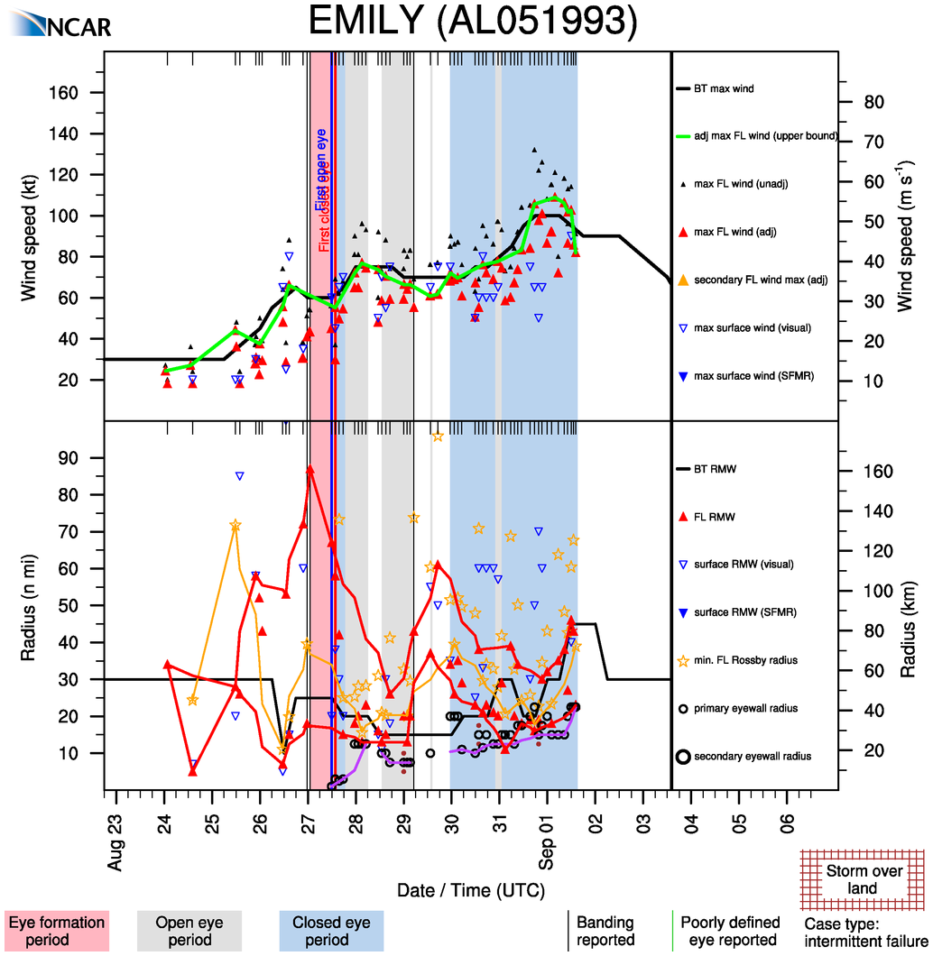
Intensification with
expansion

Slide 36
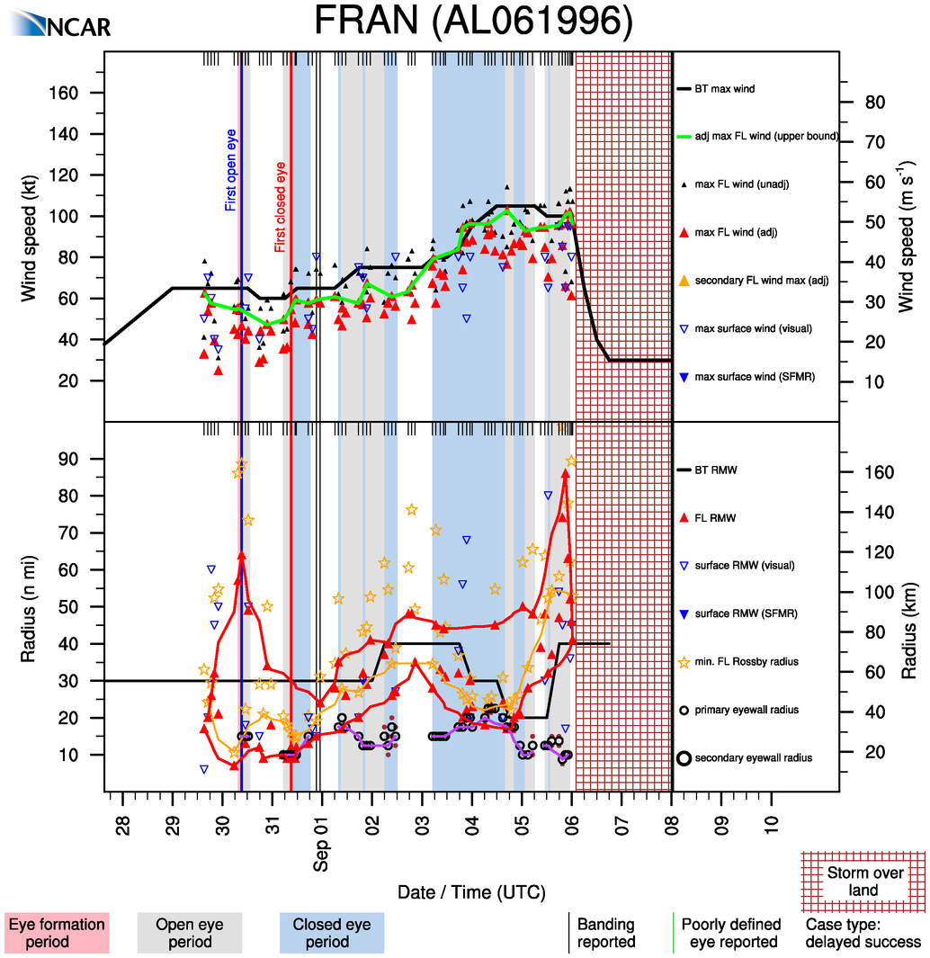

Slide 37
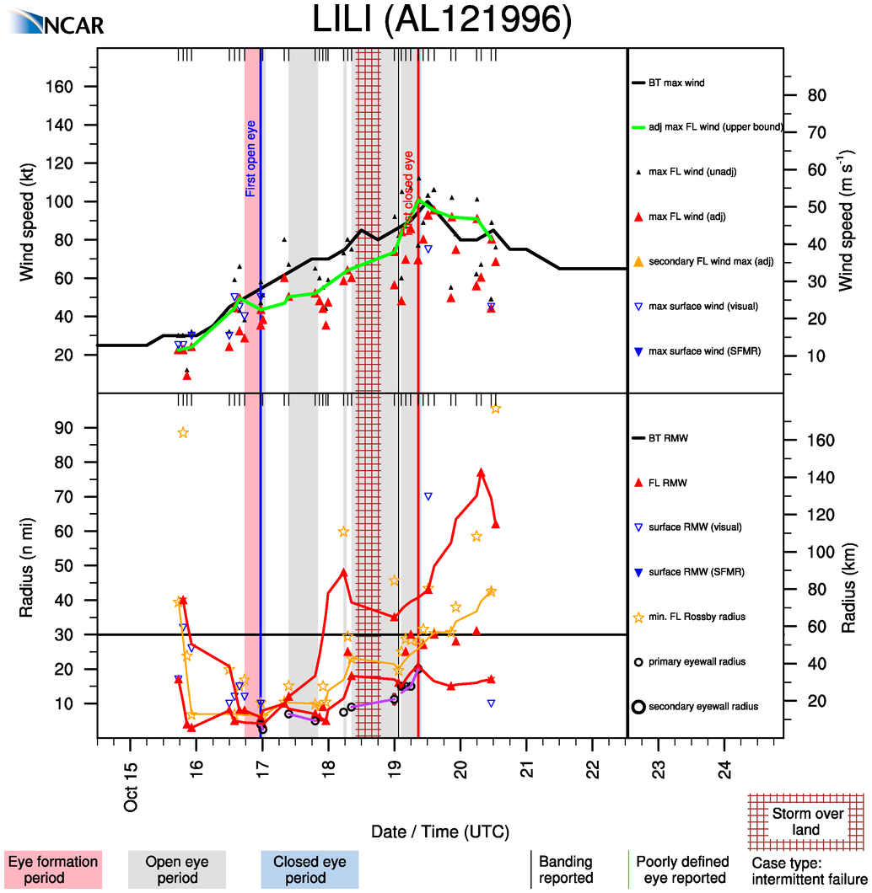

Slide 38
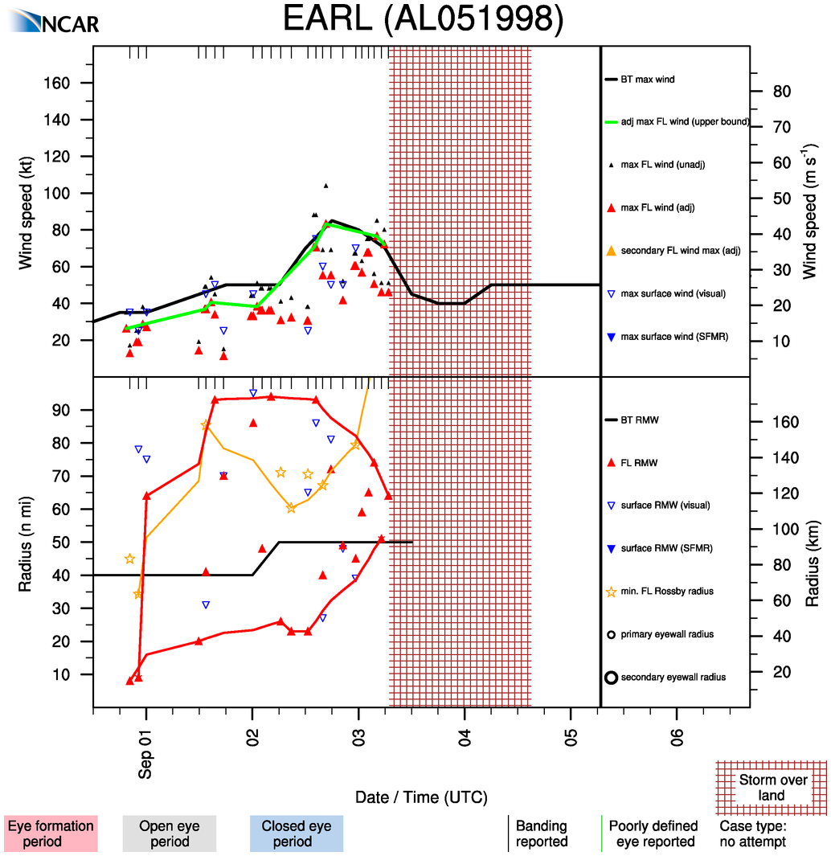

Slide 39
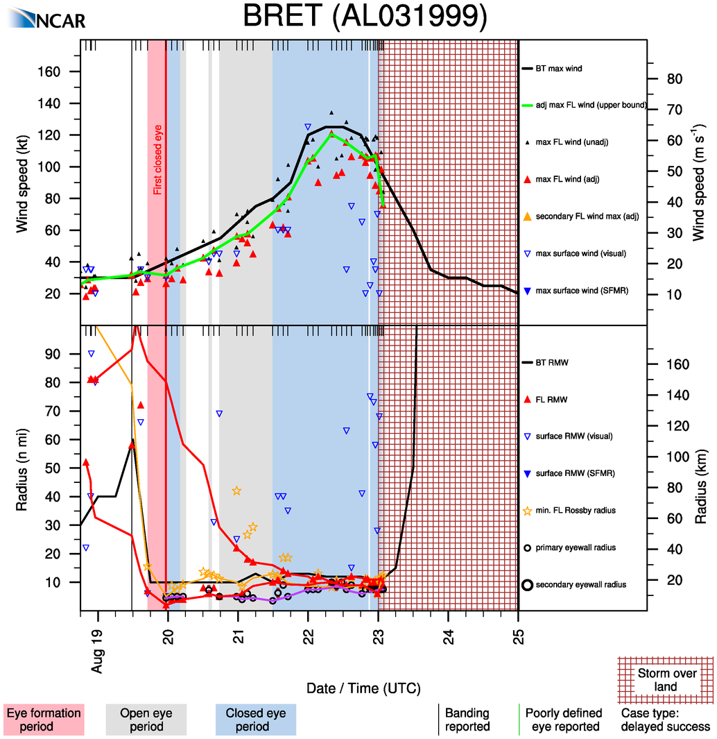

Slide 40
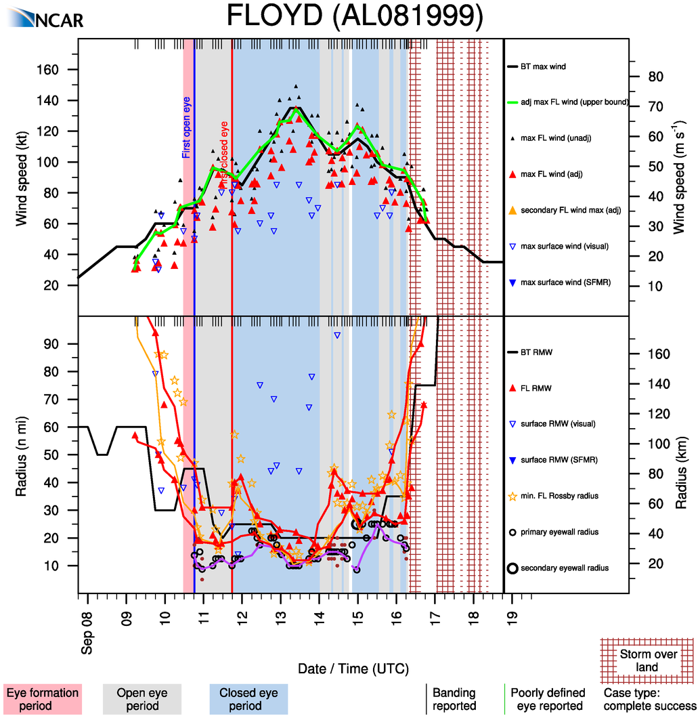

Slide 41
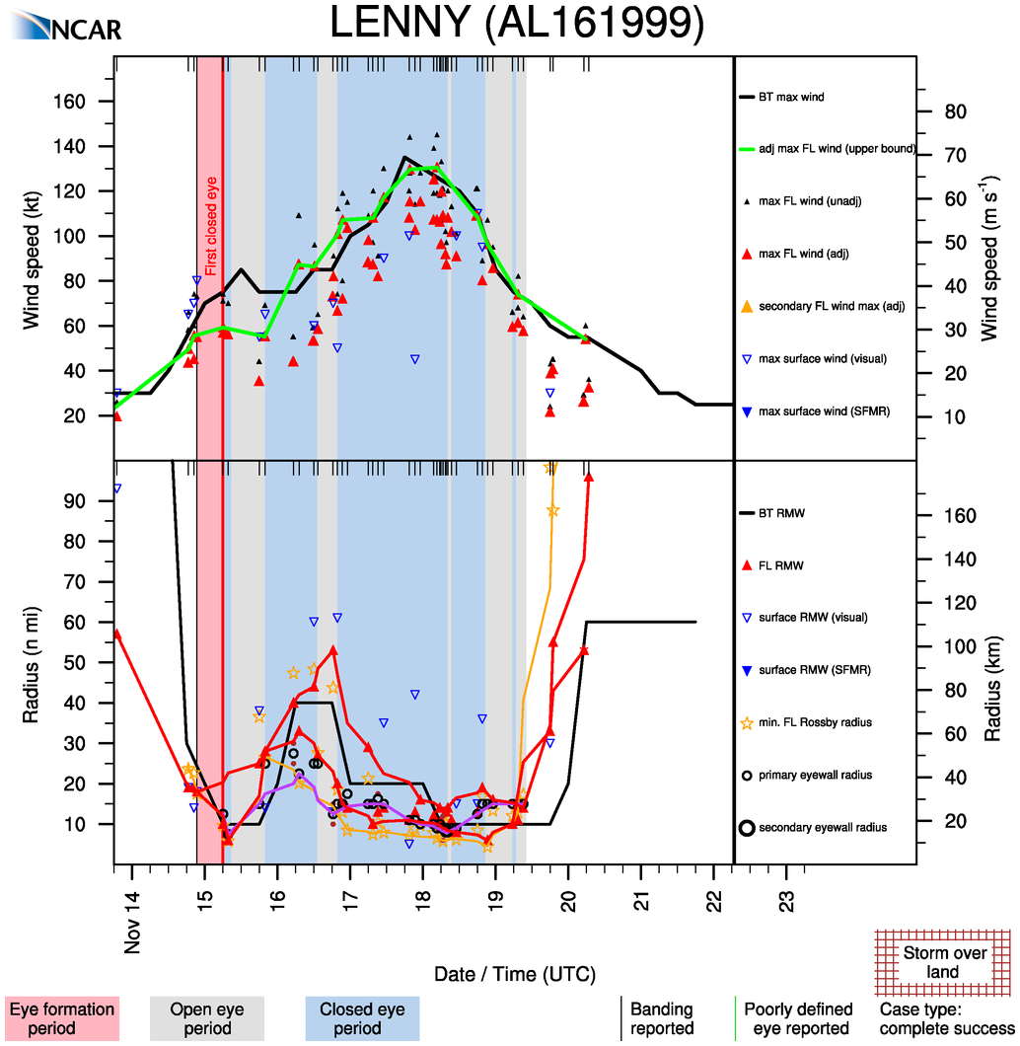

Slide 42
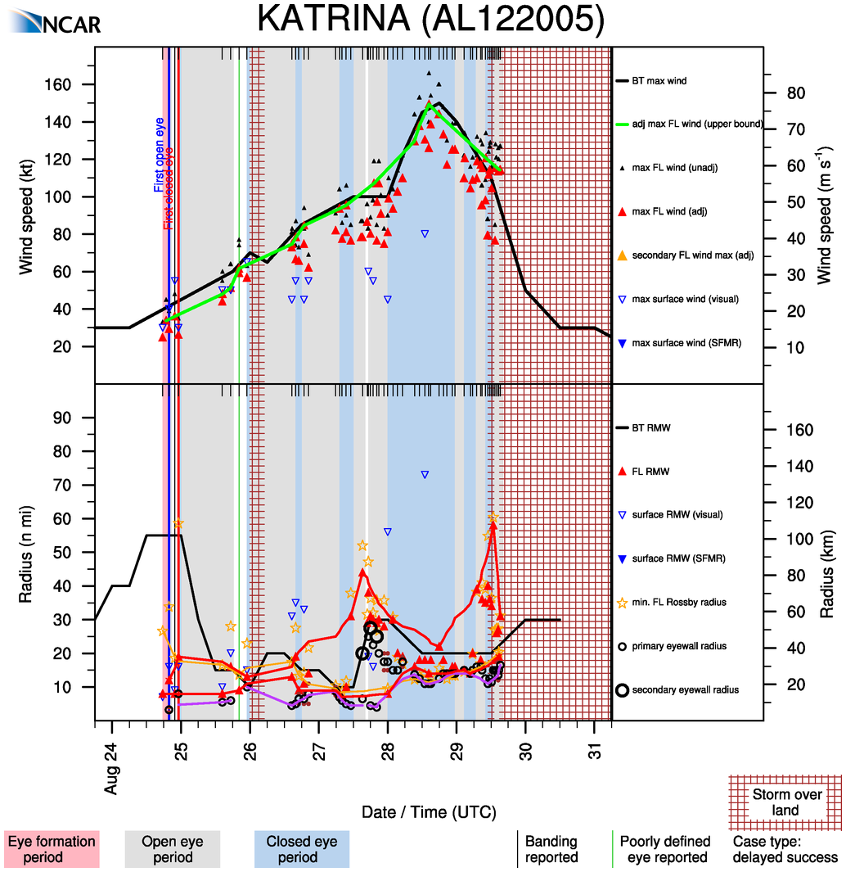

Slide 43
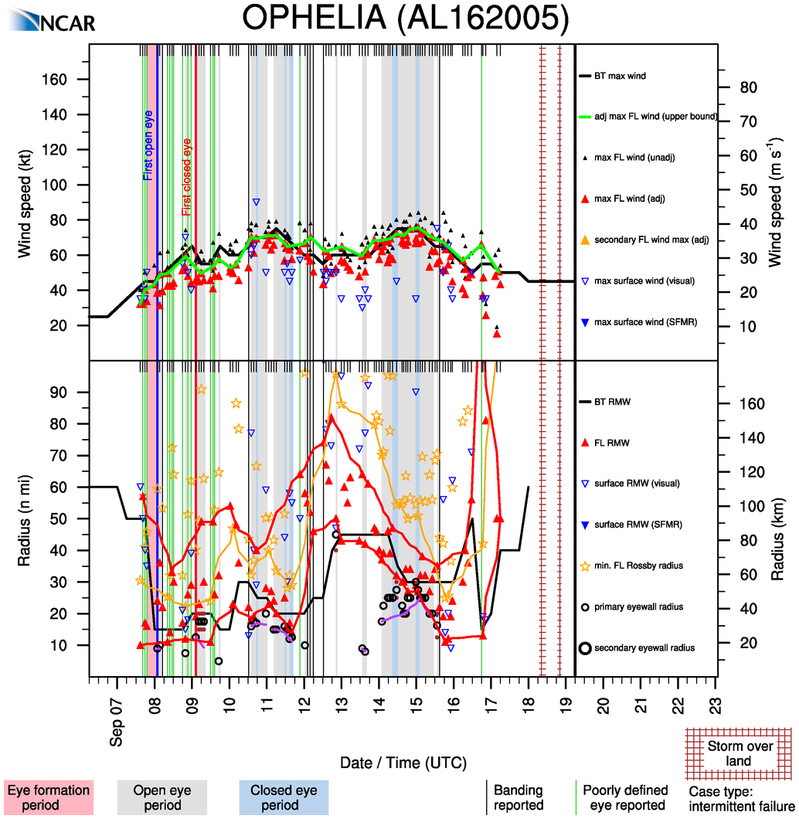

Slide 44
Initial thoughts?
NHC seems to follow upper bound of RMW (important for surge, waves)
Lower bound may be more important for inner core dynamics
Often seem to be 2 scales of RMW: battle between inner and outer cores
~11 of “normal” cases of intensification with contraction of RMW
  expected from theory
~14 “abnormal” cases of intensification without RMW contraction
  dynamical efficiency hypothesis
~9 cases of intensification with expansion of RMW!
  diagnosed or undiagnosed eyewall replacement cycles
  represent a particularly dangerous class of storms

Slide 45
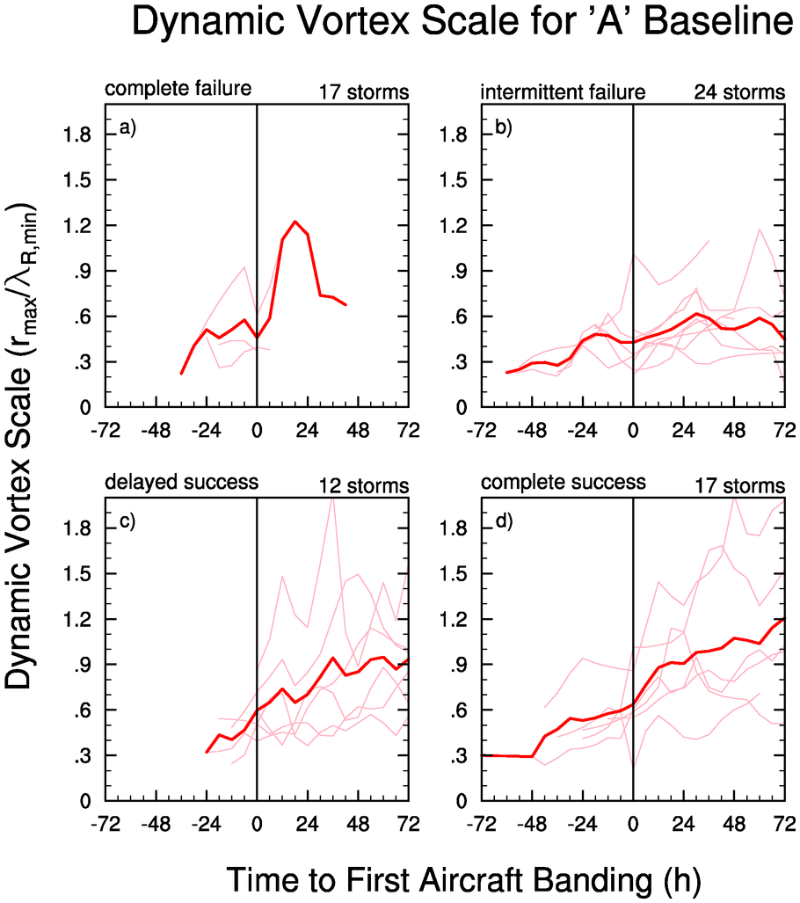

Slide 46
Next steps
Quantitative analysis challenges
  create splines of 3 or 6 hourly RMW
  measure standard deviation
  measure absolute spread between upper and lower bounds
Objectively determine “hidden” ERCs from RMW
  -> examine microwave imagery and aircraft profiles (chat with Kossin, Rozoff, and Sitkowski)
  determine “strength” of RMW (give less weight for broad peaks that produce jumpy RMWs, more weight for consistent RMWs)
Compute RMW statistics at various intensity thresholds
Do composite analysis for baseline based on peak intensity
Do a discriminant analysis of intensification based on RMW trend and vice a versa (for intensification rates)

Slide 47
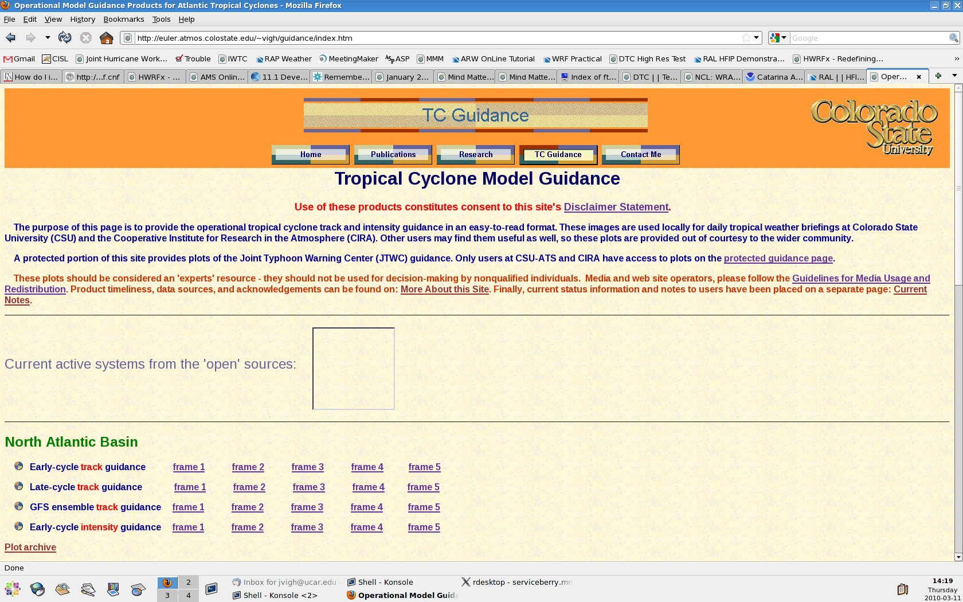
TC Guidance Page Looking for Good Home . . .

Slide 48
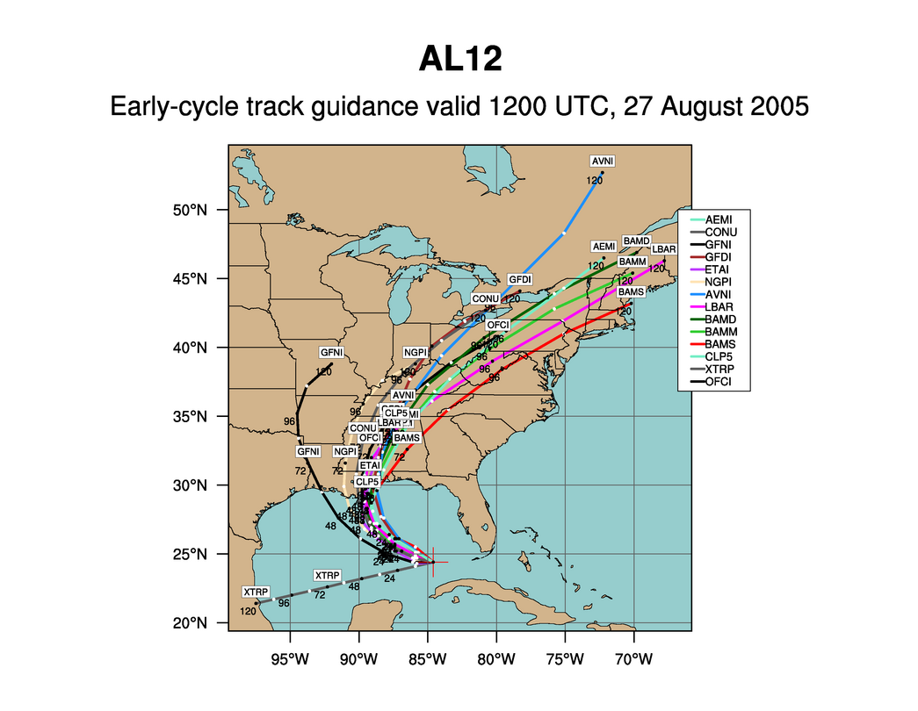

Slide 49
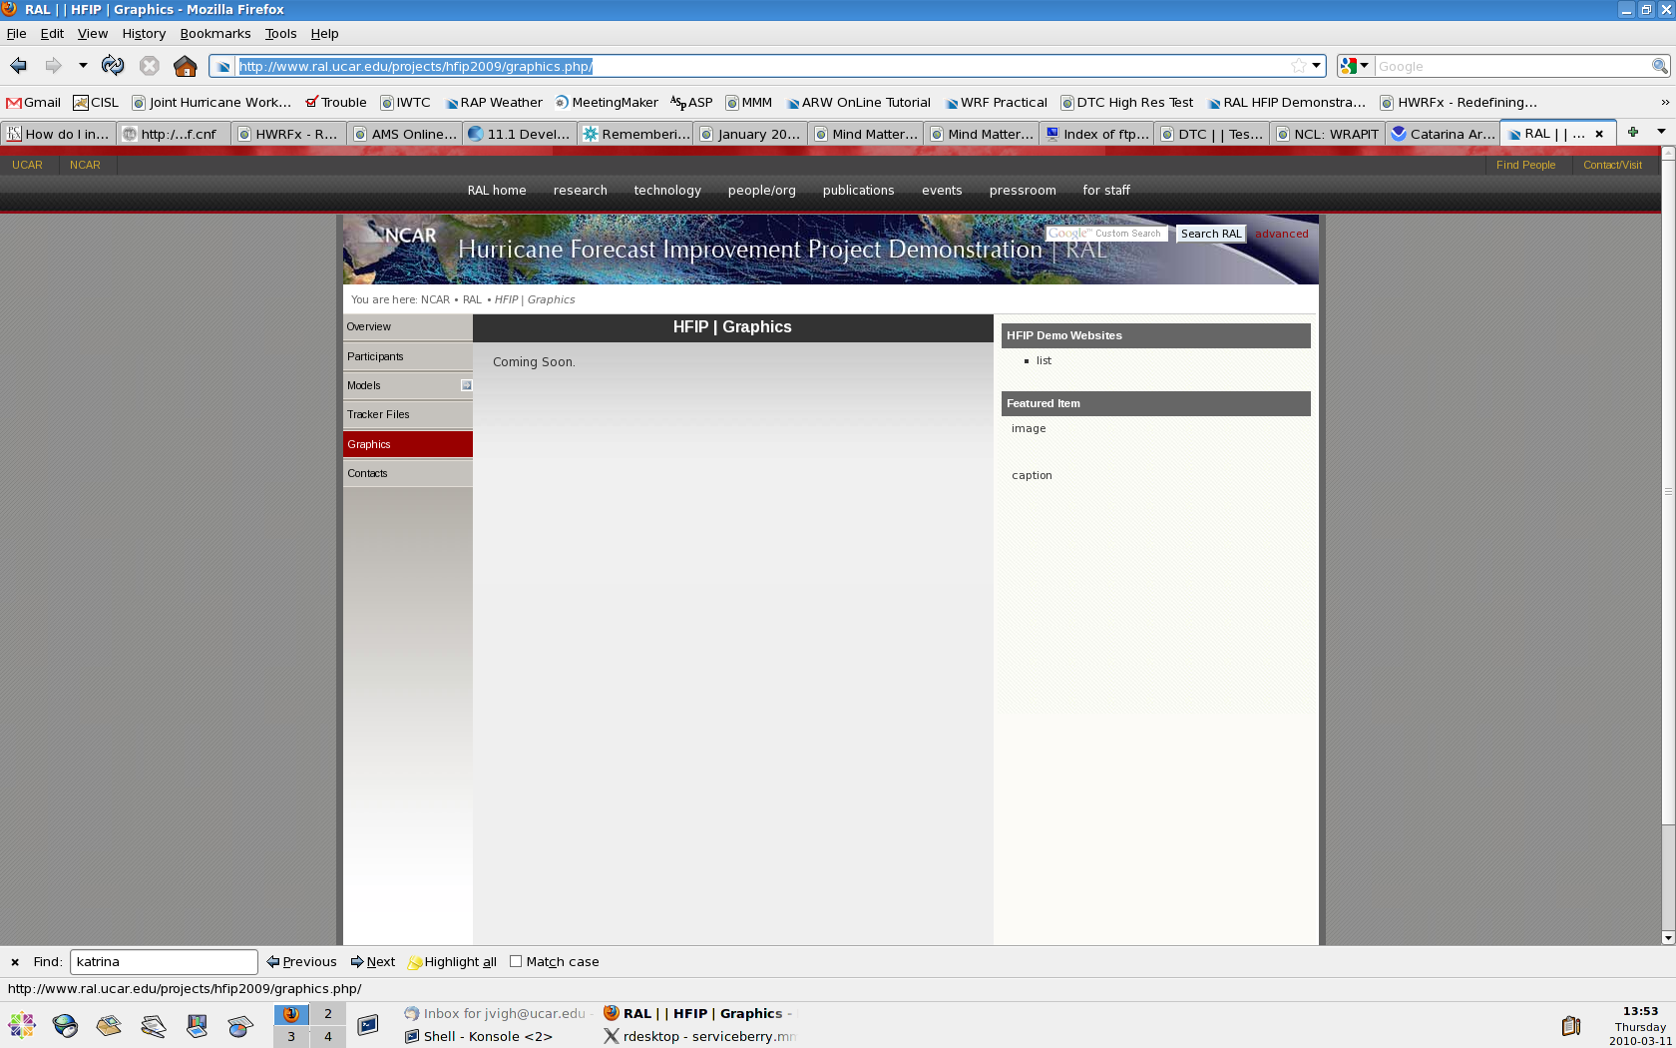
Hmmm, the DTC/TCTM/HFIP is downstairs!

Slide 50
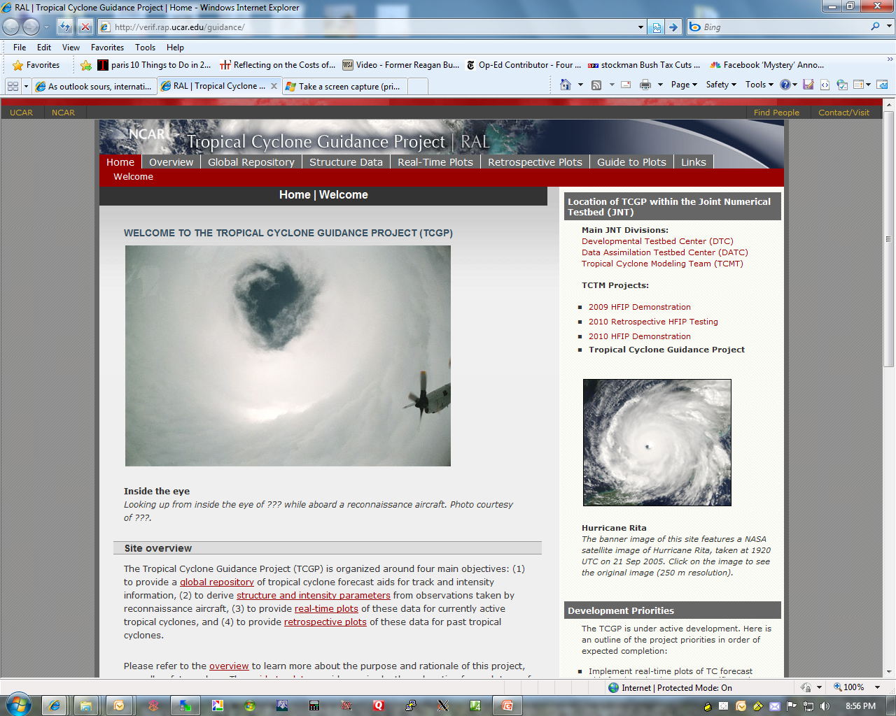

Slide 51
Towards a Global Repository
IWTC-VI designated the real-time sharing of NWP model forecasts a high priority
  Currently there is no one-stop global repository for track and intensity forecasts for various RSMCs and TCWCs
NHC/CPHC maintains operational repository for their basins
JTWC maintains in-house ATCF repository
  Can’t share due to delicate data-sharing agreements and national security concerns
TPARC/TIGGE archives model output from 10 NWP centers
  Data delayed by up to 48-h
  Uses CXML format – ick!
  Access limited
HFIP maintains an Atlantic repository for experimental aids
  Experimental models tend to be “late late cycle” (including AHW)
  Access limited

Slide 52
Benefits of a global repository
A common *real-time* repository and verification platform would greatly aid in the forecasting efforts (especially in Asia)
Should spur interest among academic researchers and other operational centers
NCAR is an ideal host for such an effort
  My goal is to build a prototype
  Hope to get WMO support/recognition of this effort at IWTC later this year
  IBTRaCS may be another key sponsor
Such a repository needs to be *open source* to accomplish objectives

Slide 53
Challenges ahead
Step 1: Build foundation on ATCF-like formats
  Develop designation protocol
    Merge JTWC and TCWC/RSMC-designated invests and storm numbers when available
    Devise method for any warning center to designate an invest
      upload a compute
      designate via a web-based interface
  Obtain/merge compute info
    lat/lon, motion vmax, pmin, etc.

Slide 54
Step 2: Develop protocols for uploading and merging a-decks
  Utilize HFIP-naming protocol if system is already designated
  If undesignated, search for current systems or designate new system using a tentative identifier
  Merge a-decks from various uploaded models
    record time each model arrived
  Leverage existing visualization codes and add on-the fly verification statistics

Slide 55
Step 3: Develop operational best track (b-decks)
  Use merged TCWC operational best track when possible
  Use tentative computes if no operational best track is available
Step 4: Convince major stakeholders to sign on
  The following models will form the initial model base in the global basins:
    GFS, UKM, CMC, tracker from ECMWF coarse grids
    Climatology and persistence aids
    SHIPS, STIPS, etc.
  Select regional and experimental aids when available
    AHW, Australian models
  Sign on other global NWP centers (Japan, China)
    Goal -> positive peer pressure!
Step 5: Open up access to academic research and commercial groups

Slide 56
Rewards
Work: Difficult and challenging
Pay: Zero (ASP outreach activity for me)
Degree of support: some
  infrastructure and a server (thanks RAL!)
Likelihood of fame: nil
Potential reward to humanity: great
=> Now accepting volunteers!

Slide 58
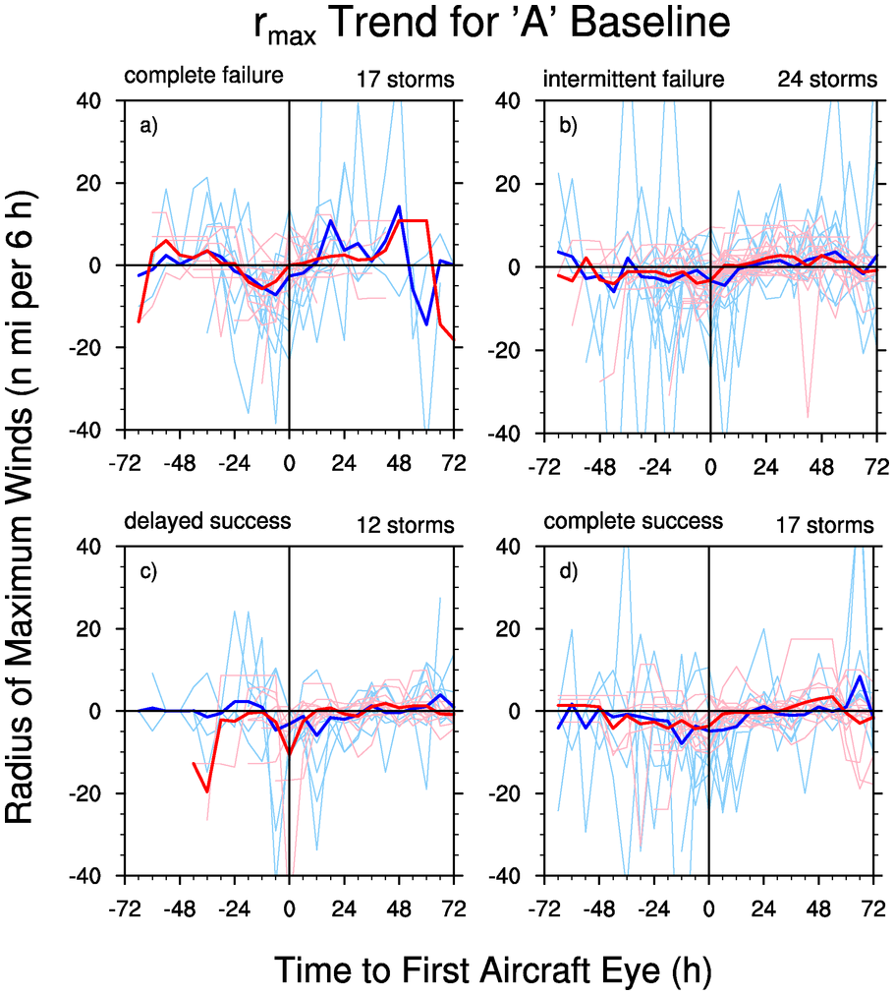

Slide 59


Slide 61


Slide 63


Slide 64


